Slide 1
Enriching Social Science with Quantitative and Survey Data Using Flipping
Wendy Olsen and teams at the
University of Manchester
September 2014
www.cmist.manchester.ac.uk
www.socialsciences.manchester.ac.uk/essted

Slide 2
Workshop Programme
1. A curriculum innovation: EMBEDDING QM
And Quantitative Data in the UG Curriculum
2. Pedagogy for Sociology classes with QM
-- methods of embedding; and
We suggest flipping the class.
3. Sociology of Family Life Teaching Pack
4. Politics and Protest Teaching Pack
5. Using Student Opinion in the Classroom
3. Concluding suggestions
Specifying learning outcomes

Slide 3
1. Our curriculum innovation
A Researcher Development Initiative of ESRC
CURRICULUM INNOVATION COMPONENT:
Ten course units
Embedding and enrichment, not substitution
Teamwork
Now + Q-STEP degrees “with quantitative methods”
Internships and reflective assessment

Slide 4
People (Sociology, Politics, Social Statistics)
Mark Brown (Principal Investigator / senior teaching fellow)
Jacqui Carter MIMAS and ESDS
Jo Wathan ESDS and Census
Steph Thomson (Research Associate)
Ian Plewis AQMEN and RSS
Tarani Chandola, Kingsley Purdam, Brian Heaphy, Andrew Russell
Jen Buckley, Research Associate
Stefanie Doebler

Slide 5
Working Units
Cathie Marsh Centre / CMIST Institute
Q-Step Centre
Five Disciplines

Slide 6
Twelve Course Units
NEW COURSES/METHODS
Data and the Media (University College: Ian Plewis et al)
The Survey Method in Social Research (Mark Brown)
Engaging Social Research (BA in Social Sciences)
PARTNER COURSES: EMBEDDING QUANTS MODULES
SOCY10471 Sociology of Personal Life (Sue Heath)
SOCY20241 Sociology of Spiritual Life (Tej Purewal)
SOCY30461 Power and Protest (Gemma Edwards)
SOCY20962 Racism & Ethnicity in the UK (James Rhodes)
POLI20801 The Politics of Policy Making (Francesca Gains)
(POLI10200) Introduction to Comparative Politics (Nick Turnbull)

Slide 7
Two Types of Student in Politics?
Year 2 Politics Course

Slide 8
2. Methods of Embedding/Using
Building bridges between methods
This builds on scaffolding ideas
Students practice, practice... ...tacit learning
Active learning
Building up a number sense
Procepts = Process + Concept = Result
(See Briefing Paper 1 on Scaffolding
At ESSTED website)

Slide 9
Example, Crosstabs, Year 1
Too messy!
It got collapsed and simplified!
satisfaction with life overall * Lives alone or not Crosstabulation
 |  |  | Lives alone or not
 |  |  | others in hhd | lives alone | Total
satisfaction with life overall | missing | Count | 695 | 223 | 918
 |  | % within Lives alone or not | 2.00% | 3.70% | 2.30%
 | completely dissatisfied | Count | 714 | 243 | 957
 |  | % within Lives alone or not | 2.10% | 4.00% | 2.40%
 | mostly dissatisfied | Count | 1322 | 295 | 1617
 |  | % within Lives alone or not | 3.90% | 4.90% | 4.00%
 | somewhat dissatisfied | Count | 2252 | 487 | 2739
 |  | % within Lives alone or not | 6.60% | 8.10% | 6.80%
 | neither satisfied or dissatisfied | Count | 3136 | 601 | 3737
 |  | % within Lives alone or not | 9.20% | 10.00% | 9.30%
 | somewhat satisfied | Count | 5845 | 1003 | 6848
 |  | % within Lives alone or not | 17.20% | 16.60% | 17.10%
 | mostly satisfied | Count | 15323 | 2287 | 17610
 |  | % within Lives alone or not | 45.10% | 37.90% | 44.00%
 | completely satisfied | Count | 4673 | 889 | 5562
 |  | % within Lives alone or not | 13.80% | 14.70% | 13.90%
 | Total | Count | 33960 | 6028 | 39988
 |  | % within Lives alone or not | 100.00% | 100.00% | 100.00%
 | Coverage: United Kingdom. Weighted as a nationally
 | representative sample.
 | Source: Understanding Society data, 2010.
 | For more information, see Persistent Identifier: http://dx.doi.org/10.5255/UKDA-SN-6614-3
 | or URL http://www.esds.ac.uk/findingData/snDescription.asp?sn=6614
 | The citation for these data is:
 | University of Essex. Institute for Social and Economic Research and National Centre for Social Research, Understanding Society: Wave 1, 2009-2010, Data Archive [distributor], February 2012. SN: 6614 , http://dx.doi.org/10.5255/UKDA-SN-6614-3
Excellent Labelling
(URL! Dates! Data source!

Slide 10
Example – Use Excel. Make Tutorial Exercise. Simplify!
Too messy!
Needs collapsing and simplifying!
satisfaction with life overall * Lives alone or not Crosstabulation
 |  |  | Lives alone or not
 |  |  | others in hhd | lives alone | Total
satisfaction with life overall | missing | Count | 695 | 223 | 918
 |  | % within Lives alone or not | 2.00% | 3.70% | 2.30%
 | completely dissatisfied | Count | 714 | 243 | 957
 |  | % within Lives alone or not | 2.10% | 4.00% | 2.40%
 | mostly dissatisfied | Count | 1322 | 295 | 1617
 |  | % within Lives alone or not | 3.90% | 4.90% | 4.00%
 | somewhat dissatisfied | Count | 2252 | 487 | 2739
 |  | % within Lives alone or not | 6.60% | 8.10% | 6.80%
 | neither satisfied or dissatisfied | Count | 3136 | 601 | 3737
 |  | % within Lives alone or not | 9.20% | 10.00% | 9.30%
 | somewhat satisfied | Count | 5845 | 1003 | 6848
 |  | % within Lives alone or not | 17.20% | 16.60% | 17.10%
 | mostly satisfied | Count | 15323 | 2287 | 17610
 |  | % within Lives alone or not | 45.10% | 37.90% | 44.00%
 | completely satisfied | Count | 4673 | 889 | 5562
 |  | % within Lives alone or not | 13.80% | 14.70% | 13.90%
 | Total | Count | 33960 | 6028 | 39988
 |  | % within Lives alone or not | 100.00% | 100.00% | 100.00%
 | Coverage: United Kingdom. Weighted as a nationally
 | representative sample.
 | Source: Understanding Society data, 2010.
 | For more information, see Persistent Identifier: http://dx.doi.org/10.5255/UKDA-SN-6614-3
 | or URL http://www.esds.ac.uk/findingData/snDescription.asp?sn=6614
 | The citation for these data is:
 | University of Essex. Institute for Social and Economic Research and National Centre for Social Research, Understanding Society: Wave 1, 2009-2010, Data Archive [distributor], February 2012. SN: 6614 , http://dx.doi.org/10.5255/UKDA-SN-6614-3
Data from Understanding Society on Solo Living and Life Satisfaction 2010
Excellent Labelling
(URL! Dates! Data source!

Slide 11
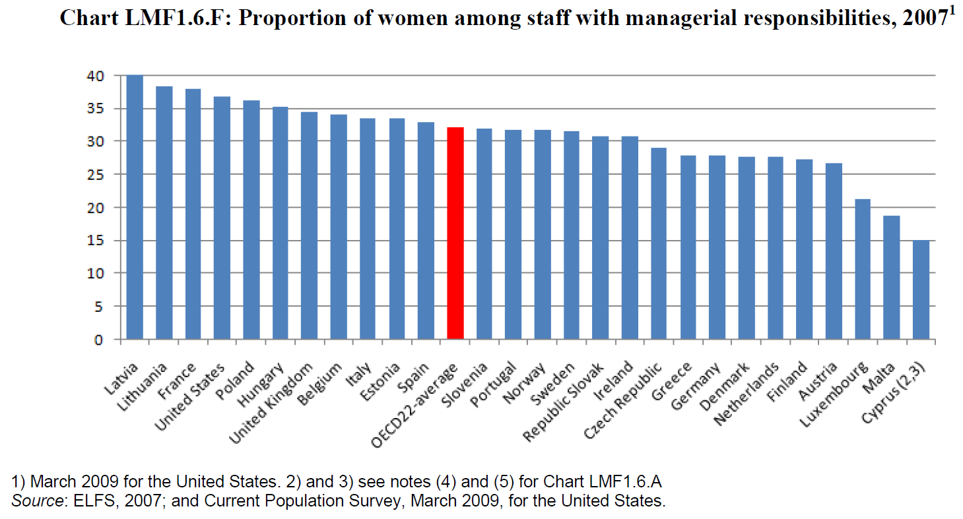
Example of a Bar Chart, Year 2

Slide 12
Example of a Complex Figure
(See Briefing Paper 2 on Social Data for Dissertations
At ESSTED website)

Slide 13
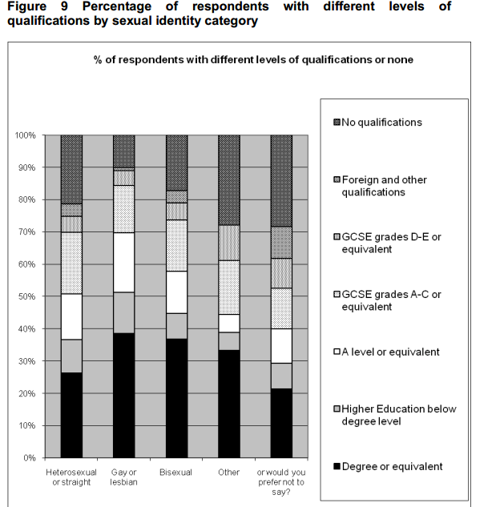
Sexual Identity (Citizenship Survey 2007)
Acknowledgement : Figure reproduced from Peter Aspinall (2009) ‘Estimating the size and composition of the lesbian, gay, and bisexual population in Britain’ Equality and Human Rights Commission Research report 37
http://www.equalityhumanrights.com/uploaded_files/research/research__37__estimatinglgbpop.pdf
Notes:
The Gay/lesbian and bisexual populations are more likely to have a degree than the rest of the population – see the report for more detailed commentary on this graph

Slide 14
Sexual Identity - NOTICE THE REFERENCES
To make open-access online resources, one needs careful tracking of the URL and the Harvard reference of the source
The authorship of the slide can get lost
We use Creative Commons licenses
Acknowledgement : Figure reproduced from Peter Aspinall (2009) ‘Estimating the size and composition of the lesbian, gay, and bisexual population in Britain’ Equality and Human Rights Commission Research report 37
http://www.equalityhumanrights.com/uploaded_files/research/research__37__estimatinglgbpop.pdf
Notes:
The Gay/lesbian and bisexual populations are more likely to have a degree than the rest of the population – see the report for more detailed commentary on this graph

Slide 15
Feedback
Student usage of various methods such as histograms, bar charts, mean/median and t-test were assessed, and many students were willing to use these methods, and had some experience--They perhaps recall their GCSEs
Staff in Sociology/Politics were surveyed with the same questionnaire, and fewer of them had experience with using these simple methods.
Most staff wanted to use the methods.

Slide 16
Student Confidence is Erratic
So
Practice
Practice
Practice
Even in discursive discipline areas
And also where technical skill is needed.

Slide 17
Example 3: Line Chart
Year 1-
Without
Confidence Intervals
Year 2-
With Margin of Error
Year 3 – ask students to do the C.I.s

Slide 18
2.b. Teaching innovations (flipping)
Active Learning:
Passive Learning is Passé
+ Problem of large class of 220
Part of solution is to reduce size → 190 → 130 people

Slide 19
Flipping for you
Old Method
New Method
Lecture
SPSS Practicals
One Tutorial
Exam 90%
2 Assignments 10%
Blackboard VLE
Lecture seating groups of 4
Activities in Lectorials
Pod casts MP3, MP4
Used the Visualiser
Exam 80%
Learning Journal 10%
2 Assts 10%

Slide 20
Pedagogy Principles
***Flip *** the lecture
TELL THEM IT IS A LECTORIAL
MANAGE THE STUDENTS’ EXPECTATIONS
Use CAMTASIA or YOUTUBE VIDEOs?
Use podcasts or MP3 or narratives on PPTs?
Make learning outcomes more explicit for each task
Even have learning outcomes for each activity
Build-up of activities
Reiterate key points of theory, and of empirics/interpretation
? Lesson plans ? – Invisible to students
Also add an element of reflective journal writing.

Slide 21
Overview of a Flipped Lecture
Students prepare 2 hours
5 min Aims (and Recap)
20 minutes Activity
10 min Discussion and Interpretation*
5 min Data Interpretation
5 min Summing-Up*
5 min Q&A

Slide 22
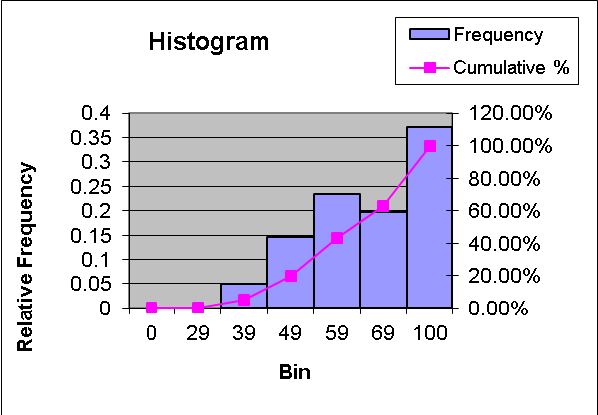
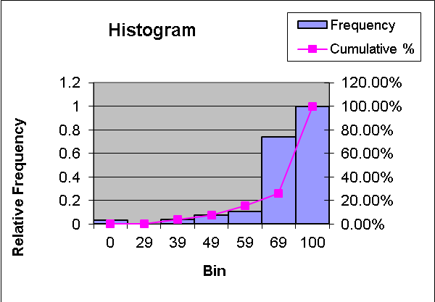
Better results with flipping
Old average mark 62 New average mark 72
Overall grade distributions:
2010/2011 Course work 69%
Exam average grade 60%.
Overall average grade 62%.
2011/2012 , Coursework 57%
Exam average grade 75%
Overall average grade 70% overall.
60% of students reached 70% overall.
Just 5 fails out of 190 students.

Slide 23
Results - feedback
Old approach: students not very satisfied,
Low attendance
New approach: students not very satisfied,
Low attendance, but the students like having lectures captured on video
ADVANTAGES:
Stronger peer support for learning
More active learning

Slide 24
Student Moves Around on Scaffolding
User of Microdata
Maker of Tables, Graphs
Critical Reader of Data
Critical Reader of Data
Rethinks, questions the usual interpretation

Slide 25
Be very explicit about learning outcomes
For higher Unit Evaluation Questionnaire (UEQ) results we are now being very explicit and clear in each Lecture whether it is a Lecture or a Lectorial.
‘manage expectations’ well.
This will feed into NSS later on.

Slide 26
Online Support for Flipping And Using More QD, QM
www.socialsciences.manchester.ac.uk/essted

Slide 27
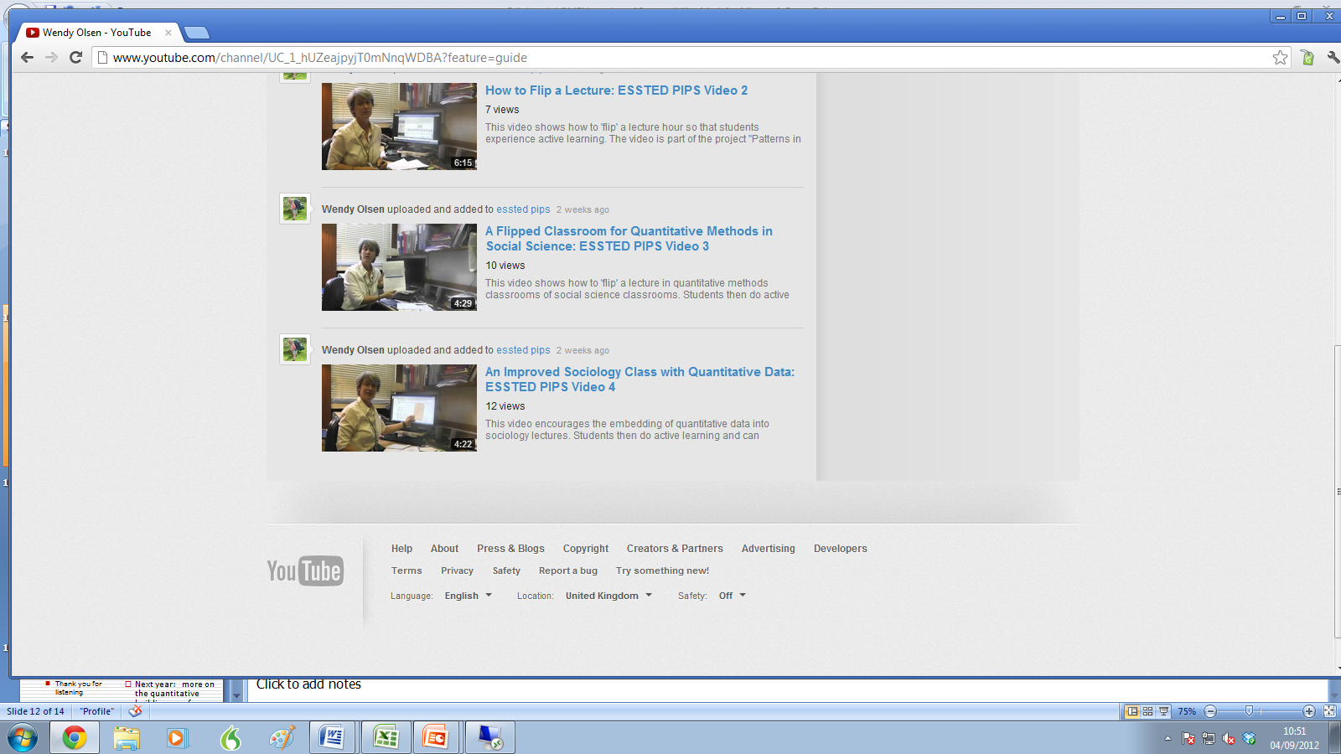
Youtube Carries Our Videos

Slide 28
3. A Series of Resource Packs
These resource packs are up online. + Discuss your own teaching materials How can they be Improved? |  |  |  | Examples From classrooms in the discipline of Sociology

Slide 29
A Series of Workshops
Embedding Quantitative Data in Sociology Politics Classroom with Flipping and Student Opinion Poll of Students |  |  |  | Examples From classrooms in the discipline of Sociology NESSTAR Demo and how to use More Data

Slide 30
Conclusions
The lessons learnt include:
Don’t innovate too much too quickly
Involve all your teaching-team members
Be explicit
Support active learning
Recognition is needed for teachers who make an effort (promotion) – this is appreciated and supported in UoM
Thank you for listening

