Slide 1

Impact, identification and management of hearing loss in people with dementia
Piers.dawes@manchester.ac.uk

Slide 2
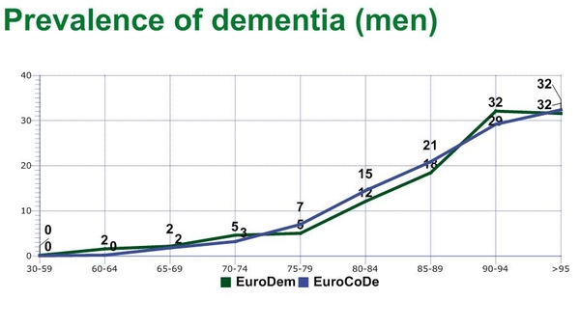
The problem
Dementia
Hearing impairment
1/3 at age 90 have dementia
60% adults aged 70-80 years
Cognitive & hearing problems are under-treated

Slide 3
Dementia and hearing loss
Allen et al (2003)
Notes:
2003 study: 83 people mild/mod dementia memory clinic in MCR
*differential diagnosis of hearing and cognition
*HL exacerbate dementia?
*Audiologists likely to be required to assess and treat people with both HL and dementia

Slide 4
→overlap amongst hearing, cognitive and mental ill health
Impact on each other
Hearing impairment and mental well-being the top 10 highest burden of EU diseases in terms of reduced quality of life.

Slide 5
Program
Dr Piers Dawes – Overview: Assessment and interventions for hearing loss in people with dementia
Dr Jenna Littlejohn - Assessment of hearing loss as part of dementia diagnosis
Dr Rebecca Millman - Management of hearing loss in people with dementia.

Slide 6
  Assessment
  Intervention

Slide 7
Hearing loss may affect diagnosis of dementia
Hearing problems look like cognitive problems
Impact of hearing loss on dementia tests
Impact of hearing loss on tasks – more difficulty, so increased likelihood of being diagnosed with dementia
→assess and rule out/treat hearing problems in people complaining of ‘memory problems’
UK national dementia guidelines recommend to ‘take into account sensory impairment’ during cognitive evaluation

Slide 8
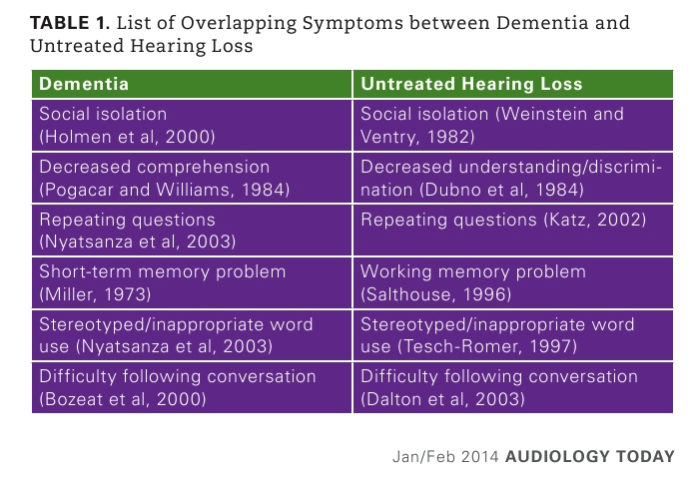
Hearing problems look like cognitive problems

Slide 9
Impact of hearing loss on dementia tests
Common dementia tests rely on good hearing

Slide 10
Mini Mental State Examination
5 and 10 minutes
attention and calculation, recall, language, ability to follow simple commands and orientation
estimate the severity and progression of cognitive impairment
Advantages
no specialized equipment or training for administration
validity and reliability for the diagnosis of Alzheimer's Disease.
Folstein, M. F., Folstein, S. E., & McHugh, P. R. (1975). "Mini-mental state": a practical method for grading the cognitive state of patients for the clinician. Journal of psychiatric research, 12(3), 189-198.

Slide 12
Impact of audibility on MMSE
125 Normal hearing young participants
five degrees of simulated hearing loss conditions
Performance on the MMSE was scored and cognitive status was categorized based on the scores.
Jorgensen LE, Palmer CV, Pratt S, Erickson KI, Moncrieff D. The Effect of Decreased Audibility on MMSE Performance: A Measure Commonly Used for Diagnosing Dementia. J Am Acad Audiol. 2016 Apr;27(4):311-23. doi: 10.3766/jaaa.15006.

Slide 13
MMSE score
Impact of audibility on MMSE
Mild
impairment
Severe
dementia
Hearing level

Slide 14
Hearing loss and dementia evaluation
Which dementia test most commonly used?
Do physicians ask about hearing?
Do physicians refer for hearing testing?
Jorgensen, L., Palmer, C. V., & Fischer, G. (2014). Evaluation of hearing status at the time of dementia diagnosis. Audiology Today, Jan/Feb, 28-45.

Slide 15
Hearing loss and dementia evaluation
Retrospective chart review
100 charts from 28 clinicians
All patients diagnosed with dementia
Large university-based primary care clinic with access to onsite audiology clinic

Slide 16
Hearing loss and dementia evaluation
Which test most commonly used?
Diagnosis based on family/self report of cognitive changes plus MMSE

Slide 17
Hearing loss and dementia evaluation
100 patients
13 patients asked
if they had hearing loss
87 patients were not
asked about hearing loss
3 confirmed
hearing loss
10 denied
hearing loss
6 previous
diagnosis of
hearing loss
81 without
diagnosis or
self-report
4 no report of
hearing aids
2 had hearing aids
Notes:
*27 patients were referrred to other specialities (neurology)
*4 patients referred to audiology (not the 3 that said had hearing loss)
*none given in-office audiometric screenings
*estimate around 40% of patients would have clinically significant hearing loss (at least
*suggests diagnosis and severity estimation of dementia may be biased by impact of untreated HL

Slide 18
Conclusions
Incorporate hearing evaluation as part of cognitive evaluation for dementia
Audiologists to work with physicians who diagnose dementia
Change UK dementia diagnostic guidelines to include hearing evaluation
Educate physicians on need for hearing evaluation

Slide 19

New project: Assessment
i) identify appropriate screening tests of hearing and vision for memory clinics
ii) identify barriers to sensory evaluation in memory clinics
iii) develop specific advice on how to take sensory impairment into account
iv) evaluate a sensory assessment protocol in a clinical setting
v) disseminate to dementia health care professions, NICE, optometrists, audiologists and the general public

Slide 20
New project: Assessment
i) identify appropriate screening tests of hearing and vision for memory clinics
ii) identify barriers to sensory evaluation in memory clinics
iii) develop specific advice on how to take sensory impairment into account
iv) evaluation of a sensory assessment protocol in a clinical setting
v) dissemination of findings to relevant stake holders including dementia health care professions, optometrists, audiologists and the general public
Feedback
What are your views?
What things should we consider in this project?
How should we address them?

Slide 21
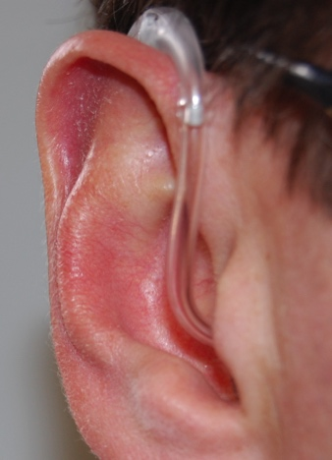
Intervention and treatment

Slide 22
Effects of hearing loss
Communication difficulties
Social withdrawal
Increased task difficulty
Increased memory problems
Poorer well-being
Hallucinations and disorientation
Increased burden on family and friends
→possible benefits of hearing treatment

Slide 23
Author | Study design (level of evidence*) | N | Intervention | Outcome
 |  |  |  | Cognition | Rate of cognitive decline | BPS | Hearing related disability | General quality of life | Activities of daily living | Carer burden
Palmer et al. (1998) | Single subject multiple baseline design (4) | 1 | Hearing aid
Palmer et al. (1999) | Single subject multiple baseline design (4) | 8 | Hearing aid
Allen et al. (2003) | Pre-post test single group intervention (4) | 31 | Hearing aid
Hutchinson et al (2012a; 2012b) | Case report (l4) | 8 | Hearing aid
Haque et al. (2012) | Case report (4) | 1 | HA Trouble shooting
Ghiringhelli et al. (2013) | Pre-post test single group intervention (4) | 26 | Hearing aid
Adrait et al. (2017), Nguyen et al. (2017) | Randomised controlled trial (2) | 51 | Hearing aid
Modest et al. (2015) | Case report (4) | 1 | Cochlear implant
Hopper et al. (2016) | Pre-post test single group intervention (4) | 31 | Assistive listening device
Mamo et al. (2017) | Pre-post test single group intervention (4) | 20 | Assistive listening device plus training
Notes:
*generally low to mid quality evidence
*one high quality RCT
*HA, assistive listening device, CI
*Mixed findings
*good compliance with HA, ALD and CI interventions
*benefit of hearing interventions for NPS and hearing disability
There is a need for properly powered, controlled trials of hearing interventions on outcomes relevant to people living with dementia.

Slide 24

SENSE-cog sensory support intervention
Who: People >60 years with dementia living in the general community
What: 12 week Individualised home-based sensory support intervention
Comparison: Wait list control group
Outcomes: quality of life, hearing/vision function, cognitive function, symptoms of dementia, carer burden (at 36 weeks)
(Dr Rebecca Millman; residential care homes)

Slide 25
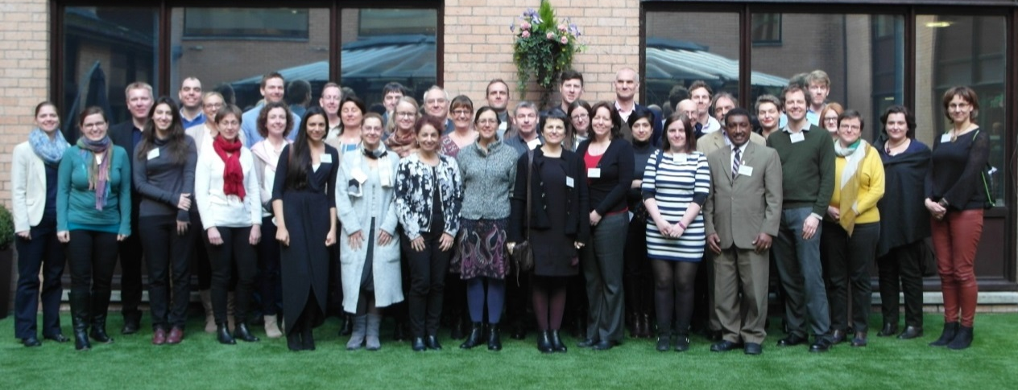
Introduction to the SENSE-Cog Team
18 partners
9 countries
UK x4
France x4
Germany x3
Cyprus x2
Greece x1
USA x1
Ireland x1
SME x3
(Dementia Pal Ltd, HörTech)
Big industry x 2
(Starkey, Essilor)

Slide 26
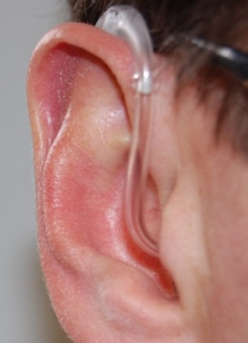
Audiology intervention
Benefit of non-instrumental rehabilitation (awareness, communication tactics)
  Improved awareness by companion
  Value of communication strategies & aural care
Positive effects of amplification on daily living
  Improved verbal communication & social connectedness
  Improved general wellbeing & quality of life
  Reduction in neuropsychiatric symptoms
  Improved performance on tasks

Slide 27
WP3: Intervention
Task 1
  Phase 1: systematic review
  Phase 2: Focus groups with PwD, caregivers and professionals
  Phase 3: Needs analysis survey
  Phase 4: Field trial
Task 2 A randomised controlled trial (RCT) of sensory support to improve mental well-being in people with dementia (PwD) with concurrent sensory impairment and their companion
    Task 3 Qualitative exploration of the experience of sensory rehabilitation for people with dementia and their companion
    Task 4 Producing the SENSE-Cog Training Manual

Slide 28
http://www.sense-cog.eu/
Piers.dawes@manchester.ac.uk

Slide 29
Program
Dr Piers Dawes – Overview: Assessment and interventions for hearing loss in people with Dementia
Dr Jenna Littlejohn - Assessment of hearing loss as part of dementia diagnosis
Dr Rebecca Millman - Management of hearing loss in people with dementia

