Slide 1




What Do Older Men and Women Say About Their Sexual Health and Wellbeing? A Qualitative Analysis of ELSA Wave 6 data.
Josie Tetley (Manchester Metropolitan University
David Lee (University of Manchester)
James Nazroo (University of Manchester)
Sharron Hinchliff (University of Sheffield)

Slide 2
Sexual relations and activities in later life
Background
Focus on decline, dysfunction and dissatisfaction (Domoney, 2009; Tiefer, 2007).
Individualistic models of sexual health.
Studies of birthday cards show how older people are portrayed as physically weak and a sexual failure (Bytheway, 1995; Demos and Jache, 1981; Snellman, Johnansson & Kalman, 2012).
Older men and women are also portrayed differently in both negative and positive ways (Rhino versus the Cougar) Lawton and Callister, 2010.

Slide 3
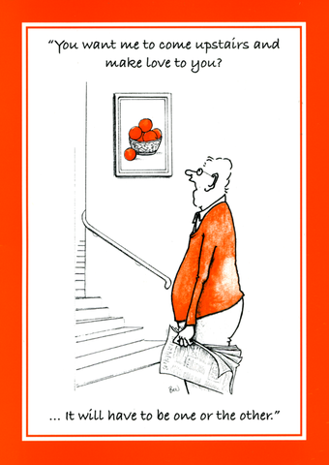
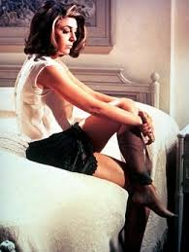
Notes:
Mrs Robinson (Anne Bancroft) Benjamin Braddock (Dustin Hoffman)

Slide 4
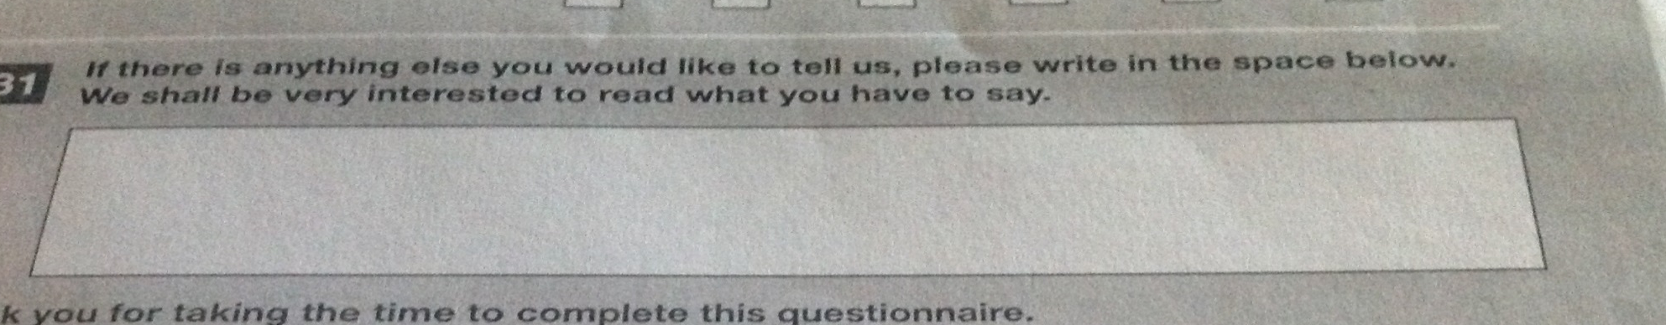
Understanding the reality
ELSA wave 6 Sexual Relationships and Activities questionnaire.
Primary mode of data collection was a tick box response to a series of questions. However, at the end of the questionnaire an open comment box was provided, which asked respondents whether there was anything else that they would like to say.
Over 1000 respondents provided additional information (681 women and 405 men)

Slide 5
Method of analysis
Template (King, 2004; Brooks and King, 2012; http://www.hud.ac.uk/hhs/research/template-analysis/)
Why
  flexible use, including open ended question responses on a written questionnaire
  allows for coding template on subset of data
  flexible and iterative approach
  allows for more than one person to be involved in the analysis

Slide 6
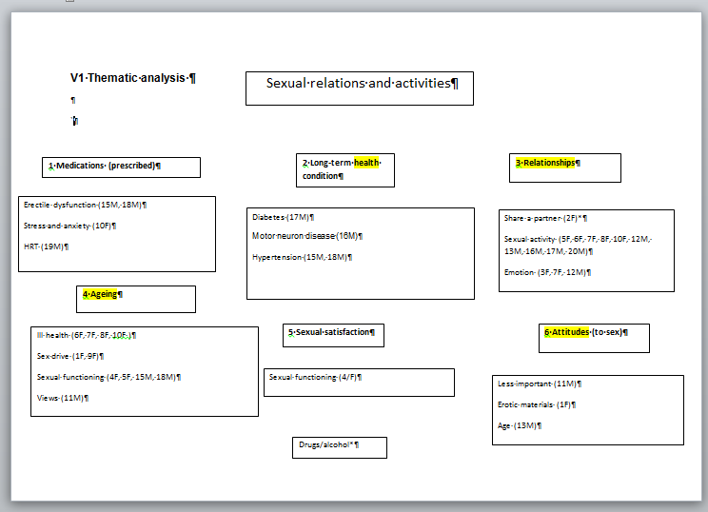
Initial template

Slide 7
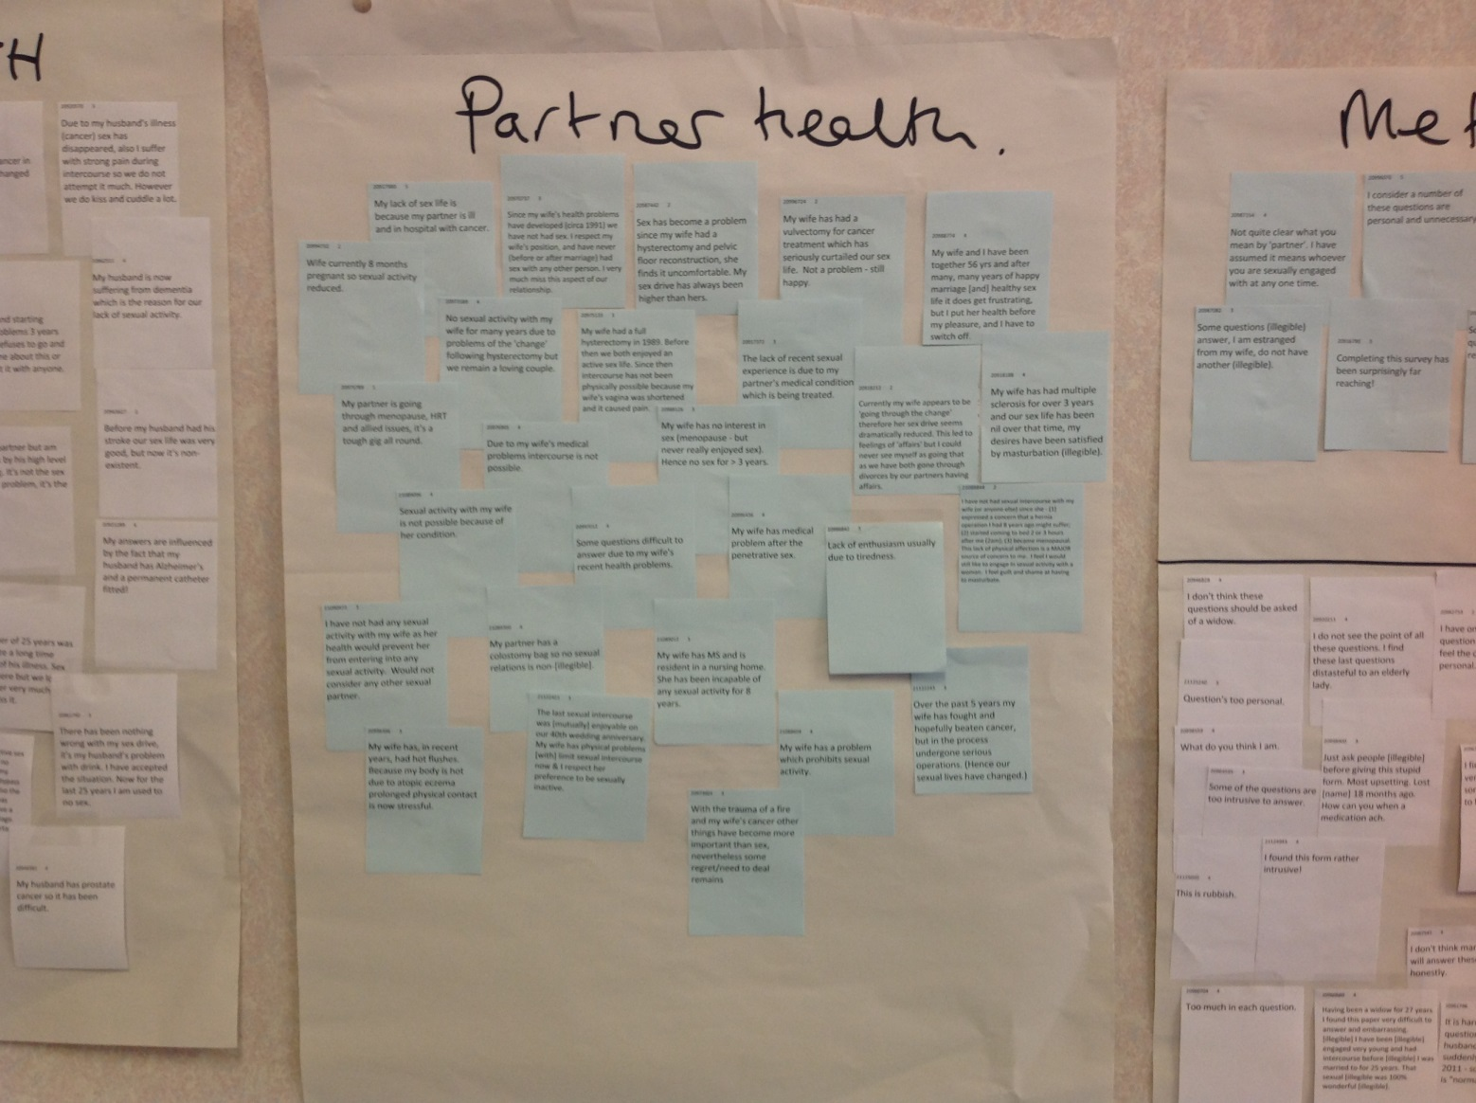
Our approach

Slide 8
Findings
Four main categories
Health (long term conditions, medications, partner health, gendered sexual health)
Relationships (gendered difference, sexual satisfaction and identity)
Sexual satisfaction and sexual activity
Ageing (stereotyping, ageism and reflection)

Slide 9
Health
Men were more likely to make comments about the impact of long-term conditions, or medications that they were prescribed to treat long-term conditions.
Comments were specifically made about:
  Diabetes
  Depression
  Cancer
  Cardio vascular disease and high blood pressure

Slide 10
Health
How can I solve erectile problems, I suffer from blood pressure and diabeti[es] (Man aged 60-70)
…because of the anti-depressant medication I am taking. For six months, while I have been taking this medication I have had no sex drive, (Man aged 50-60)
Since going through the menopause and suffering from clinical depression this has all contributed to me not having any sexual desires, (Woman aged 50-60)
Breast cancer operations (three) and radiotherapy, left me with painful breast, rib area and shoulders, sexual relations with my husband dropped off dreadfully. Although we feel very close, it’s a concern that we don’t have sex very often, (Woman aged 60-70)

Slide 11
Individual and partnered perspectives on health
Loss of sexual drive mostly attributable to medication for hypertension and prostate problems. (Man aged 70-80)
During the last month my husband has been recovering from a hip replacement plus prior to operation the pain did have an effect on our sex life. (Woman aged 60-70)
Sex has become a problem since my wife had a hysterectomy and pelvic floor reconstruction, she finds it uncomfortable. My sex drive has always been higher. (Man Aged 70-80)
No sexual activity with my wife for many years due to problems of the 'change' following hysterectomy but we remain a loving couple, (Man aged 70-80) .
Notes:
80-90 gp 4?
50-60 gp 1 ?
60-70 gp 2?
70-80 gp 3?

Slide 12
Relationships
Both men and women commented on factors that impacted on sexual relations and activities in the context of their relationships and identity which included
  Numbers of sexual partners
  Relationships at a distance
  Widowhood
  Being a carer
  Having children at home
  Divorce and remarriage
  Sexual satisfaction (context of relationship/sexuality)

Slide 13
Relationships
I consider sex to be only part of a caring relationship, and if by taking it gives pleasure to the other, I shall continue as long as able, (Woman aged 60-70).
Sex is part of a married partners life, (Man aged 80-90).
The act of sex does not make you ‘happy’ but having a loving partner does, (Woman aged 50-60).
I don’t feel that sex is the most important thing in a relationship. Commitment and care are more, or as, important, (Man age 60-70)

Slide 14
Relationships
I just want to say that I would be interested still in a sexual relationship (my husband is not). However, circumstances (adult children still at home) make it difficult even if my husband was interested!! That said, sex has never been the focus of our relationship (Woman aged 50-60)

Slide 15
Sexual satisfaction
I have never had much of a sex drive and am quite content with it that way, (Woman aged 60-70)
Have been fully satisfied with the sexual side of marriage and found it pleasurable and rewarding, (Woman aged 80-90)
Sexual orgasm is not as good now as it used to be, (Man aged 60-70)
I am embarrassed to talk about sex but I want to be honest, I have only had one sexual partner in life and I was not satisfied sexually, I have never had an orgasm, (Woman aged 60-70)

Slide 16
Sexual satisfaction
We have oral sex now, but very infrequent, it may be four months since we did it, (Woman aged 80-90)
Would like other forms of sex e.g. Anal and oral but my wife will not engage in them, (Man aged 70-80)

Slide 17
Ageing
Comments indicated that sexual relationships and activities were affected by:
  Stereotyping (sex not for older people)
  Biological ageing (ill health and ageing bodies)
  The responses of health services (discriminatory, not receptive to talking about sex with older people)
  Reflections on the past and comparisons with the present (the mind is still 20 even when you get old)
  Expectations (should it all be about penetrative sex?)
  Sexual satisfaction (diversity issues)

Slide 18
Ageing
I would like to be more virile but since I am not I accept the situation in view of my age, (Male aged 70-80).
Don’t forget: the mind is still in its 20s even when you get old, (Man 80-90).
I am 75 and still enjoy sex. I don't see why some people say to me "oh my god sex at your age". If a couple enjoy it then what's the problem. It relaxes me, (Female aged 70-80).

Slide 19
Ageing body
Penis shrunk with age, (Man aged 70-80).
My sexual drive declined after my divorce and my menopause. This, however, has not concerned me. I take care of my appearance and body image, (Woman aged 50-60).
I think it would be enjoyable to still have sex, but I no longer have a partner and in any case as I’ve got older all these lumps and skin tags have appeared and I don’t think I would be appealing any more. (Woman aged 70-80).

Slide 20
Health care responses
Doctors and health care professionals do not seem to give any help re sexual health problems: in my case, erectile dysfunction, (Man aged 70-80).
Have sought help through GP and privately. Very little help available – often feel that you shouldn’t be concerned ‘at your age’! (Woman aged 70-80).
The NHS seems reluctant to help with sexual problems in someone of our age. Penetrative sex is incredibly painful and I have been advised it’s due to age, (Woman aged 70-80).

Slide 21
Publications and future work
Findings published in:
Archives of Sexual Behaviour
Ageing and Society
How Long Will I love You? Published by the International Longevity Centre http://www.ilcuk.org.uk/index.php/publications/publication_details/how_long_will_i_love_you_sex_and_intimacy_in_later_life
Journal of Sex Research
Chief Medical Officer – annual report 2015 – health of the baby boomer generation
ELSA wave 8 – findings out soon!

Slide 22
Media response
Women’s Hour
Print and online press coverage –the Guardian and Daily Mail as examples
Radio 4 news quiz
Loose women
Quotes: a mixture of good, bad, disgusting, laugher and mocking:
You baby boomers sicken me on every single level
What’s nasty, the thought of older people having sex?

Slide 23
Public responses
Lets be honest if your still sleeping in the same bed at 65 your’re already onto a winner. Intimacy ontop of that you are laughing.
https://www.theguardian.com/lifeandstyle/shortcuts/2017/feb/14/lust-for-life-why-sex-is-better-in-your-80s

Slide 24
Talking about our work
https://www.youtube.com/watch?feature=youtu.be&v=PWIcttU5BWE&app=desktop

Slide 25
What Do Older Men and Women Say About Their Sexual Health and Wellbeing? A Qualitative Analysis of ELSA Wave 6 data.
Josie Tetley (Manchester Metropolitan University
David Lee (University of Manchester)
James Nazroo (University of Manchester)
Sharron Hinchliff (University of Sheffield)

