Slide 1
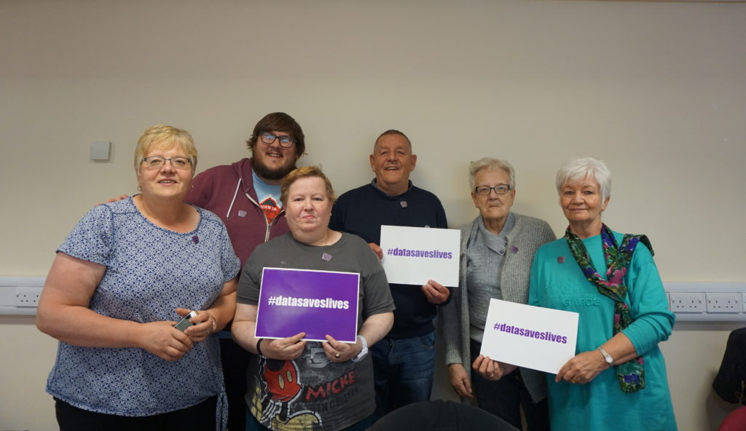
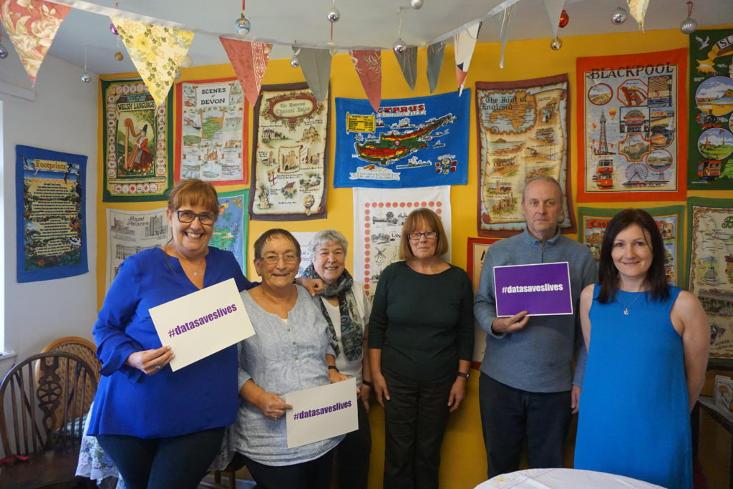
♯datasaveslives Community Reporters Public Engagement Project
Notes:
Introduce self
Collaborative project between the Health eResearch Centre – Herc at the UoM, Inspiring Communities together Salford, and AgeUK Manchester Crossacres Community Centre

Slide 2
Background
Technologies to facilitate self-collected health data tend to be focused on the younger population
However….
Chronic conditions which require long-term monitoring are more common in later life
Therefore….
Older people potentially have the most to gain from collecting health data themselves in their own homes
There is a perception that older people are less likely to engage with health data technologies
Research involving older people and health technologies is lacking
Notes:
So why did we undertake this public engagement project?
We were interested in the ways health data, and heath data technologies could improve the lives of older people
I think its fair to say that….

Slide 3
Public Engagement
Usual method: interviews, group discussions
Researcher-led
No/little benefit for participants
Always need to consider that researchers/environment may influence what people say
Not very exciting!
Notes:
Public engagement is nothing new, however, we thought it would be interesting to do things a bit differently.
Standard methods of public engagement tend to be….

Slide 4
Community Reporters
Notes:
Community reporters is an initiative which trains people to create video recording, and upload them onto the CR website – a free, open forum where people can share their personal stories. The ethos of CR is to encourage members of the public to share experiences about issues in their local area. CR runs certified training programmes, at the end of which you become an official ‘reporter’ for the website. Videos are tagged by subject and locality, allowing you to search for similar videos online.

Slide 5
Aims
To capture older peoples views on health data and technology
To identify motivators and barriers to engagement in research using activity trackers
To explore ‘Community Reporters’ as a public engagement technique
Notes:
Read
We used smart watches as activity trackers in this project, which are small sensors which measure step count. I will explain in more detail in a moment

Slide 6
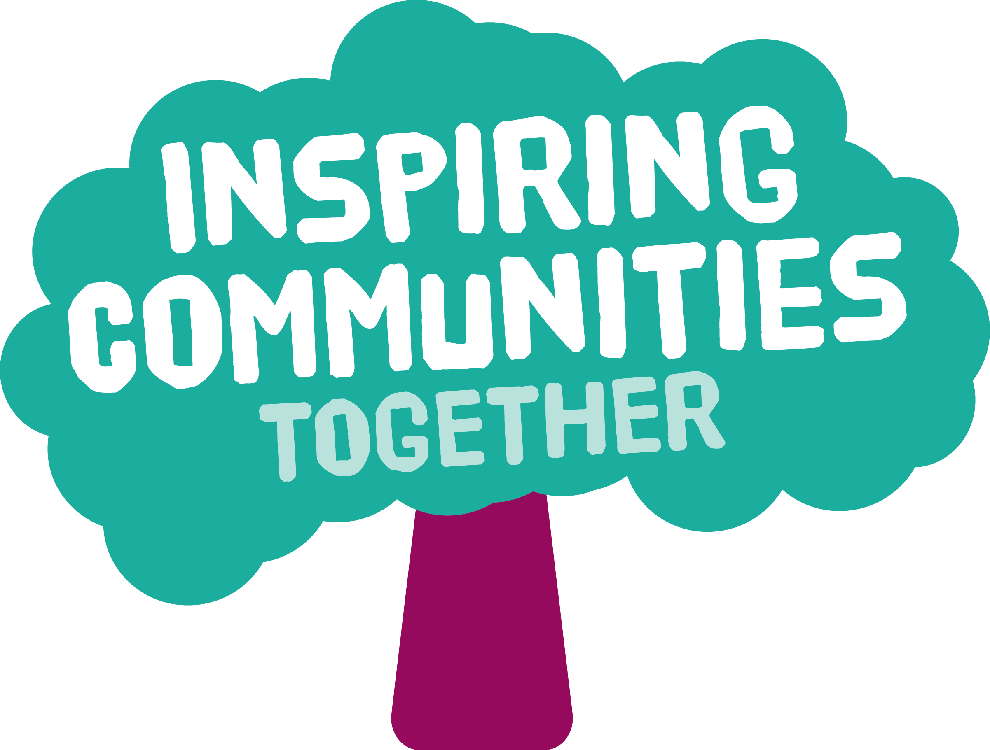
Team Members
Notes:
This was a collaborative project involving:
Health eResearch Centre
MICRA
Manchester AgeUK, Crossacres in Wythenshaw
Inspiring Communities Together, Salford
Macc – Mancheste’rs voluntary organIsation which runs community reporter training in MCR

Slide 7
Project Overview
Community Reporter Training
Up to 20 participants over 2 sites
3-5 x group training sessions
Test out smart watches for duration of training (3-5 weeks)
Health Data
videos/interviews
Exercise Group Smart Watch Testers
15 exercise class attendees recruited to test smart watches for 1 week
either ‘50+ class’, or ‘step-up’ falls prevention class)
Smart Watch Data
videos/interviews
Smart Watch Data
videos/interviews by community reporter trainees
Notes:
So this is what we did:
We trained up to 20 people aged 50+ how to become a Community Reporter over 3-5 weeks
Used ‘health data’ as the theme for their videos and interviews
Asked the CR trainees to test out smart watches (activity trackers) during training period and video record their experiences
Asked the CR trainees to interview exercise class volunteers who were also asked to test the trackers
Upload videos onto the Community Reporters website

Slide 8
Health Data video
Notes:
Jennifer – before this project, were you familiar with term ‘health data’?
Jennifer/Gordon – how did you find interviewing other people about ‘health data’?
Jennifer – you talk about using phone apps in the video, what do you think about using apps as a way to collect health data from older people?

Slide 9
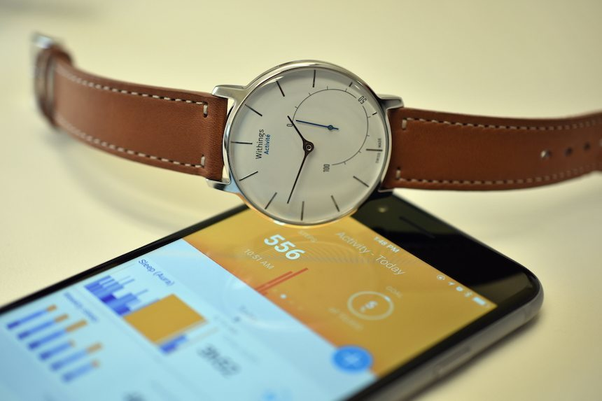
Smart Watch
Notes:
Designed to look like a normal watch
Set up with an app – phone, ipad, computer
Set up personalised step count target
Sub-dial keeps track of your daily step count – and buzzes when you hit your target

Slide 10
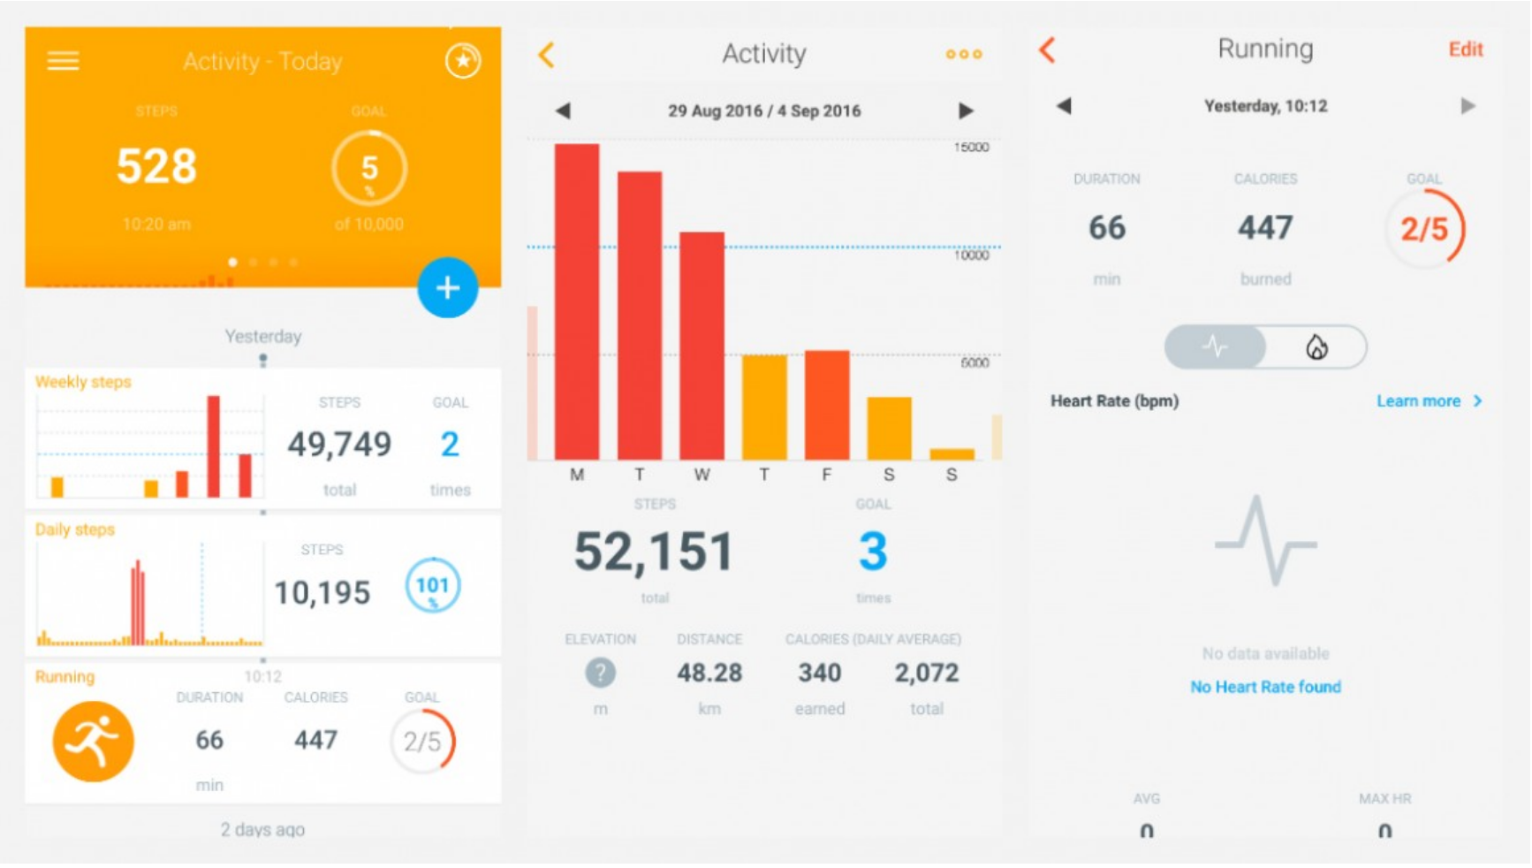
App Dashboard
Notes:
This is the dashboard you see when you syncronise your watch with the app
As you can see, this gives you much more in depth information about your activity for the day
This is a pretty stardard application for activity tracking devices, as you can probable appreciate, it is really geared towards a healthy, normally functioning group of people
Also monitors sleep, can be set to measure BP etc

Slide 11
Smart Watch Video
Notes:
Jennifer/Gordon – we see some of the participants talking about the pros and cons of the smart watches, what did you think were the main benifts? And the main downsides?
Jennifer/Gordon – some participants talk about feeling a bit overwhelmed with the app, how important do you think it is to personalise the settlings on the app? Or perhaps even use an app specifically designed for older people?
Jennifer/Gordon – would you wear an activity tracker in the future?

Slide 12
Community Reports
Malc's film on health data
Lunching ladies
Eileen's cafe interview re health data
Geoff's Story - Using the watch
Mark's story - health technology
Dave's Story - Health Technology
Olivia and Jennifer - discussion about the watches
Olivia - using the watch
Geoff and Linda - discussing the watch
Geoff's experience of using his watch
Gordon - Using the watch
Overview of experience of using watches
Jennifer - using eyesight apps
sandra - using pilates apps
Robert - Healthy eating apps
Jackie - Using health apps
June's Story
data saves lives
Kath's Blood Pressure
Fitness Trackers- Do they encourage exercise?
Martine
Health - No Smoking
Health – Café
Health - More than physical
Health - Keeping Fit
Health - helping others
All available at: https://communityreporter.net/data-saves-lives
Notes:
As you can see, our participants created 25 videos – all of which hare available online to be viewed
Jennifer/Gordon – what did you think about the community reporter training?
Jennifer/Gordon – did you enjoy the project?
Jennifer/Gordon – what would motivate you to participate in research projects in the future involving health technologies?
Matt – do you think CR could be used as a useful tool for public engagement with research?

Slide 13
Thank you for listening!
This project was funded by Health eResearch Centre Public Involvement Small Projects Scheme
https://www.herc.ac.uk/research_project/community-reporters/
Notes:
Stay on stage
More on to panel

