Slide 1

Isolation: the emerging crisis for older men
Brian Beach, Research Fellow
International Longevity Centre – UK
@ilcuk

Slide 2

ILC-UK Planning Tomorrow, Today
Westminster based think tank
Evidence based research organisation
Focussed on policy
Independent
Experts in ageing, demography and longevity
Broad remit in research
Take a balanced approach to intergenerational fairness
Well respected
Well networked – part of an international alliance
www.ilcuk.org.uk

Slide 3
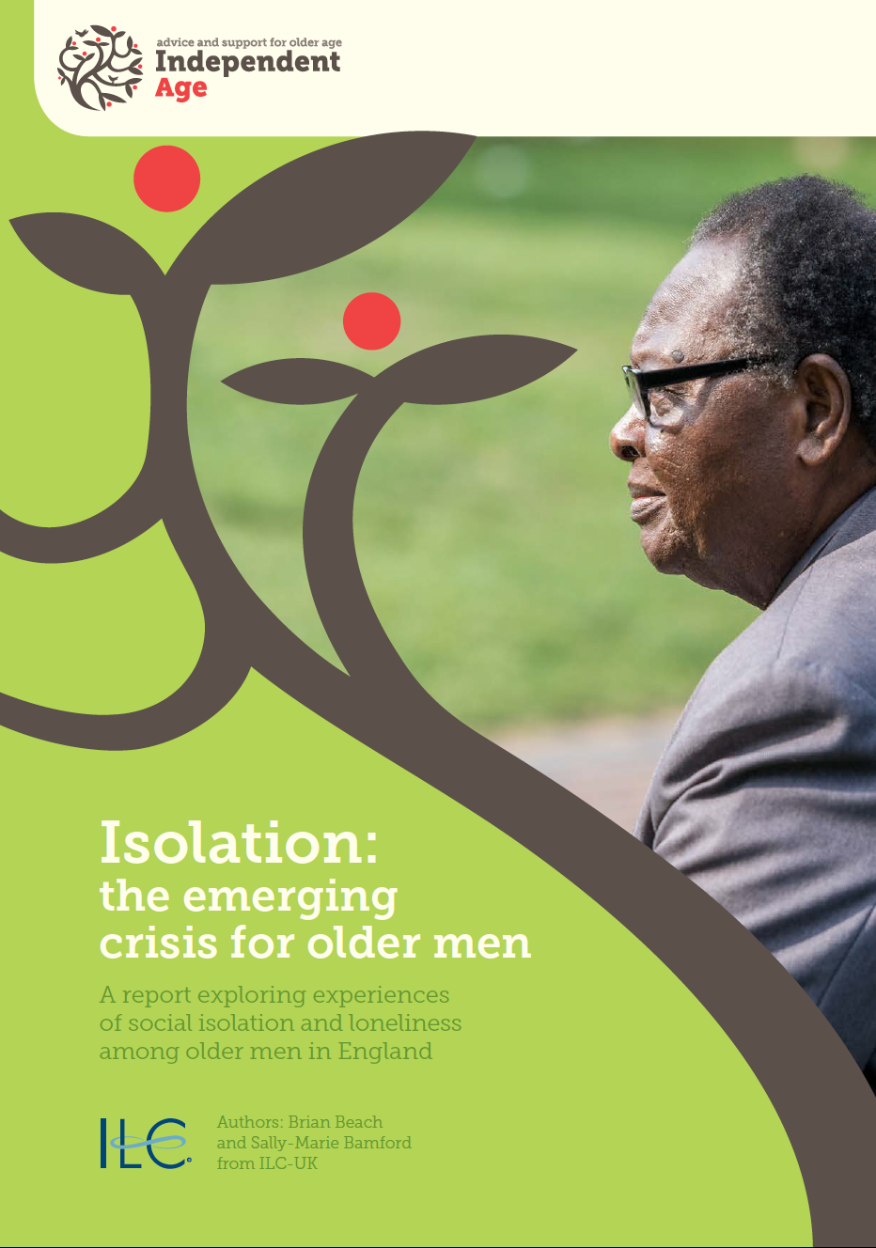
Explored the experiences of social isolation and loneliness among older men
Review of existing evidence
Analysis of latest data from ELSA
Interviews and focus groups

Slide 4
Topics for Today
Why look at older men? How do they differ from older women?
What do we mean by social isolation and loneliness?
How prevalent are social isolation and loneliness among older men?
Why do older men experience social isolation and loneliness differently than women?
What do we know about the most isolated and loneliest older men?
What lessons can be learned about how to improve services to address social isolation and loneliness among older men?

Slide 5
Why look at older men?
Previous evidence suggests that older men and women experience social isolation and loneliness in different ways, and that men are less likely to seek help and support, e.g. medical services
Women tend to use support services more – are they failing older men?
Male-specific programmes have grown in number and scope, while providers need a better understanding of best practices and what works – are current programmes effective?
Women have received greater focus in ageing research and policy debates – are men being left out?

Slide 6
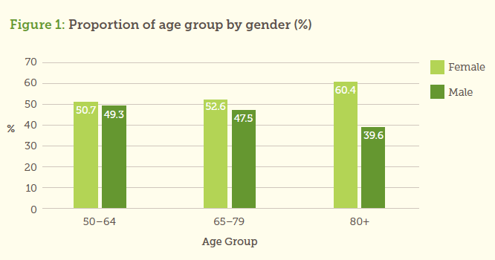
Women make up more of the ‘oldest old’…

Slide 7
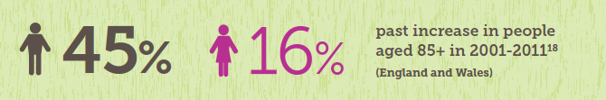
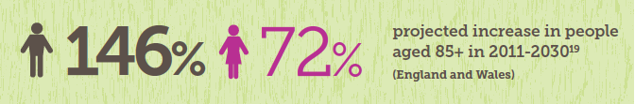
…but the gap in life expectancy is shrinking
In 2012 in England & Wales:
16% of men were aged 65+
23% of women were aged 65+
In 20 years:
21% of men aged 65+
24% of women aged 65+

Slide 8
What do we mean by social isolation and loneliness?
Loneliness: a subjective perception in which a person feels lonely
Social isolation: broadly refers to the absence of contact with other people
Social exclusion: refers to being marginalised; closely related to social cohesion

Slide 9
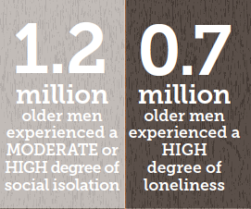
Social isolation and loneliness among older men
13.9% of men aged 50+ reported a moderate to high degree of social isolation
  29.9% were not isolated
8.1% of men aged 50+ reported a high degree of loneliness
  Over half (52.2%) were not lonely

Slide 10
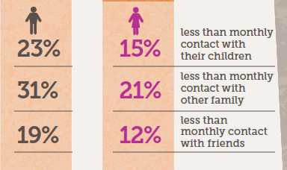
Differences between men and women
Overall, men reported more social isolation but less loneliness than women
Social isolation: While women are more likely to outlive their partners, a lack of contact with children, family, and friends explains higher isolation among men

Slide 11
Differences between men and women
Loneliness: Despite appearing more isolated, men report being less lonely
  Are older men alone but not lonely?
  OR
  Are older men under-reporting loneliness?

Slide 12
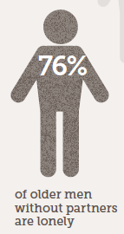
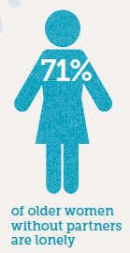
Loneliness, partnerships, & living alone
When we take partnership into account, a higher proportion of older men without partners report loneliness
Over time, the number of older men living alone could be expected to grow by 65% to around 1.5 million men aged 65+

Slide 13
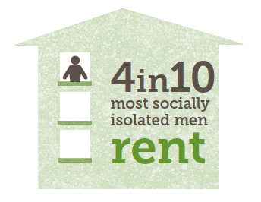
Other factors impacting the most isolated older men
Living arrangements
  Renters are more likely than homeowners to report moderate to high isolation rather than no isolation
Income
  Men with higher income are more likely to report no isolation

Slide 14
Other factors impacting the loneliest older men
Health
  Poorer general health
  Limitations with I/ADLs
  However, NOT just chronic illness or disability
  Depression
Informal care responsibilities
Marital status (not being married or cohabiting)

Slide 15
What older men want from services
A service for people – not for lonely older people
  Some men may not acknowledge they need such services
Services appealing to men’s interests and passions
  Services can appear or feel ‘feminised’
User-led involvement and engagement
  Encourages effective recruitment, buy-in, & follow-up

Slide 16
Examples of best practice
Men in Sheds – shared space for hands-on DIY activities
Walking Football – open to everyone, but particularly attracts men aged 50+
  Incorporates both social and physical activity
Culture Club – more intellectual activity focused on learning
  Built around group’s interests, who help select speakers

Slide 17
How might services be improved?
Better engaging older men through their partners
Better support in preparation for retirement
Referrals through health services to proper support
Think about older men who have moved, especially those into institutional care

Slide 18
Areas of further work
Older men in care homes
Engaging older men with dementia
Addressing living alone among the oldest old
Other hard-to-reach groups: ethnic minorities, LGBT
Adapting to changing relationships: divorce/re-marriage
The potential for technology

Slide 19
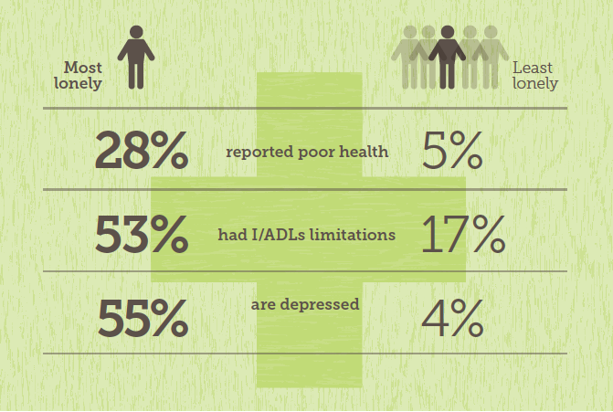
Some concluding thoughts
Health and loneliness have a complicated relationship

Slide 20
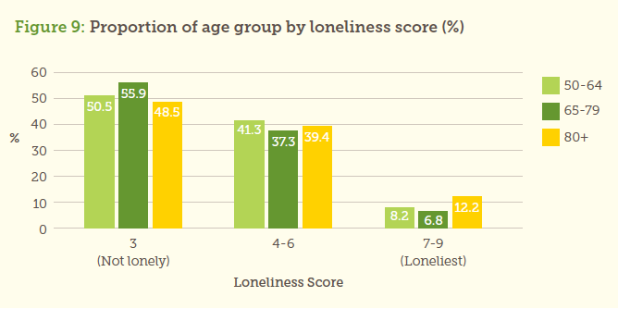
Some concluding thoughts
Health and loneliness have a complicated relationship
Loneliness is not an inevitable consequence of ageing

Slide 21
Some concluding thoughts
Health and loneliness have a complicated relationship
Loneliness is not an inevitable consequence of ageing
Socio-economic disadvantages appear to be a main driver for social isolation – suggesting a life course perspective needed
Key transitions – in particular the loss of one’s partner – play an important role in older men’s experiences of social isolation and loneliness

Slide 22


Many thanks
Brian Beach
Research Fellow
International Longevity Centre – UK (ILC-UK)
brianbeach@ilcuk.org.uk
02073400440
Twitter: @ilcuk

