Slide 1
The madness of Barclays
Background briefing
by cresc researchers
cresc.ac.uk

Slide 2
What’s going on?
The standard line on Barclays (and investment banking) since the crisis is that it has a “cultural” problem
The long standing CRESC argument is that there is a material problem about the business model in investment banking (which can be illustrated from the Barclays report and accounts)
The slides below present a basic briefing in slide form on what’s wrong (originally prepared by CRESC in response to a media request for some statistics in May 2012)
As the briefing has now been cited in public by national media (eg Guardian, 10 July) after the libor scandal, we have reviewed the argument and are putting it up on the cresc web site; with the proviso that we would ordinarily present a more sophisticated and rounded analysis of company and industry.

Slide 3
“Diamond vows to try harder as Barclays disappoints”
That was how the FT (10 Feb 2012) reported Bob Diamond’s presentation of disappointing financial results for 2011
He admitted that the bank had made an “unacceptable” 6.6 % return on equity, and reiterated his target of 13% which is below what the bank delivered in the mid 2000s (see next slides, comparisons complicated by acquisition of Lehman; first slide gives our calculation, second B’s slightly different calculation)
“ I am not satisfied with these returns. I care about this a lot……it is important to shareholders. We have a lot more to do” “ If it wasn’t for the external factors we could still do it (13% target ROE ) we’ll make steady progress next year”

Slide 6
“Repeating the same mistakes and expecting different results”
That’s how we would characterise the Barclays strategy
Remember the strategy for Lehman and Bear Sterns which ended in disaster (a) ramping speculative assets to improve RoE (b) game over and bailout when asset prices fall unpredictably or liquidity fails….
But Barclays’ strategy in 2011 is as before; 3/4 of its assets are in BarCap which now earns a wafer thin 0.3 % return on assets and only half the profit (see next slide); compare the healthier UK retail and Barclaycard businesses which have a higher ROA and a more modest appetite for assets

Slide 8
“Where’s the RoA?”
In the report and accounts: the percent of Barclays’ income from trading stands no higher than 23% and interest income from old fashioned banking intermediation stands no higher than 37% (both asset intensive).
There is a further 26% derived from fees and commissions (less asset intensive traditionally).
It may be that like JP Morgan they are increasingly wily about reclassifying their trading, but key question = why does BarCap need to ramp so many assets to generate a paltry RoA ?
Put more provocatively: why are those employees paid the most within Barclays investment banking division unable to turn a higher profit on the assets they manage than other Barclays divisions?
If intermediary function (and societal contribution) of banks = efficient capital allocation, why are the highest paid the worst performers in this process of allocation?
Especially the case when BarCap’s speculative assets may be more prone to write-downs historically.

Slide 10
The madness of Barclays
The investment banking led business model results in a bloated balance sheet and huge credit risk; In 2011 Barclays’ credit risk is £1,795 trillion i.e. larger than nominal British GDP of £1,500 trillion; nearly half of that is in derivatives + off balance sheet
Barclays’ net risk is half that size at £794 trillion but that assumes all Barclays’ counterparties would or could pay up… but that depends on the quality of its internal risk models, and whether there is a systemic crisis (see Haldane, A. (2012) Tails of the Unexpected).
The euro crisis is a banking crisis because of long chain interconnections through bank lending and derivatives from South to North Europe (CRESC Working Paper 110); against this background Barclays’ strategy is madness which may cost the taxpayer dear in a further round of bank recapitalisations.

Slide 12
“What have you done for me lately?”
Taxpayers should ask this question because Barclays is (a) a machine for enriching elite investment bankers with £1.5 billion in staff bonuses last year cf pre tax profit of £3billion (b) the risks to the taxpayer are not offset by corporation tax because Barclays has used losses to minimise its payments; a parliamentary question in early 2011 forced disclosure that Barclays paid just £113 million in UK corporation tax in 2009
Barclays’ pile of assets continues to do very little for the real economy because of its lending pattern;
>60% of PLC / company wide and of UK lending is to other financials and on house mortgages;
loans to manufacturing, retail and wholesale account for no more than 7.2 % of the UK loan book and are in nominal terms sharply down on 2007 levels

Slide 14
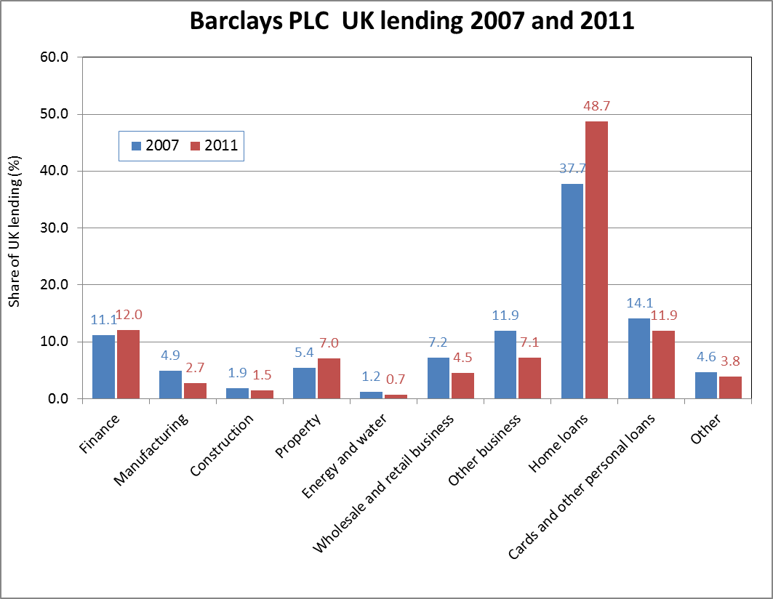

Slide 15
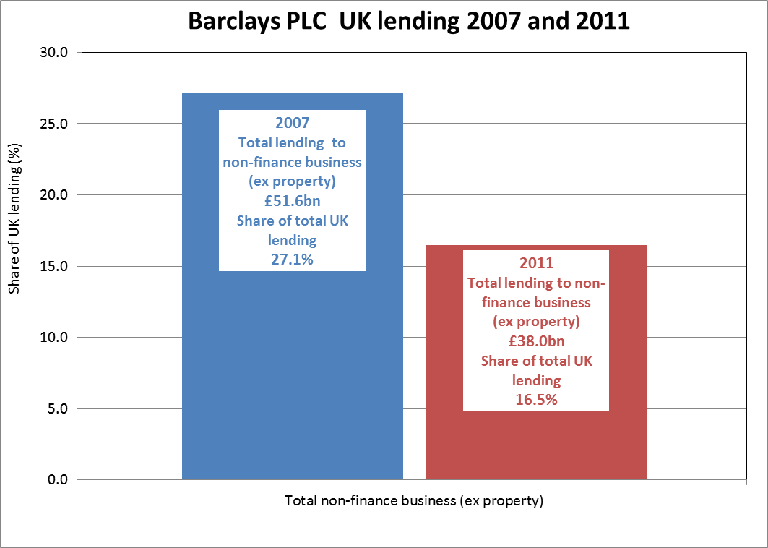

Slide 16
Alibi or charge sheet?
Barclays’ alibi is that the demand isn’t there for real economy loans…
Our charge sheet is that the real economy is irrelevant because financial reform is inadequate + Barclays remains irresponsible :
(a) the firm’s strategy is centred on increasing asset volume in more speculative activity in the hope of higher ROE
(b) the taxpayer (once again) is placed to foot the bill if or when it all goes wrong

