Slide 1
ANT4D Workshop, London School of Economics, 30 June 2011
Understanding responsible innovation in small producers’ clusters in Vietnam through
Actor-Network Theory (ANT)
Authors: Jaap Voeten, Gerard de Groot, Job de Haan (Tilburg University) and Nigel Roome (Vlerick Leuven Gent Management School)

Slide 2
Our ANT exploration
Innovation research (2007 - ongoing) on new dynamics in informally organized small producers’ clusters in Vietnam.
Is it innovation? (2007 – 2009):
development of assessment instrument;
confirmed cases of innovation (+ pollution, poverty).
Is it responsible innovation? (2009 – 2010):
Normative/positivist/eurocentric indicator framework did not work
conceptual understanding of 5-stages societal process;
cases either in the ‘responsible innovation zone’ or not.

Slide 3
Responsible innovation - a form of governance of an innovation and its consequences

Slide 4
Emerging research challenge
To understand the way innovations and their consequences are governed in the informal setting of small producers’ clusters in Vietnam.
Limitations of existing theories on innovation diffusion (Rogers, 1962) innovation process (Dosi ,1988; Edquist ,1997; Tether, 2003), innovation systems (Lundvall,1992; Freeman, 1995; Edquist ,1997):
deterministic view on innovation and diffusion (lab, R&D dept.) ;
static understanding of formal institutions, systems and networks;
no interaction with material world;
developing countries are missing.

Slide 5
Actor-Network Theory (ANT)
Social interactions in evolving networks. Integration of human and non-human actants (Callon, 1986; Law 1992; Latour, 2005).
Innovation studied in action; focus on the dynamics rather than on the stability of their relationships (Latour, 2005).
Network creation (translation – ANT) and innovation: both on-going processes. Similarities, overlaps, parallels?
Concepts: actants, obligatory point of passage (OPP), translation, black boxed, punctualization

Slide 6
Research methodology
No theory/hypothesis to test;
grounded theory: understanding patterned relationships between social actors and how these relationships and interactions actively construct reality (Glaser & Strauss 1967);
ANT and GR match well: ANT is descriptive, ‘how’ relations assemble (ANT is not a theory (Law 2007)).
Our research:
case descriptions (Yin, 2005) focusing on ANT concepts and particularly translation moments (Callon. 1986) in past 10 – 15 years;
iterative process combining data collection, interpretation and theoretical sampling, reflections, validation, more focused data etc.

Slide 7
Field work
Two innovation cases (information oriented), similar and extreme.
Field work on ANT in 2 weeks in February 2011. Intimate knowledge of villages gained in the past 5 years.
A variety of data collection methods, interviews with all actors identified on problematization, interessement, enrolment, mobilization of allies
Recorded and transcribed, coded, constant comparison and developing relations, possible causalities.
Data collection (negotiation): academic agenda, no direct stakeholders in the innovation promotion (!).
Notes:
no funding agency agenda (although on the long term we wish to contribute to poverty alleviation)

Slide 8
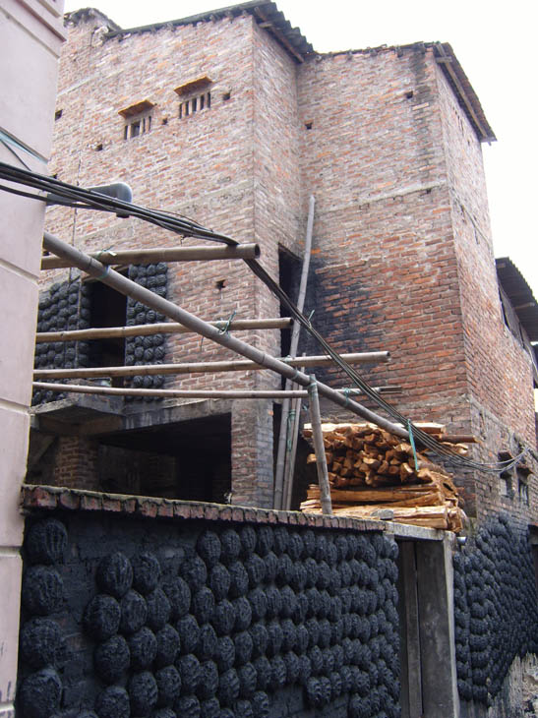
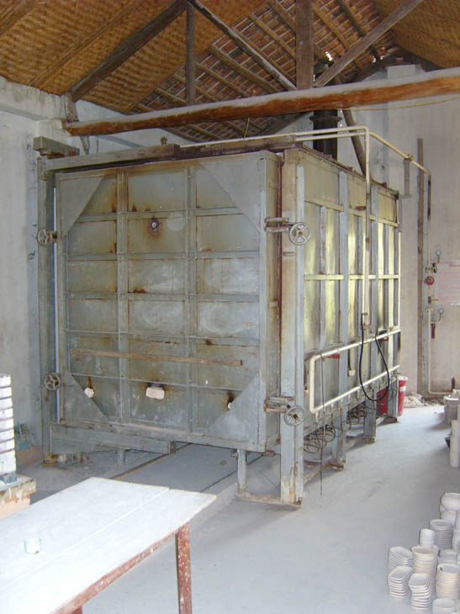
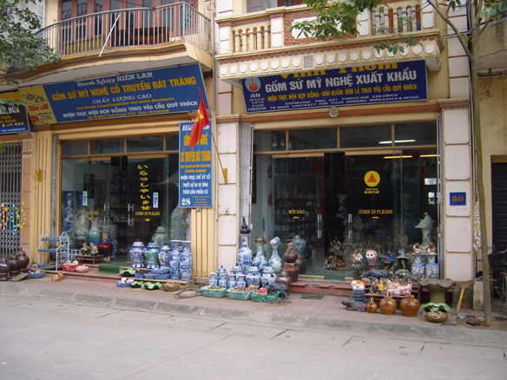
Case Bat Trang ceramics
Household business organized in collectivized system.
Environmental problems and new economic opportunities after Doi Moi.
Technology innovation, few innovators, broad group of followers.

Slide 9
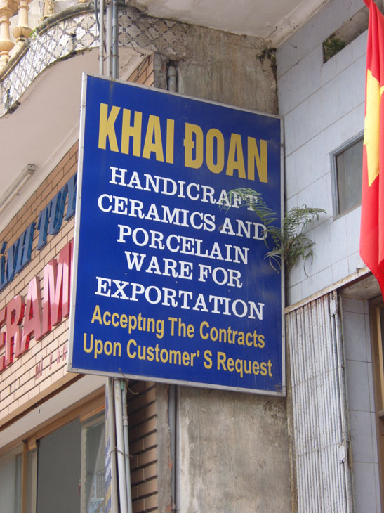
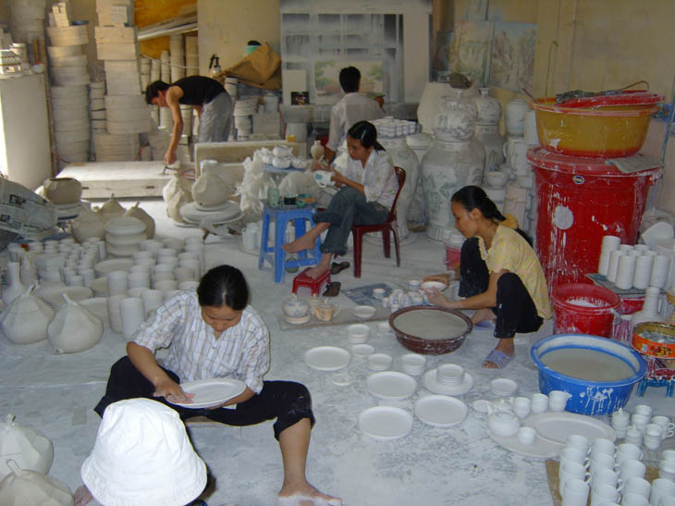
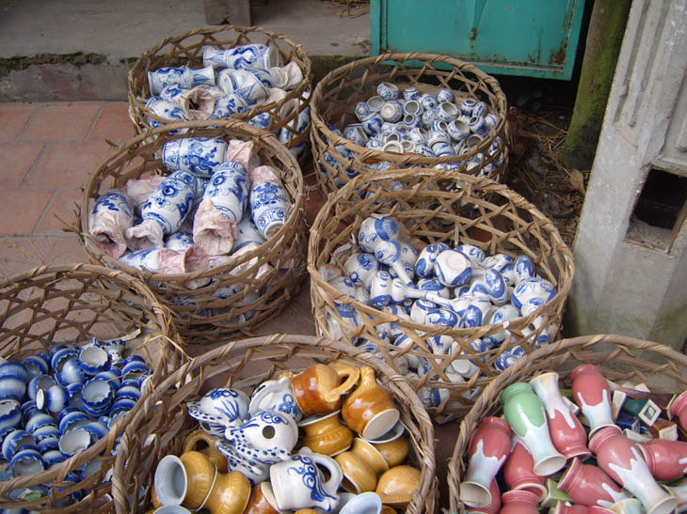
Bat Trang
60% of households switched to LPG technology.
All households do the same steps in production.
Cleaner air, more income for everybody.
Strong ceramics association, altruism.
New clients, tourists, export.

Slide 10
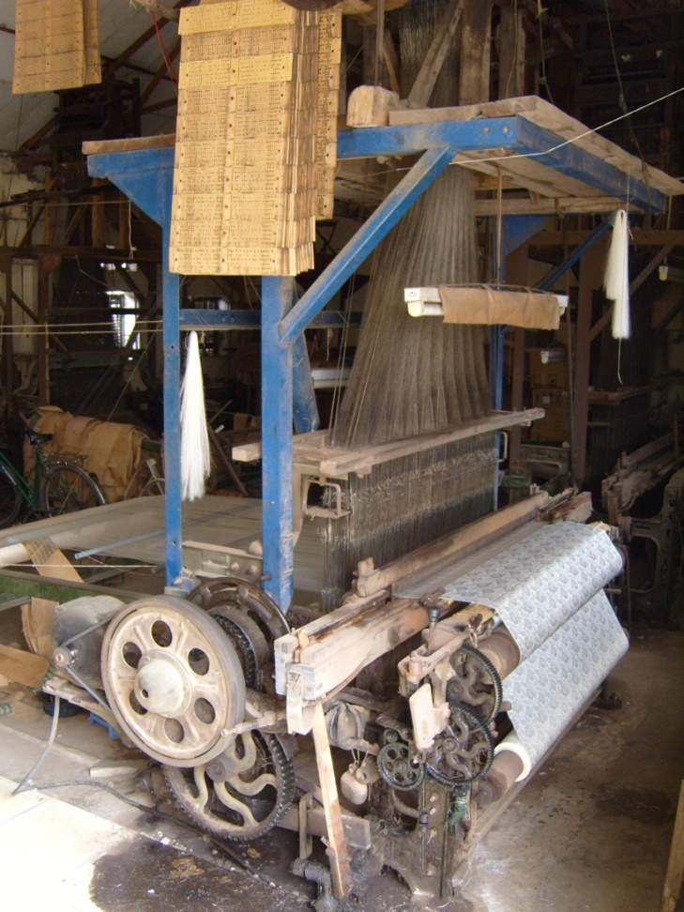
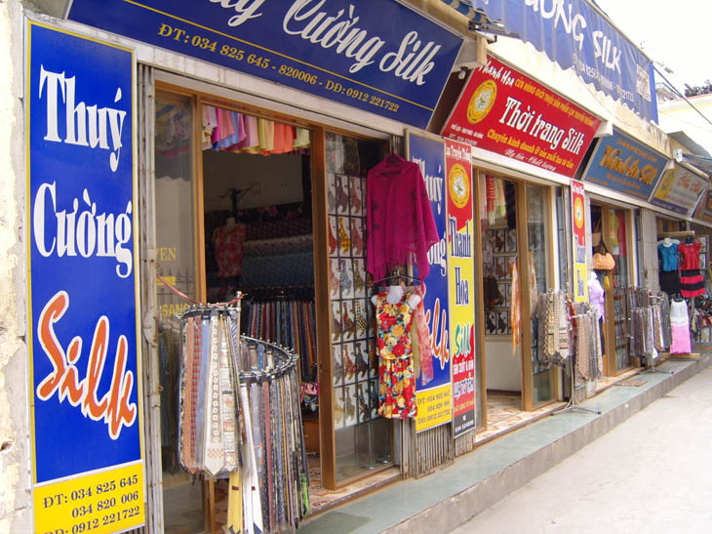
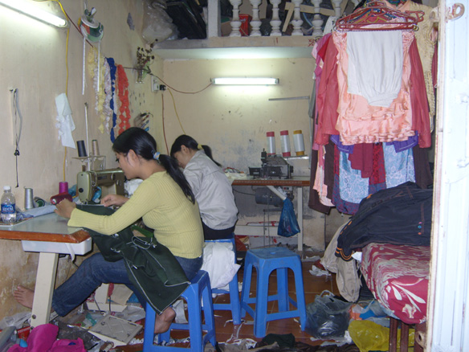
Case Van Phuc silk
State owned cooperative dissolved in 1980s.
Villagers established household business. according to the various VC functions, weavers, dye workshops, tailors, shops.
Shop-owners dominant players.

Slide 11
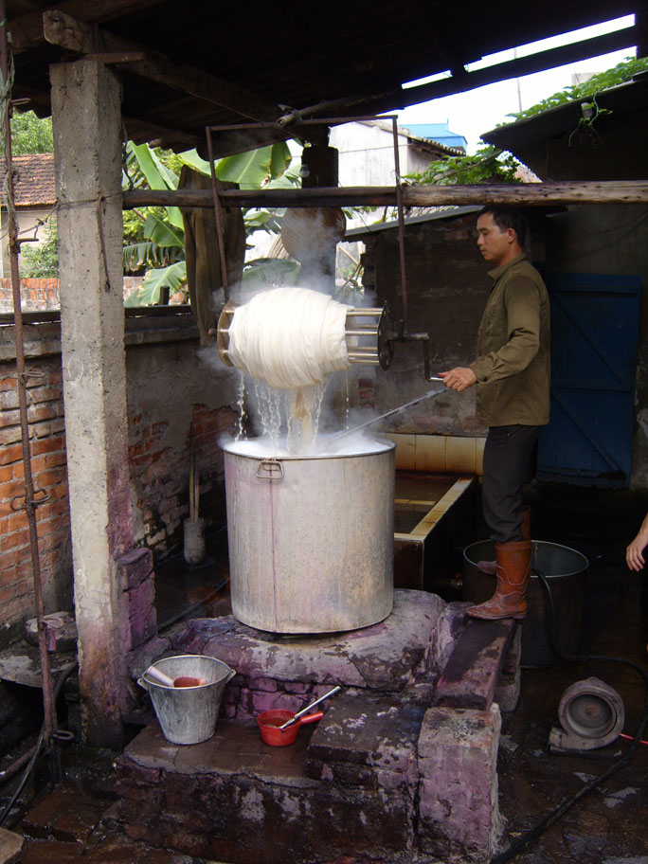
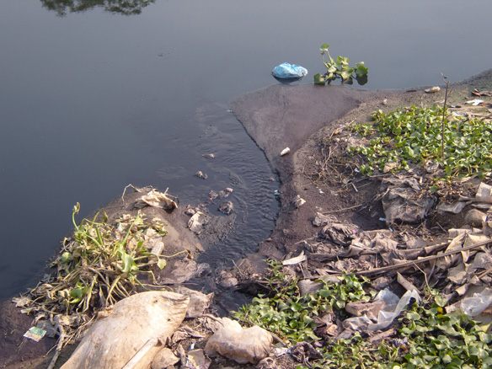
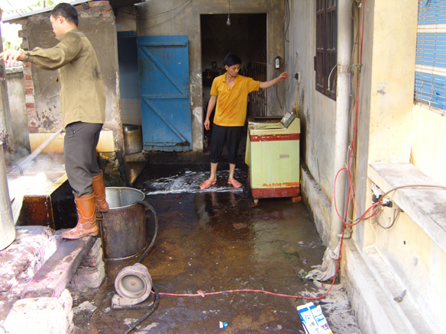
Case Van Phuc
New pollution problems, chemicals by dye workshops.
Show owners appropriate most value.
Other producers outside the village engaged
Frictions in the village. Opportunism.

Slide 12
Analysis - Similarities
Actor-networks have developed in both cases, could be framed by translation moments (!):
cases show the various translation moments;
on-going strings of translation moments;
in between translation: material outcomes of innovation (LPG technology, pollution, products) leading to subsequent translation.

Slide 13
Analysis – Differences in translation
Translation | Bat Trang | Van Phuc
Problematization (focal actors/OPP) | Broad group of producers | Small group of shop owners
Interessement | Few new relations - homogenous | Many new relations - specialization
Enrolment | Similar terms for all producers, existing institutions | A variety of new terms, new forms of actor engagement
Mobilization of allies | Association represents small producers | Small producers do not feel represented; they have no choice (!)

Slide 14
Interpretation
Through tracing the network creation, 2 types of innovation processes emerge:
homogeneous: few new relationship sorted out, joint sense of responsibility and ownership (responsible innovation), altruism;
specialization: more dynamics and better competitive position. Difficult innovation process, opportunism, no acknowledgement of responsibility, uneven distribution of value created

Slide 15
Reflections against theory
ANT translation analogy with innovation process (Dosi, 1988; Edquist 1997; Tether 2003), however, the innovation process in the cases is not projectified.
Innovation systems assume formal institutions (Lundvall 1992, Freeman 1995), in the cases informal institutions play dominant role. ANT shows an alternative: focus on interactions instead of organizations.
Social learning (Beers et al, 2010; Pahl-Wostl, 2006), double loop learning, interactive learning; further exploration
Allowing an actor relates to bounded rationality (Simon, 1957).
Conflicts (Mills, 1959; Glasl, 1999) in this setting are well explained with ANT. Opportunism (Williamson, 1986) and altruism are better understood with ANT

Slide 16
Conclusions
ANT reveals differences in the innovation process in informal institutional settings that we were not able to see with earlier methods.
However, further exploration into related theories/methods is necessary to exclude overlap
Shaper focused questions emerge with ANT:
Trade-off between competitiveness and responsible innovation?
Who decides on inclusion of actants (pollution for instance)?
Does specialization negatively impact the distribution of value within the actor network?
How to define innovation capacity from an ANT perspective?

