Slide 1
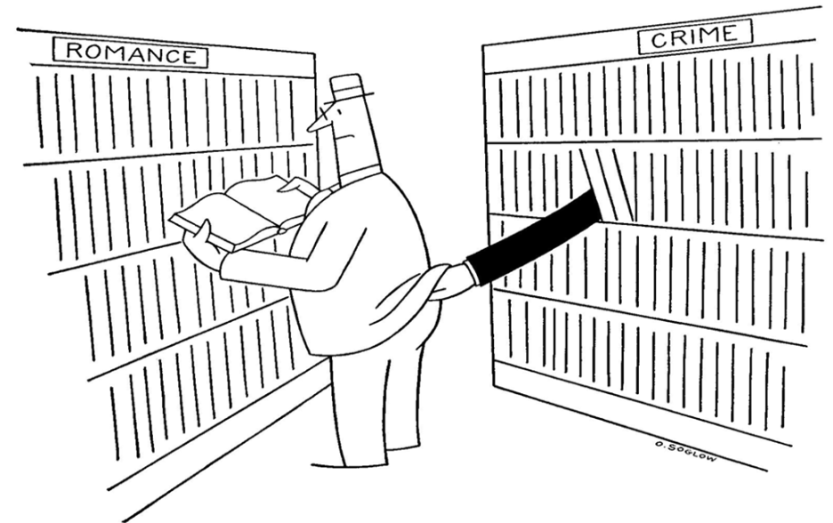

“There Should Be A Copy in the Library….” Innovative responses to traditional concerns about books
Ian Fishwick & Sarah Rayner
Notes:
Introduction
Even though student satisfaction rates re #16 “Are the Library resources sufficient for your needs?” currently stand at 93% (best rate in all of them!) always looking to addressing the perennial student lament of “not enough books on the shelves!” Accordingly offering snapshot of current library initiatives addressing the perennial student lament of “not enough books on the shelves!” Progress reports will cover Books Right Here (Right Now) the eBook pilots; Books on Demand (print; the mysteries of Patron-Driven Acquisition (ebooks) and we’ll end with some individual snaps and ask your thoughts….

Slide 2
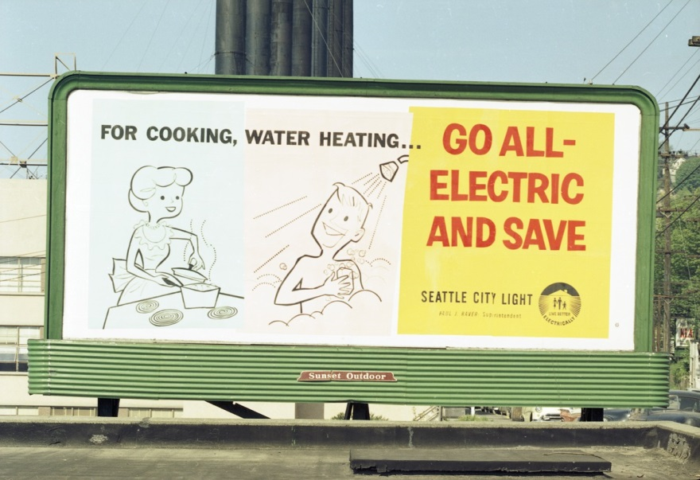

CONTENTS
Books Right Here
Books on Demand
Notes:
Overview of what we are going to cover
Not enough books in the Library? What are we doing to address this perennial issue?
Library strategy project – Books Right Here Right now - specifically reading list terminology, eBook pilots, and identification of core texts.
Books on demand –
Print on Demand service for students
Electronic PDA -

Slide 3
Books Right Here
solutions for improving access to core/key texts
Notes:
Overview of Books Right Here
Strategy project focusing on Books, improving access to core/essential texts – managing student expectations and improving their experience of accessing books via the Library.

Slide 4
Project outputs
New models for identifying core/key texts
A series of eBook pilots
New purchasing models for core texts
Standard terminology for recommended texts
New Library purchasing policy for recommended texts
Reading strategy
Notes:
Standard terminology for recommended texts – terms should mean the same thing regardless of which school, programme is using it.
New purchasing models – we are trying to get publishers to review and change their pricing models for key/core texts.
Reading strategy will bring all the project recommendations together and outline a collaborative way of working between the Library, lecturers and students to ensure clarity for students and realistic expectations in the provision of resources. that students know what they required to read what format it should be provided in, what they and how to access.

Slide 5
ANTICIPATED PROJECT BENEFITS
1
Better value for money
2
Improved and more equitable student experience
3
4
Improved student feedback
Enhanced teaching & learning experience; students read more?
Notes:
(1) institutional approach to purchasing core texts we can improve our purchasing power and save the University time and money on e-book deals.
(2) Providing core texts as eBooks ensures an equitable experience for Distance learning students. And across programmes in general. Otherwise you have a situation whereby one programme has access to an e-book but another programme who uses the same text do not.
(3)This point is a little contentious. Publishers providing interactive eBooks say that they can be integrated into teaching and accessing books in this way will encourage students to read. We’ll be trying to assess this as part of the ebook pilots...
From the tutors perspective, they can have access to their own copy and direct students to certain chapters. Analytics also allow us to see how many students are actually accessing and reading the books!
(4)From analysis of the last 2 years NSS open comments, we still see significant frequencies of comments around – ‘not enough books in the library’. We will continue to monitor improvement.

Slide 6

What are students saying about
Library books?
Notes:
Market research looking at user perceptions of the Library services. Plus feedback gathered by the AE team
Two substantial pieces with over 2,000 responses. Methods included quantitative survey, ethnographic observations and interviews, focus groups and interviews.
Giving us a statistically significant bank of information to draw upon.
One piece of research looked at students’ perceptions of Library services; the other focused specifically on the digital environment and also included academics.
How are students reading?
When asked questions about the way they read, most students stated that they read a mix of electronic and hard copies with the overall preference leaning towards electronic – eBook pilots will test this.

Slide 7
Our students said
They want to know what is being recommended and to be able to access [it] easily.
Notes:
Students are reporting that they would like a clearer steer on which reading is compulsory and which is only
Recommended.
The Library also finds it difficult to get the number of copies right if we do not know if the book is an ESSENTIAL book that all students MUST read or a SUGGESTED book that they should read if they have time.

Slide 8
Our students think
ALL of the books on their READING LIST should be available in the LIBRARY
Notes:
We get comments via various channels every year including the NSS reporting that there are ‘not enough books in the library’
And out of the 1,446 students who took part in our survey and focus groups, 91% strongly agreed with this statement.
So, students are saying that we don’t have enough books in the Library BECAUSE they have the perception that we should provide ALL the books on their reading list.
Plus This is an issue of managing student expectations… if the majority of students think that all of the books on their reading list should be in the Library and they come to the library and do not find the books or cannot get hold of them then they will have a negative experience.

Slide 9
University policy
‘Core readings should be made accessible to students via the Library, either digitally or for Loan’
Notes:
This is what the additional costs policy states and was written in response to the students union hidden costs campaign.
Hidden costs include printing, photocopying, lab coats and books etc.
where additional costs are required then information on these costs must be provided to students, in writing, in advance of the start of the programme and in the programme handbook. In such cases Schools should endeavor to make a low cost or free option available. Low cost is no more than 1% of the annual home UG fee

Slide 10
only 46% of students
Were happy to PURCHASE books for their course
Notes:
Hidden costs policy was supported by the survey responses – only 46% of respondents were happy to purchase books for their course

Slide 11
Over 90% of students said
‘…the Library should make an electronic
copy of core course reading available for
all students.’
Notes:
Over 90% of students who took part in our research indicted that they thought the library should provide them with access however they also reported that…
Whilst the debate is still ongoing in relation to preference for print or ebooks, students are recognising that ebooks are the best way of providing access to lots of students for books that are in high demand.

Slide 12
They also said
‘I think the idea [of e-books] is great it’s just that some of them are more
user-friendly than others.’
Notes:
However, users also expressed frustration that e-books accessed via the library didn’t have the functionality and advantages that they perceived e-books as offering In general:
Frustration with lack of editing and highlighting, not being able to print, and problems with accessing.
The new types of eBooks should go some way to address these issues.

Slide 13

Books Right Here
EBOOK PILOTS
Notes:
One of the in elements of our core text strategy project is to investigate alternative ways of providing e-book texts to our students. We are doing this by running a series of eBook pilots across the University.
The established models of electronic core text provision do not meet the needs of our students and teaching colleagues or the ambitions of the library service.
Test new eBooks and their functionality – do students like them? Or will they still state that they prefer print?
Do lectures like using them? Does it help to integrate the books into teaching? We will be interviewing all the academics involved in the pilots in order to find out if they saw any benefits.
To explore new ways of delivering core texts we have instigated a number of pilot projects for the academic year 2014-15 with the following guiding principles:
Every student must have an individual copy of the e-book for the duration of their module, with no restrictions on usage during this period
These titles must be seamlessly accessible via Blackboard (our virtual learning environment platform)
Acquisition of and payment for these titles must be based on actual usage, not notional student numbers
Titles must be available for download onto personal devices
We also intend to fulfil the following ambitions:
To involve a wide range of disciplines in the pilot projects (moving beyond the traditional business and health science subjects)
To collect meaningful quantitative and qualitative data and user feedback that will allow us to draw firm conclusions about usage and value for money

Slide 14
How many?
12 pilots with 3,000 students semester 1
8 pilots confirmed for semester 2
Notes:
Providing access to core/key recommended texts as eBooks via blackboard to over 3,000 students across 12 modules in semester one
More pilots in semester 2.
The pilots are running across FLS, Pharmacy, Psychology, French, Law, Chemical Engineering, Geography, German, Materials, MBS and SEED.
4 X Pearson titles, 5 X Cengage, 2 X Taylor & Francis and 1 X Palgrave across all four Faculties

Slide 15
Semeseter one pilots
BIOL10521 Genes, Evolution and Development
BIOL10811 Body Systems
CHEN10041 Chemical Engineering Design 1
CHEN10102 Chemical Engineering Design 2
LAWS10200 Obligations 1
FREN30210 French Language and Life III
GEOG10251 Understanding Human Geography
LAWS10300 Criminal Law
MATS21041 Strategic Management
BMAN31610 Corporate Financial Communication and valuation
PSYC10311 Lifespan and Aging
EDUC20221 Marketing and Consumers
GERM10100 Beginners German Language Skills
Notes:
Good selection of pilots across humanities subjects.

Slide 16
How?
Seamless access via Blackboard
Download and sync across devices
Highlight/make notes & share
Notes:
How does it work?
Each student gets access to their own copy of the books for the duration of the course
An easy to access ebook
Sign up and use online – just to read
Can also access via various devices – can sync across up to 4 including a Kindle Fire model and any beyond (not original Kindle)
Downloading enables you to be able to annotate, highlight text, make margin notes etc as you go along
Downloading also enables collaborative learning: you can share annotations etc with others in your class and the lecturer can share annotations or notes too of required

Slide 17
Usage
73% of the titles have been redeemed
OR
2,209 students out of 3,020 have redeemed their book
Notes:
We have access to raw usage data via the Vital source platform so we can see how many students have actually redeemed the book, how many have gone in more than once, page views etc. This means we can actually see how many students out of a whole programme or module are reading or looking at) the recommended text!
At this juncture the data we get does not show us which student but Vital Source will be launching their analytics dashboard month and this will mean that we can get more granular data – if we decide as an institution that we think it is appropriate to do so.
i.e. You would be able to see which students have not accessed the reading and it may help flag up problems at an early stage.
This means that 2,209 students have redeemed the code and accessed the book once. It doesn’t mean they have read it though!

Slide 18
Usage
68% of the titles have been used more than once
OR
2,074 students out of 3,020 have actually read [some of] the book
Notes:
This means that 2,074 students have gone into the book at least once – still doesn’t mean they have read it

Slide 19
Notes:
This chart is showing usage to date for each title as a percentage of the cohort size – blue is EPS, Red is FLS, purple is Humanities & green is MHS. The law, FLS and EPS titles have the highest usage and this is as expected. The two SALC titles with low usage are for the full year and not really CORE texts as such so we would expect students to dip in and out of them over the year.

Slide 20
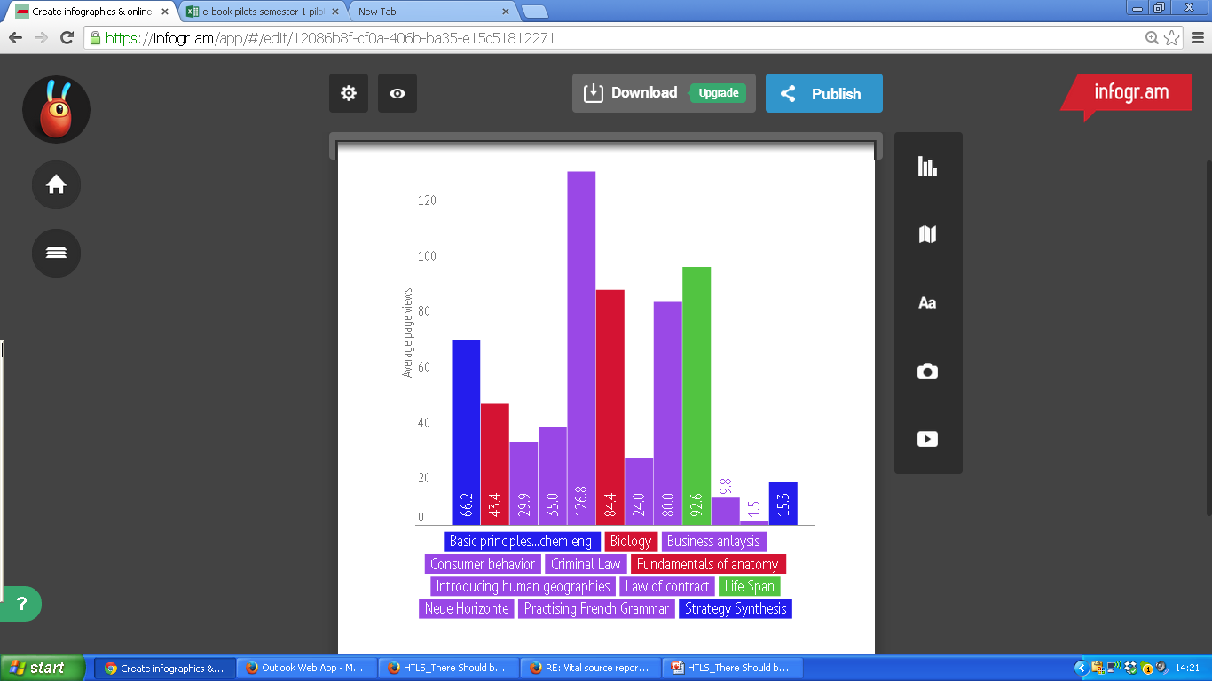
Average page views
Notes:
This is how many pages each student has viewed on average for each title.
Again, the criminal law text is getting the most usage on average, with each student viewing an average of 126 pages. The psychology text, law of contract and the anatomy text also have a lot of page views.

Slide 21
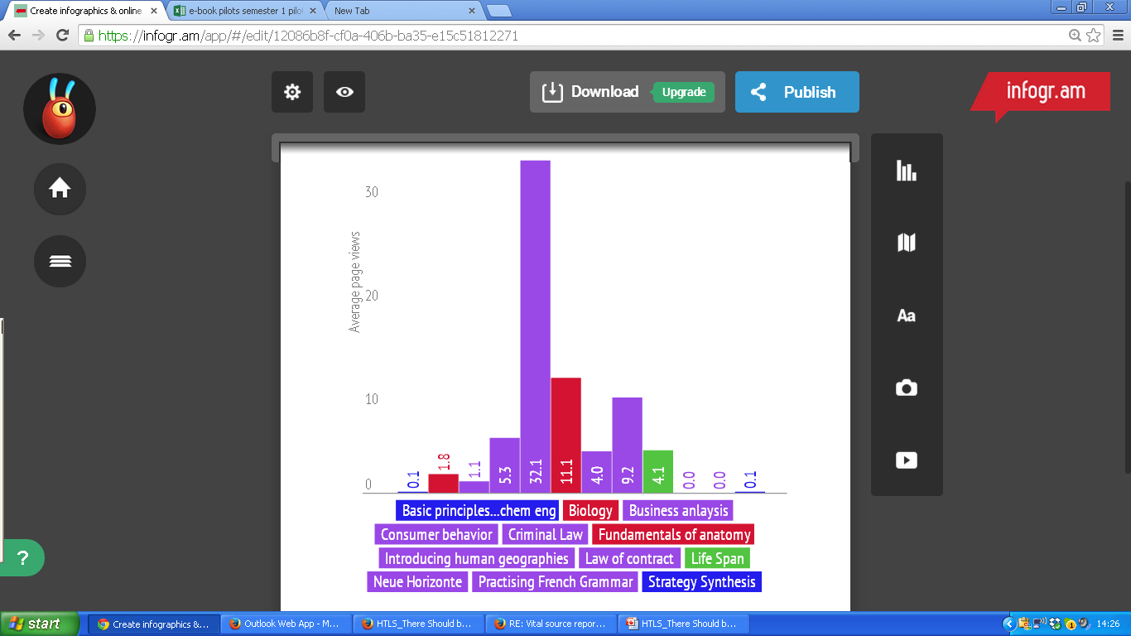
Average highlights created
Notes:
A key feature of these eBooks is the highlighting and notes features. Students consistently report that they would find this feature useful – however currently this is not being borne out n the usage stats.
Student using the criminal law text are making most use of the highlight feature. If you compare with the other law text and the FLS texts –they have more students using the ebooks but less highlights.
Criminal law text – students making an average of 32 highlights.

Slide 22
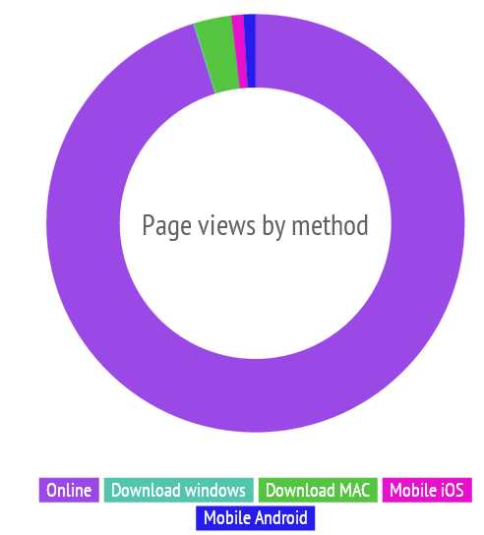
Page views by method/device
Notes:
This last one is showing how the students are reading the eBook – which device are they using?
The ability to download to multiple devices and read offline is a real selling point for these eBooks – however as things stand the vast majority of students (93%) are accessing the books online (via the Vital source platform)

Slide 23
Evaluation
Students’ experiences of using the eBooks
Notes:
But of course, statistics do not tell us the whole story. We can look at what is being used but we do not know why some texts are being used more than others. We have designed a survey that is being circulated by the lecturers to all students taking part in eBook pilots. We’ve got a pretty good response rate so far but have not started analysing the responses yet as we need to wait for them all to come back in... And our data analyst has got a new job!
The AE team will also be conducting short interviews with all the academics involved in the pilots in order to evaluate their experiences and views.
We’ll be looking at the students awareness, usage and general thoughts about these eBooks.
We’ll be asking a series of questions including:
If they read the book? If not why not?
How did they access, what did they think of the features such as highlighting.
Most importantly, we are trying to assess the experience of reading eBooks –
Did they print pages off? If so why?
Did they still borrow or purchase the print copy? If so, why? If they read both, which format did they read more.
This info will help inform whether we continue to provide eBooks in this way and feedback to the publishers what it is studetns like or dislike about eBooks

Slide 24
Books On Demand
Patron driven acquisition of Library books
Notes:
What is Books on demand?
What is Patron driven acquisition?

Slide 25

Books On Demand
PRINT
Notes:
What is it?

Slide 26

Books on Demand
Finite fund
Price cap (£100)
Has to be in print
Limited to 5 requests per person
Number of copies we purchase may be limited
Notes:
80K fund (if pushed)

Slide 27
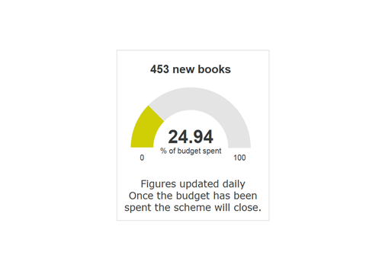

Work in Progress…
Notes:
Started Nov ‘14

Slide 28
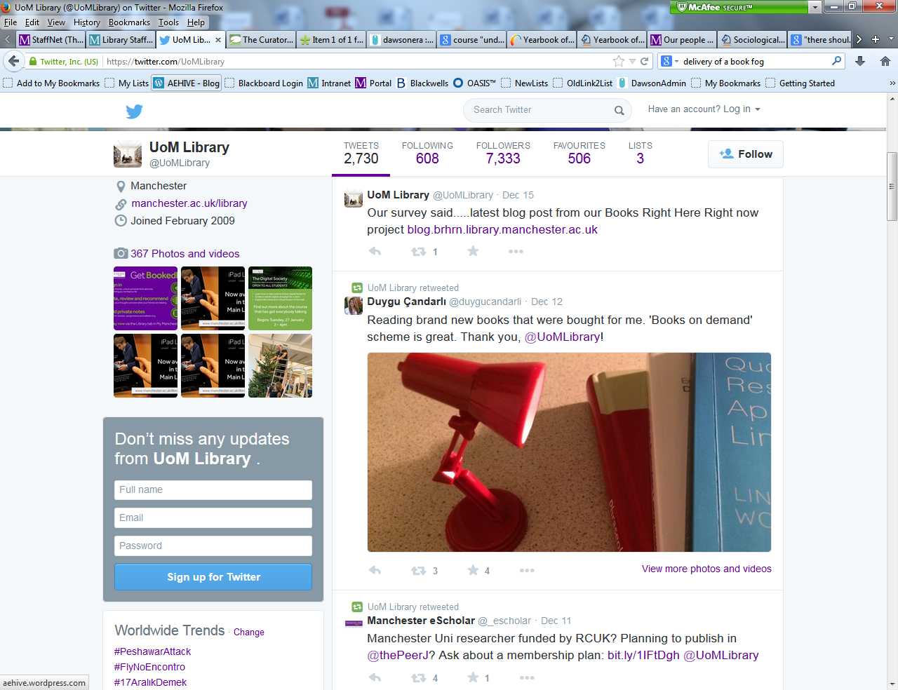
Work in progress
Notes:
One of the desired outcomes

Slide 29
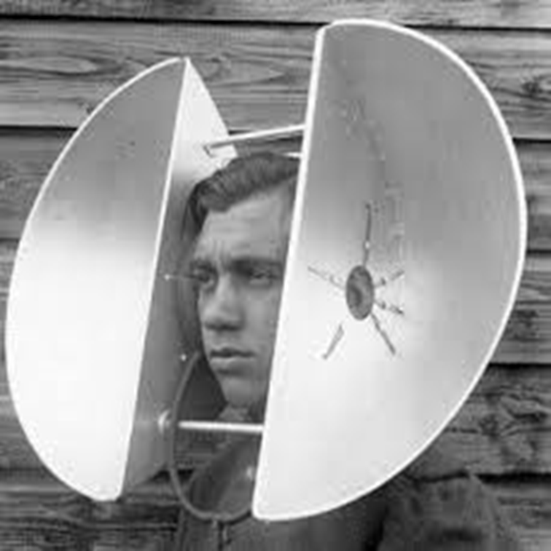
Desired Outcomes…
Students more involved in the conversation
Get what they want
Analysis of requests by user type, discipline and rationale offered to help inform future decision-making.
Any subsequent schemes, repeat or otherwise, will therefore be evidence-based.

Slide 30

Books On Demand
EBOOKS
Notes:
What is

Slide 31
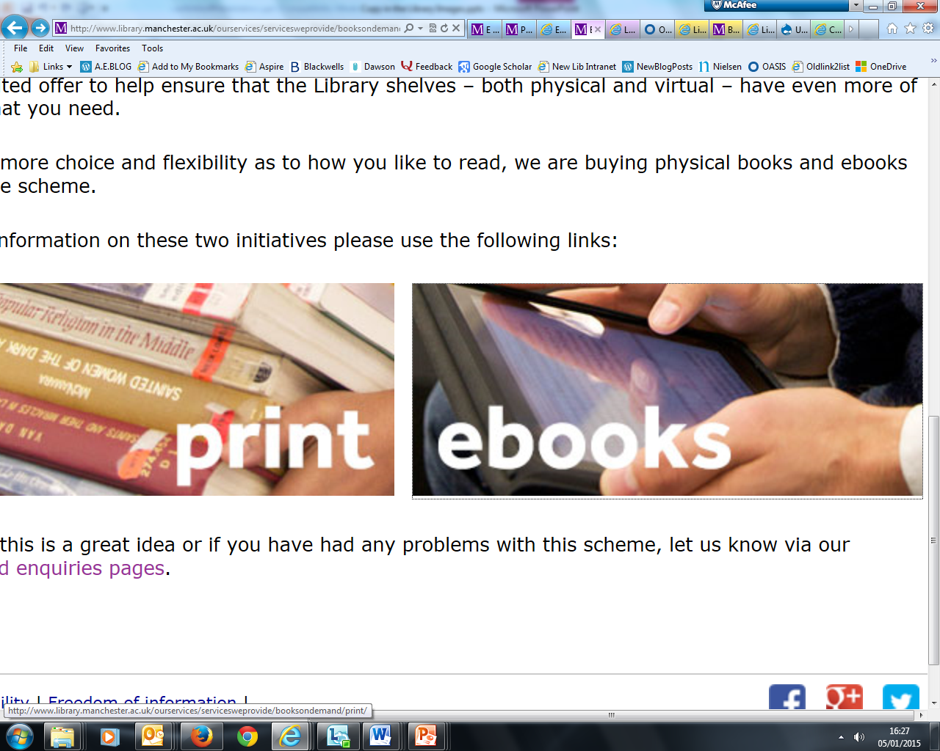
Books on Demand
First cycle
Evaluation to select aggregator – Dawson.
14,000 potential titles
Profiled against subjects with low
NSS scores.

Slide 32
Books on Demand
Second Round
Same supplier - broader range – 20,000 potential titles
Set Readership level: technical, postgrad or undergrad.
Date range – Post 2010
Exclusion of owned e-content
Maximum price (£150)
Further exclusions on publishers we found unsatisfactory
and keywords (e.g. ‘A-level, AQA, Beginner’s guide,
Revision guide, Teach Yourself etc ….’)

Slide 33
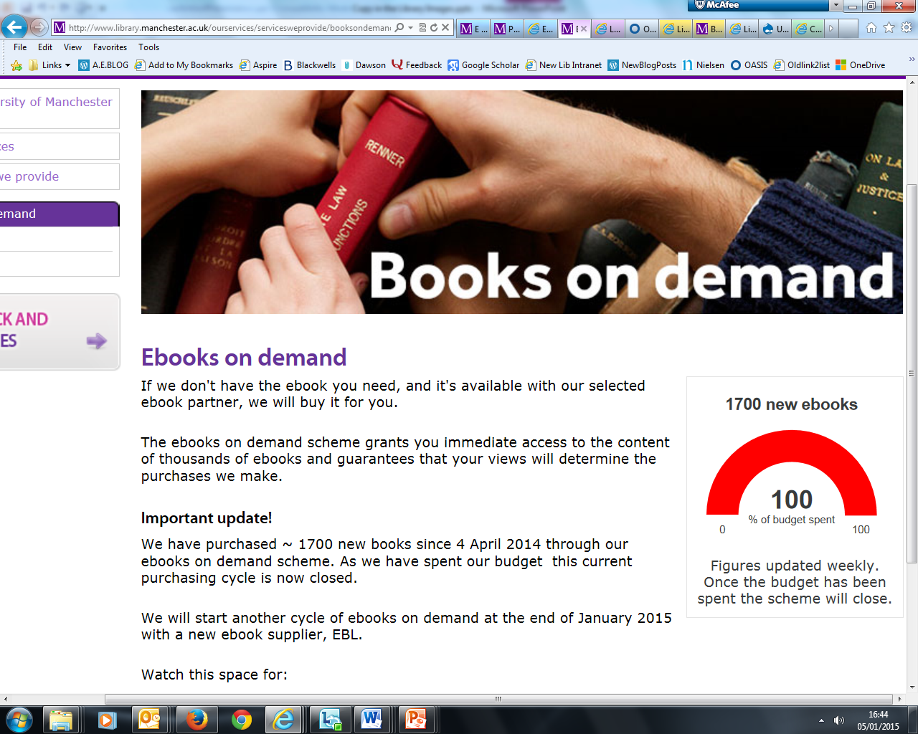
Recently Concluded
Notes:
100K fund (if pushed) – ran from March – Dec 2014

Slide 34

Outcomes…
Seamless access to additional electronic reserves (no complaints) – inc preview material not purchased.
Purchased material used twice as often as discipline-based ebooks purchased conventionally.
Work beginning on analysis of material purchased.
Notes:
Difficult to assess as “hiding in plain sight’ – hiding books in a library ….

Slide 35
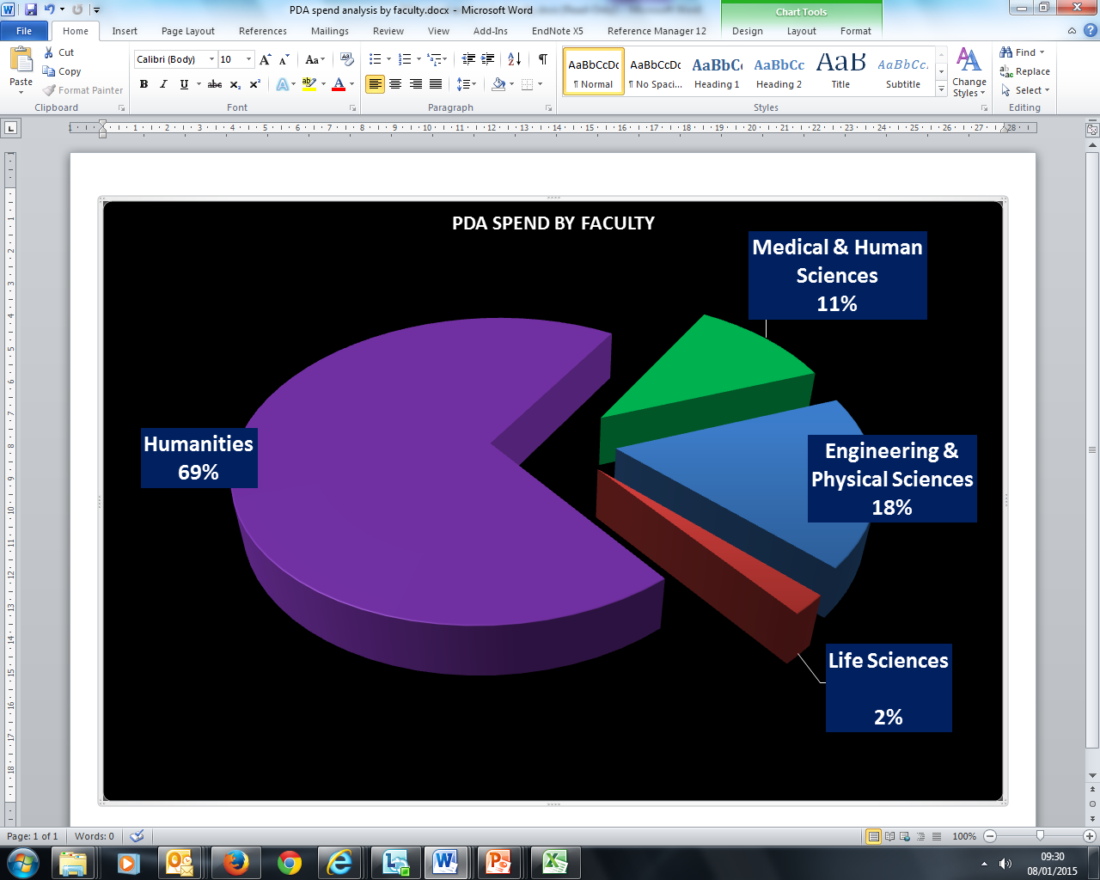
Notes:
Plus side – you can where the spend has come from!

Slide 36

Outcomes for next round….
New supplier – EBL
More bespoke requirements – different dates re currency.
Longer preview times to view without buying
Promise of better managerial information
Notes:
– so new limits will be post 2012 but for law and medicine post 2013 and post for 2014 for IT. Demonstrated commitment to this by walking away…

Slide 37
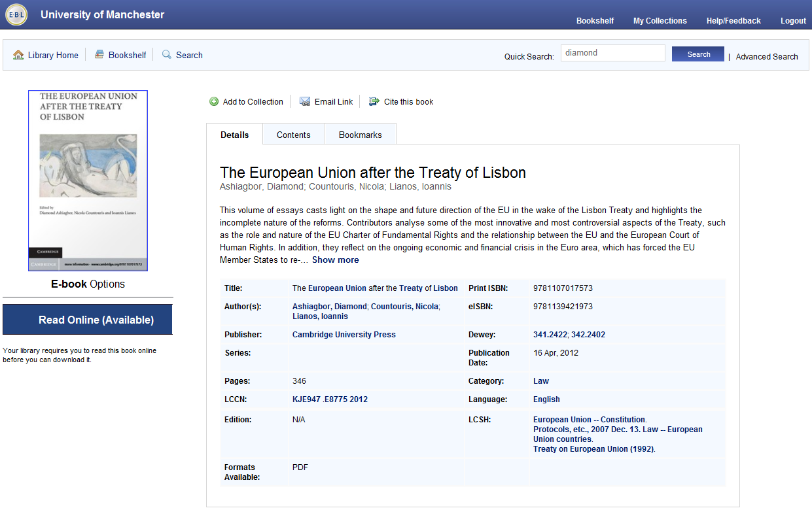

Slide 38

Down to the pips…
Possible review of emerging (identifiable) themes in relation to futureproofing
Looking at doing the same with eScholar
Reapplication elsewhere - Collection Development Profiling

Slide 39
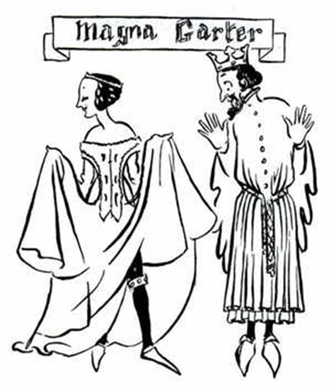
In the spirit of ‘1066 and All That’
Treaty of Versailles …
Led to “a great many more countries: this was a Bad Thing as it was the cause of increased geography”

Slide 40

Good Thing, Bad Thing…
Notes:
3 of these ordered…..!

Slide 41
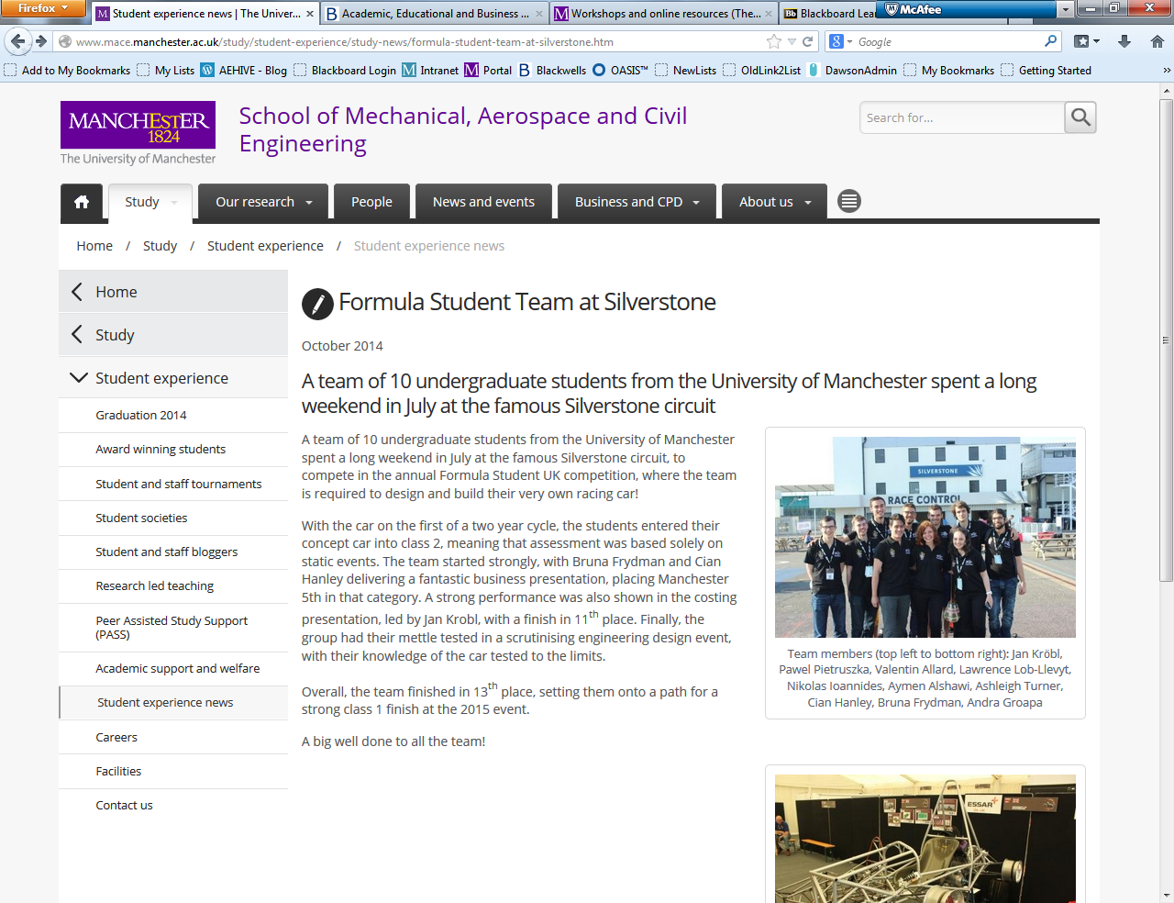
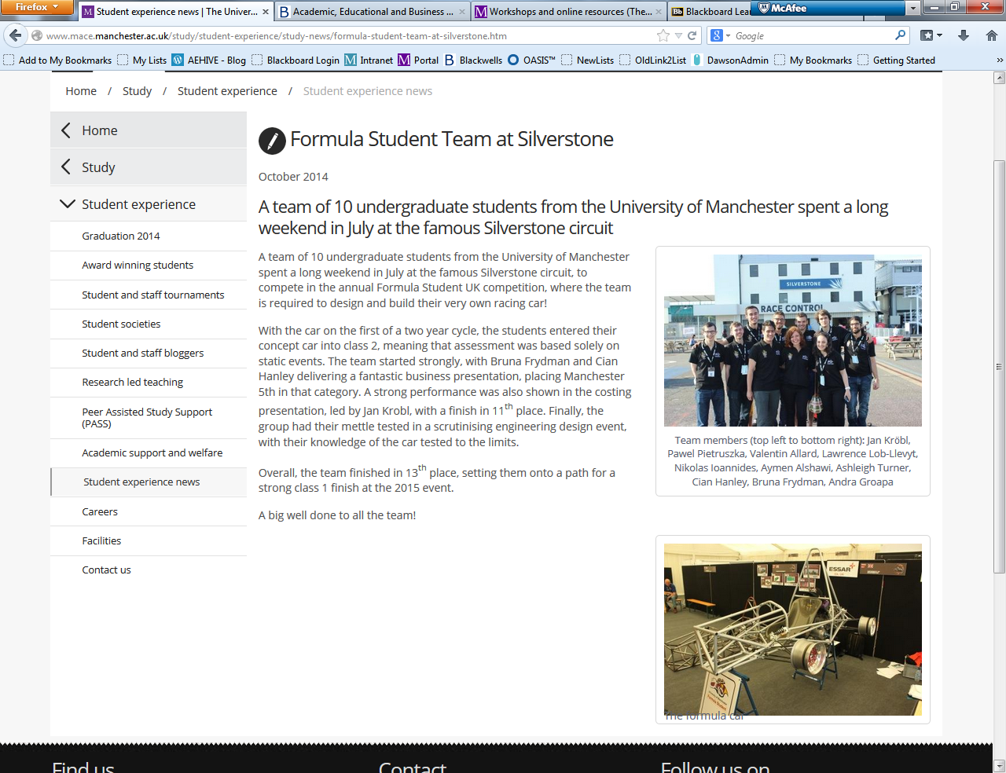
Notes:
Also set up investigation into eboook acquisition if more than 3 requests….

Slide 42
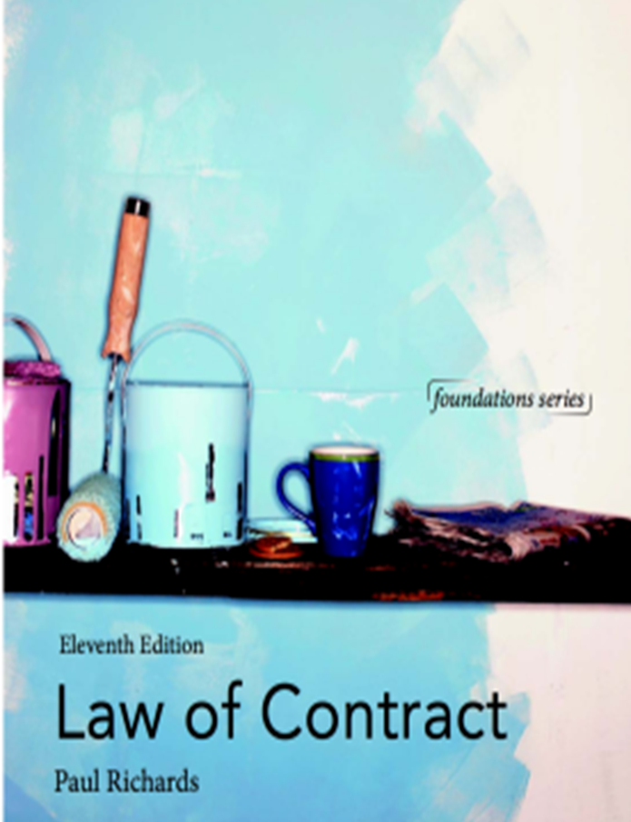
Good Thing, Bad Thing…
Notes:
Another print book…

Slide 43

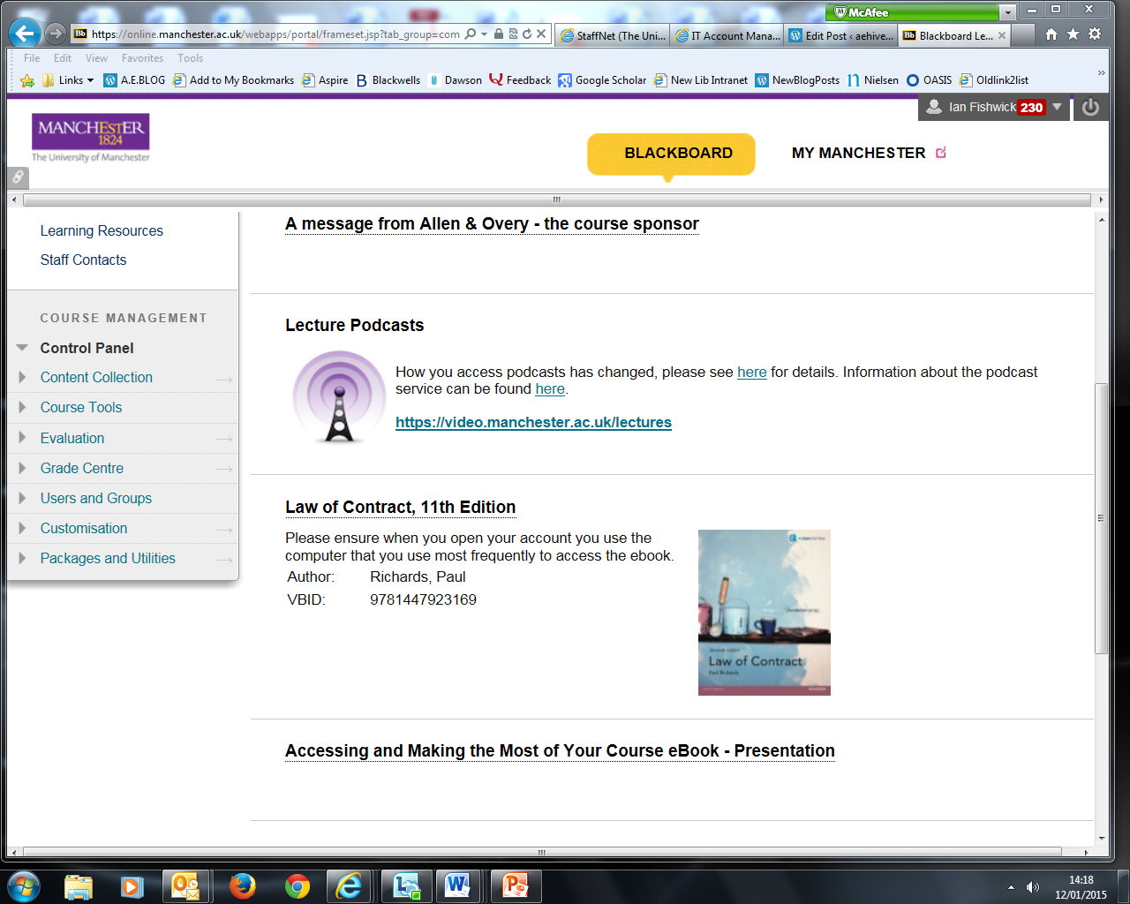
Notes:
One of the eBook pilots

Slide 44
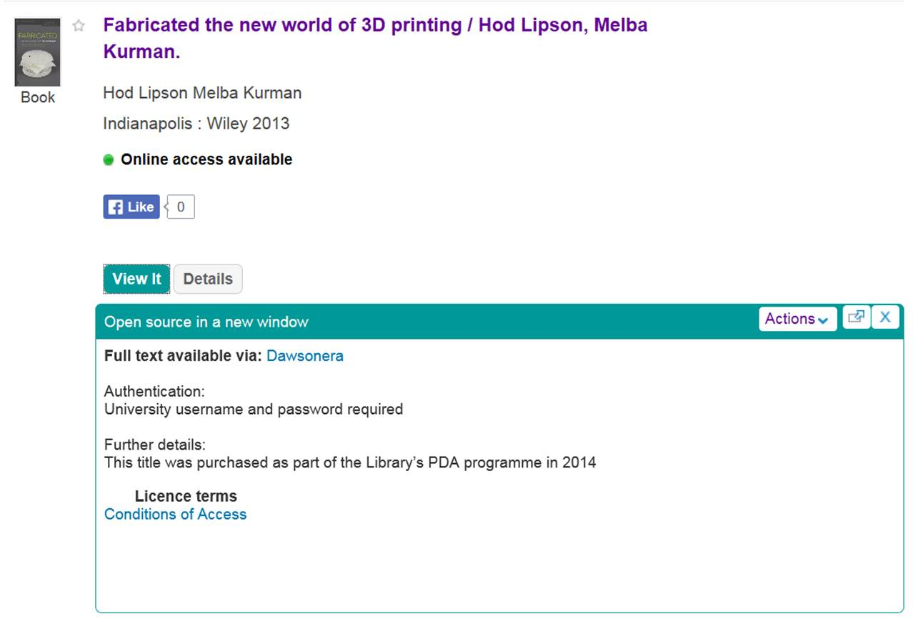
Good Thing, Bad Thing...
Notes:
New area – interdisciplinary – digilab oproject

Slide 45
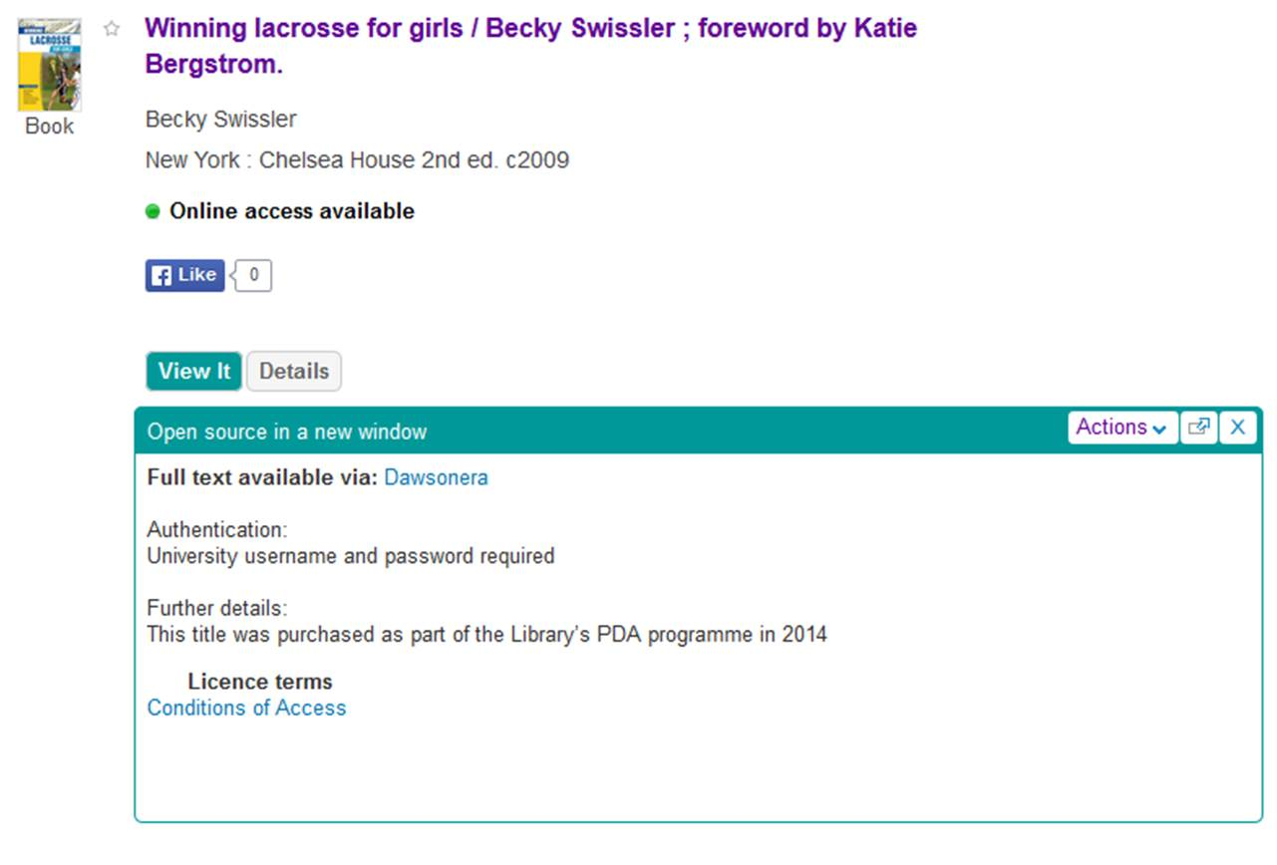
Good Thing, Bad Thing...
Notes:
Thru the net?

Slide 46
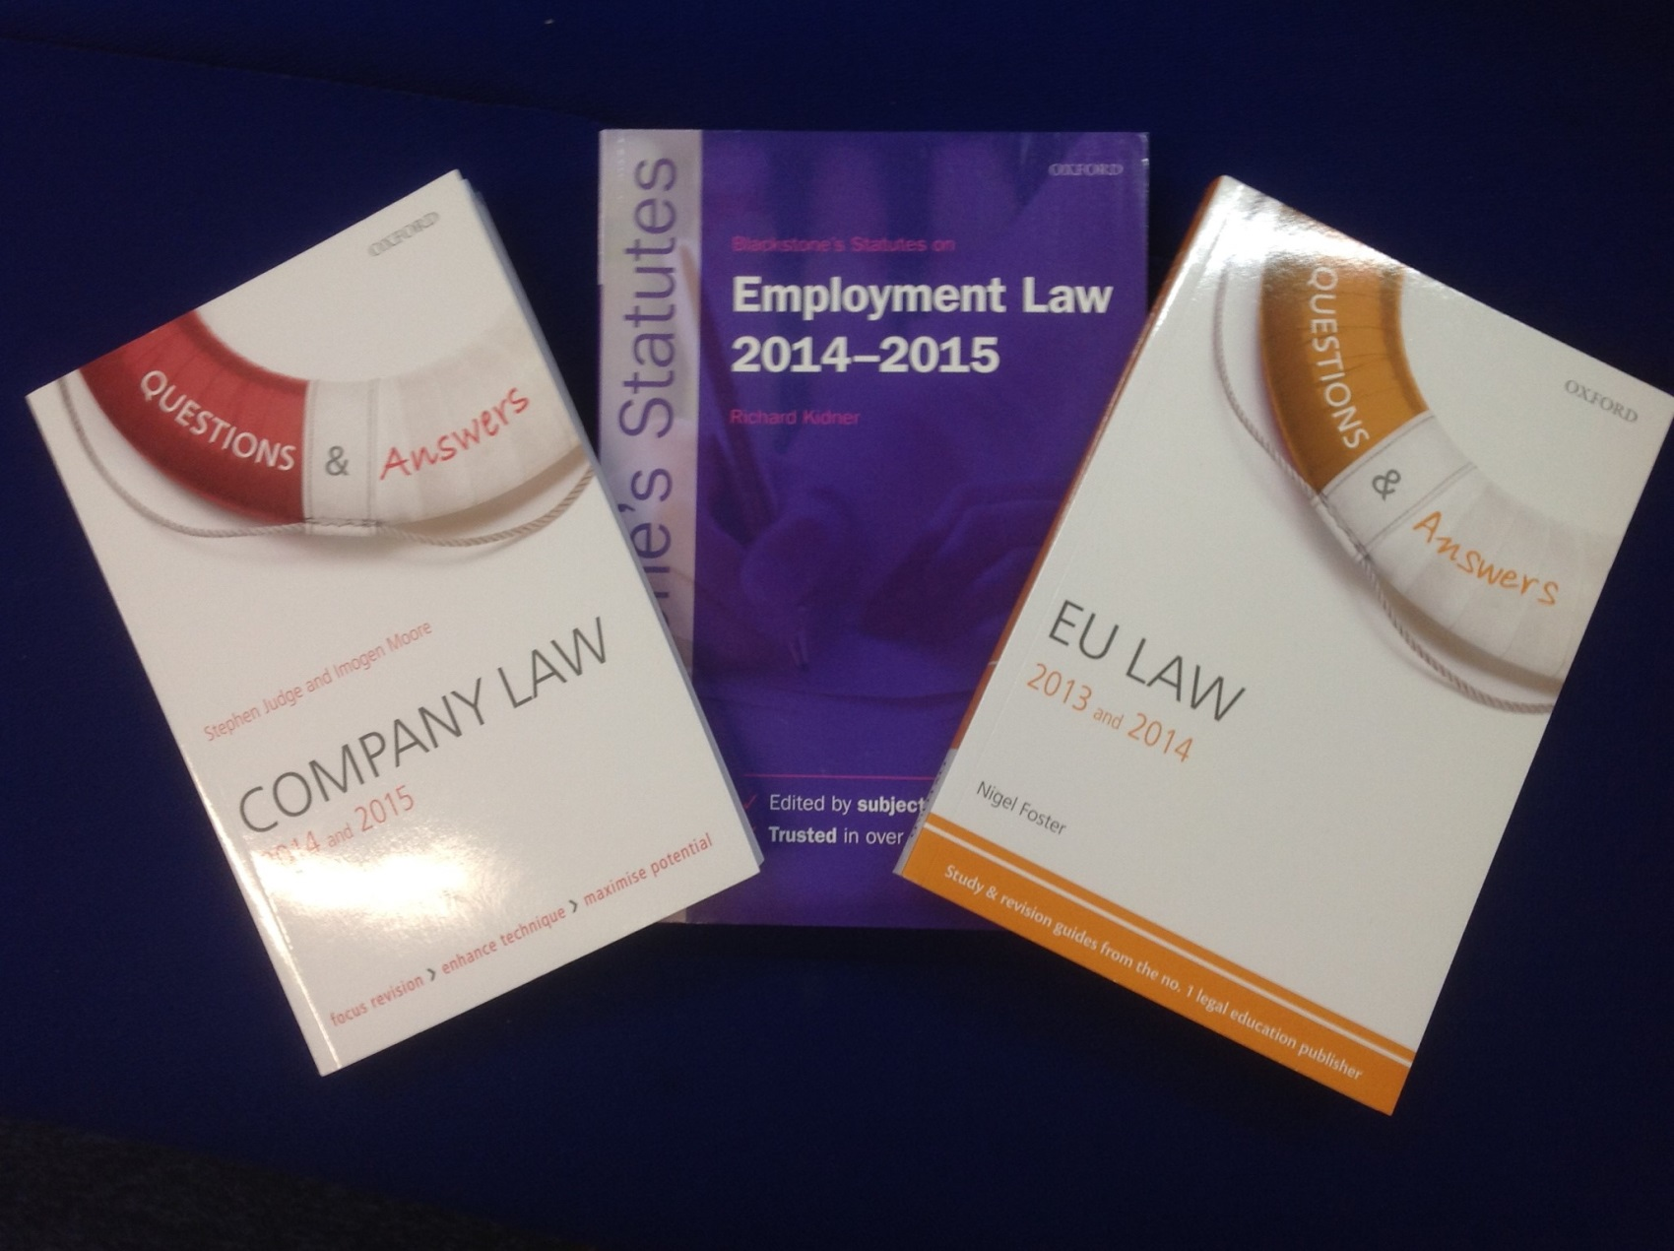
Good Thing, Bad Thing...
Notes:
Compare with restrictions in terms we set up re revision texts……

Slide 47
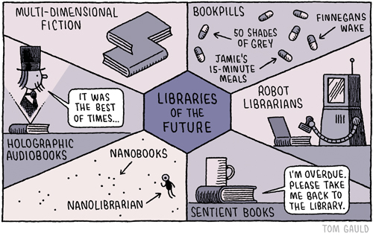
Mixed model...
Notes:
Clear best result is a mixed model – drawing upon your expertise and ours and not excluding students from the conversation….

Slide 48
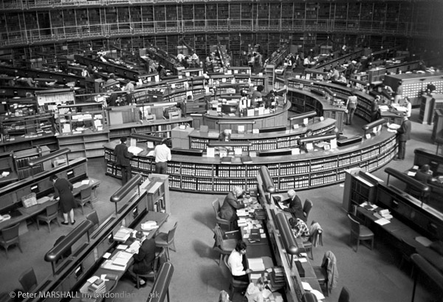
Things are improving…
“During the autumn and winter the delivery of a book is not infrequently hindered by darkness or fog”
- A Guide to the Use of the Reading Room (1924)

