Slide 1
Stay tuned: supporting teaching with television and radio broadcasts
Anna Goatman
Manchester Business School
anna.goatman@mbs.ac.uk

Slide 2
Background
Teaching Fellow in Marketing
Co-ordinate a range of undergraduate courses (levels 1, 2 and 3).
Course | level | Number of students
Business and Management Skills | Level 1 | 485
Marketing Foundations and Applications | Level 2 | 309
Retail Marketing | Level 3 | 176
Services Marketing | Level 3 | 201

Slide 3
The Challenges
Explaining business/ marketing concepts in lectures
Designing seminars where students can apply what they have learned
Keeping large classes engaged
Providing extra ‘value’ through Blackboard

Slide 4
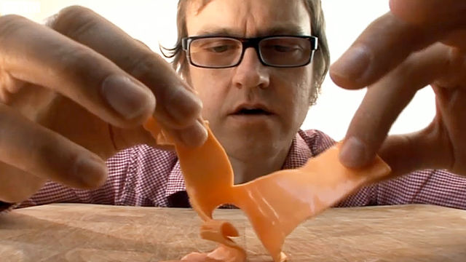
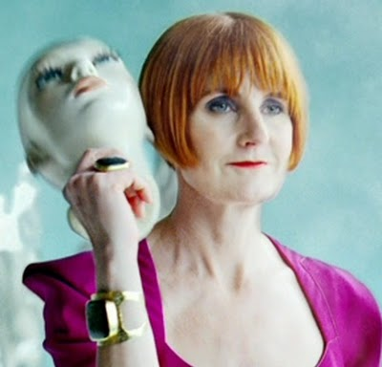
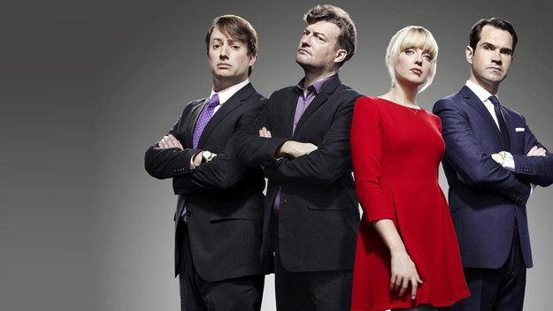
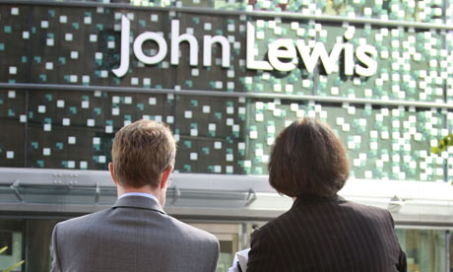
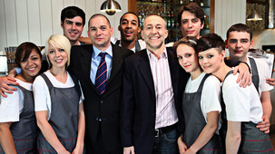
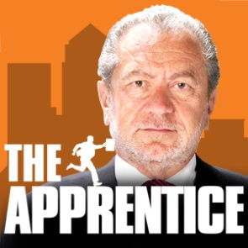
Some Solutions
Using short clips from a BBC Radio 4 ‘In business’ programme to stimulate discussion in a seminar.
Using an episode of ‘Britain’s really disgusting foods’ as the basis for a seminar on the ethical issues surrounding marketing.
Using episodes of ‘Mary Portas Secret Shopper’ to support a services related coursework task.
Using a clip about MOSAIC from BBC documentary ‘A history of Now’ to explain geodemographic market segmentation
Using clips from ‘10 O’clock Live’ to promote discussion relating to government cuts
Embedding ‘Inside John Lewis’ in Blackboard to encourage students to think about retail management issues
Using examples from ‘Michel Roux’s Service’ to explore the importance of customer service
Using clips from ‘BBC Breakfast’ to explain the proposed NHS reforms
Embedding ‘The Apprentice’ in Blackboard. To encourage students to check Blackboard regularly

Slide 5
Sources of Material
Box of Broadcasts (BoB)
Full programmes
Searchable database of broadcasts
Tool to make clips
Video Library Service
Material recorded from the television on DVD or VHS can be added to this database
YouTube
BBC Website
Often contains video and radio clips/ interviews

Slide 6
Benefits of using TV and Radio
Encourages students to think about the application and implications of what they are taught.
Engages students in the teaching process
They make suggestions/ send links
Useful for building relationships with graduate teaching assistants.
Receives positive feedback from students.
Helps make lectures and seminars more engaging.
Helps build a link between lectures, seminars and Blackboard.
Helps keep courses up-to-date.

Slide 7
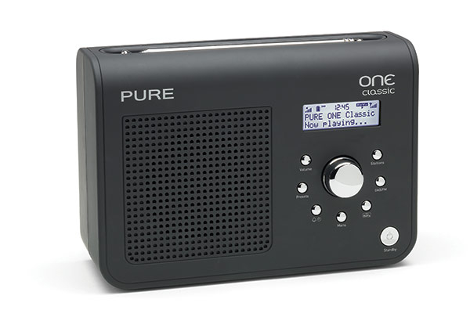
Any
questions?
Anna Goatman
Manchester Business School
anna.goatman@mbs.ac.uk

