Slide 1
Embedding quantitative methods in the undergraduate curriculum Pilots in Sociology and Politics
Mark Brown, University of Manchester

Slide 2
Curriculum Innovation (CI) Teaching quantitative methods in disciplinary context: integrating quantitative method and evidence into the Social Science undergraduate curriculum
Researcher Development Initiative (RDI)
Patterns in Politics & Society: Promoting the Enrichment of Undergraduate Teaching with Quantitative Methods
Mark Brown; Wendy Olsen; Stephanie Thomson;
Tarani Chandola; Ian Plewis; Jackie Carter; Jo Wathan
Andrew Russell; Brian Heaphy

Slide 3
QM Disconnected
Substantive Modules
Methods Modules

Slide 4
Embedding Quants
Teaching Partnerships (7 modules)
The Sociology of Personal Life
Race and Ethnicity in the UK
The Sociology of Spiritual Life
Power and Protest
Intro to Comparative Politics
Politics of Policy Making
Elections and Voters
QM CONTENT
QM content that...
1. Embeds the contribution of QM to substantive themes
2. gives students the skills and confidence to engage with quantitive evidence.

Slide 5
Example 1
Race and Ethnicity in the UK

Slide 6
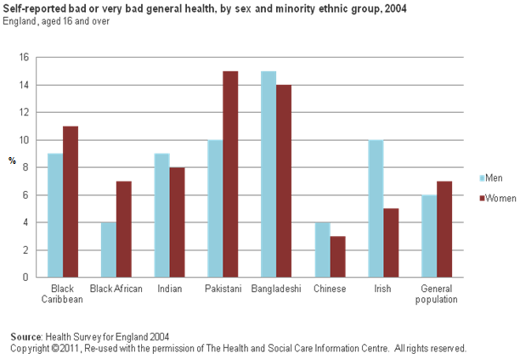
Self-reported General Health by Sex & Ethnic group
This graph a vehicle for addressing multiple QM learning objectives...
Data sources
Measurement issues
Representativeness
Making comparisons
Association and causality

Slide 7
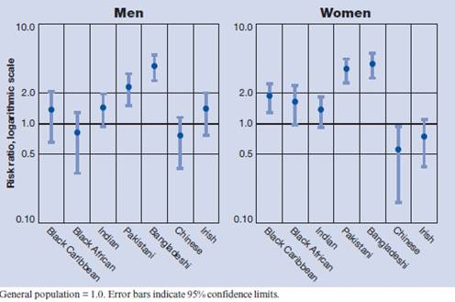
Stepping it up...
Age-standardised Self Reported General Health
Key concepts...
Age standardisation
Risk ratios
Confidence intervals
Logarithmic scale
2004 Health Survey for England

Slide 8
Example 2
Introduction to Comparative Politics

Slide 9
From critical reader to producer of data (making students part of the dataset)
Class complete selected survey questions from the British Social Attitudes
relating to attitudes to immigration
questions developed by the course lecturer as part of his own research
An exercise that enables addressing of multiple QM learning objectives, but firmly within a substantive context, and with all the benefits of interactivity

Slide 10
Making a difference... Learning Objectives and Assessment
To make a difference these innovations need to impact on
Course Learning Objectives
Methods of Assessment

Slide 11
Making the methods class relevant
Cross-fertilisation, QM in context
SUBSTANTIVE MODULES
Race and Ethnicity in the UK
(comparisons of health using the Health Survey for England)
Intro to Comparative Politics
(British Social Attitudes – public v student comparisons)
METHODS MODULES
Research Design
About data
Sampling
Measurement
Formulating Tables
Statistics

Slide 12
Using QM in the Final Year Dissertation
SUBSTANTIVE MODULES
METHODS MODULES
THE IDEAS
THE SKILLS
Theory
Questions
QM Exemplars
THE DATA
How to operationalise a research question
Finding data (is it fit for purpose?)
How to analyse data
A DISSERTATION USING QM

