Slide 1
Enriching Social Science Teaching with Empirical Data (ESSTED)
Enabling Students to Use Data in their Sociology and Politics Dissertations and Coursework
Wendy Olsen, Mark Brown, Jen Buckley
(Social Statistics)
www.socialsciences.manchester.ac.uk/essted

Slide 2
Manchester Dissertation Audit
(190 in Politics, 46 in Sociology)
Of the 236 dissertations reviewed....
49 collected primary data
41 showed some evidence of using secondary data sources (most was by way of referring to statistics from articles and reports rather than using raw data).
17 made use of secondary tables or graphs, usually by pasting them from other reports or articles
8 dissertations made use of original tables, that is they re-worked data to fit their purpose or as evidenced by SPSS output.
7 dissertations attempted some form of descriptive statistics. This was mostly calculating percentages.
1 attempted to do a bivariate analysis and referred to a Chi-Square test.’

Slide 3
Why so little use of quantitative data?
(esp.. secondary data analysis)
A shortage of suitable data?
A shortage of skills?

Slide 4
Why so little use of quantitative data?
(esp.. secondary data analysis)
Knowledge about available sources..
..and the confidence to use them
Comfort zones and tradition
  Fieldwork v secondary analysis
  a question of supervision

Slide 5
A ‘British Problem’
‘British students are usually encouraged to collect their own data for final year undergraduate projects…This contrasts with the USA where most sociology students conduct secondary analysis of large-scale survey data…
The lack of use of secondary analysis in Britain is surprising given that such a large number of high quality national surveys are readily available and that expertise in the analysis and data management of large surveys is in great demand by employers.’
Sara Arber in Nigel Gilbert (2001)Researching Social Life

Slide 6
Coursework and Essays
Same story
But is it a consequence of the way we assess?
Reliance on the essay. How many essay based assignments include explicit reference to the use of evidence?
Reading lists - How many modules include guides to empirical sources?
Module (and programme) learning outcomes – how many make explicit reference to the use of evidence?

Slide 7
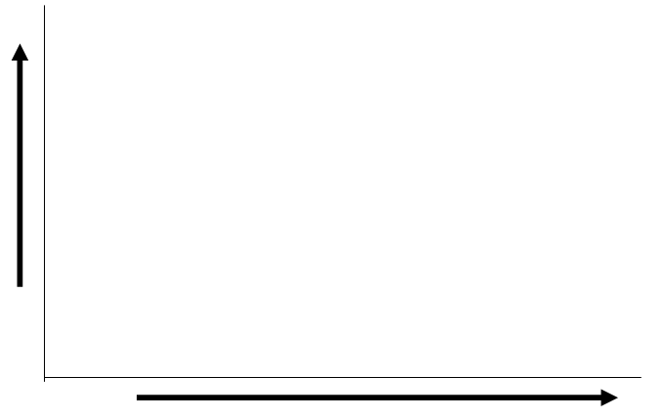
Bringing QM into dissertations
It isn’t all or nothing
Secondary analysis of survey data (using SPSS or equivalent)
Creating bespoke outputs on-line
Reproducing a published table or graph
Increasing QM skills
Increasing use of quants data

Slide 8
Why we should bother..
It makes for better research.. There are very few dissertations that won’t be enhanced by some use of quantitative data...even if only to provide background and context.
We have access to a goldmine of social data on topics of interest to social science students...from simple tables to full survey datasets, advances in web-technology have brought increasing amounts of data within the reach of undergraduates
Developing skills for employment... Bringing some quantitative data into a research dissertation is an ideal way to practice and develop quantitative skills that are highly sought after by employers in today’s competitive jobs market.

Slide 9
3 illustrations
1. Re-purposing published sources
A published table or graph to provide context

Slide 10
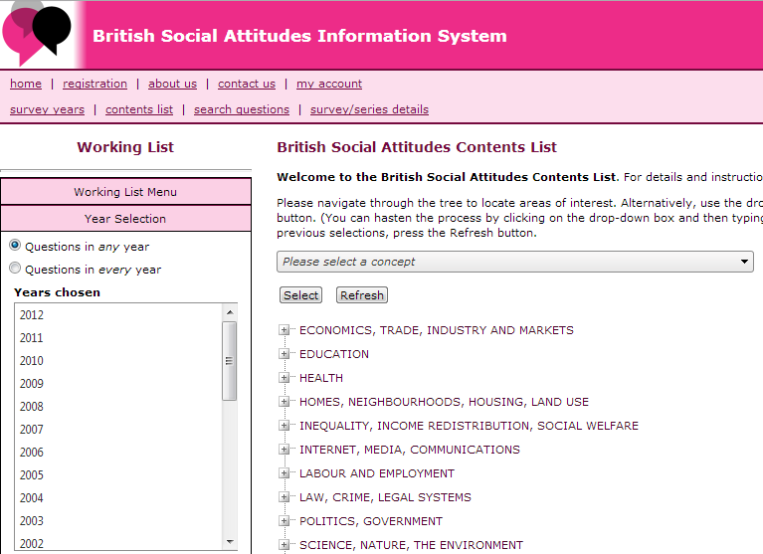
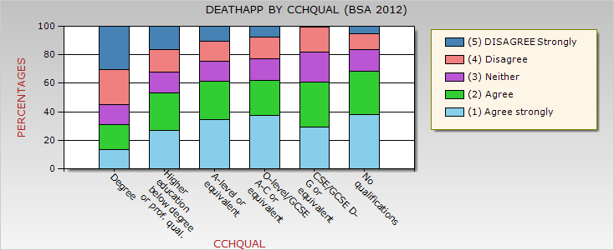
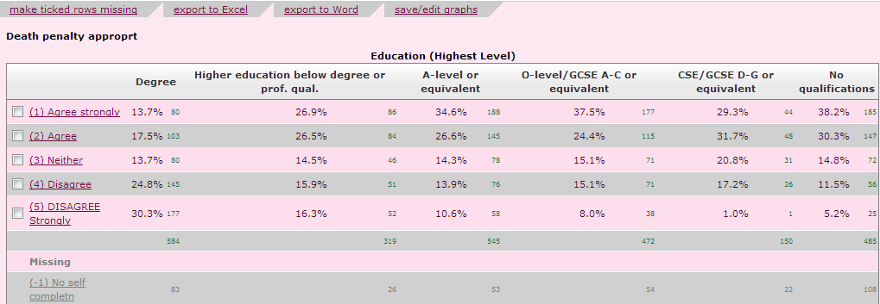
2. Creating bespoke tables e.g. From British Social Attitudes using http://www.britsocat.com/

Slide 11
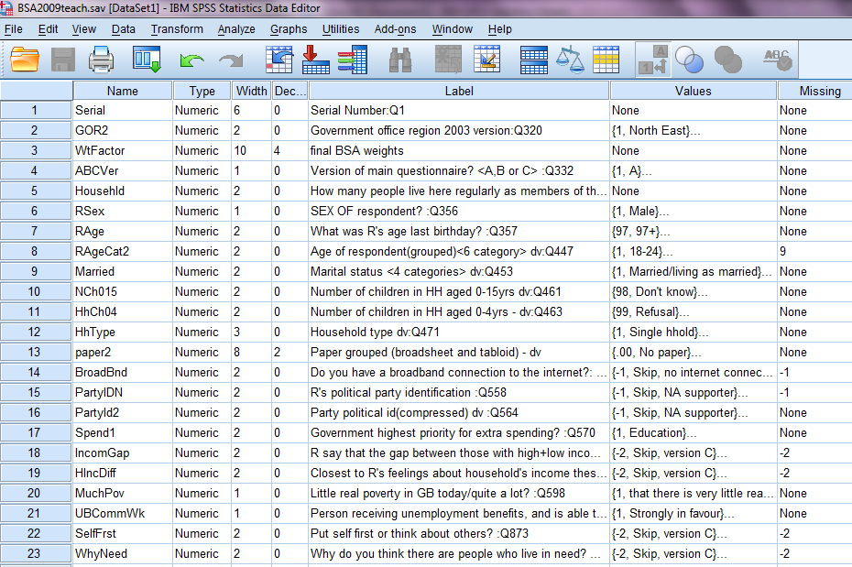
3. Analysis of Survey Microdata

Slide 12
Bringing QM into dissertations
It isn’t all or nothing
Secondary analysis of survey data (using SPSS or equivalent)
Creating bespoke outputs on-line
Reproducing a published table or graph
Increasing QM skills
Increasing use of quants data

Slide 13
Using published data for context and background
Students well tutored in importance of citing academic literature to develop arguments (reflected in assessment criteria). We should be encouraging students to do the same with published data outputs.
In a dissertation there are many ways these data can be used to provide background and context for the framing of research questions (even where the main focus of the research is qualitative)
  e.g. a time series showing how ‘living-alone’ has increased over recent decades
  e.g. Some statistics on the demographic/economic /social composition of a case study area chose for fieldwork

Slide 14
Using published data for context and background
Increasing number of these published outputs are accessible online (much easier to reproduce than from hard copy manuscripts)
How to find them?
  Google .. or something more systematic
  On-line reports of Government Surveys
  Academic ‘value added’ sites:
  www.ethnicity.ac.uk, www.brin.ac.uk, www.poverty.org

Slide 15
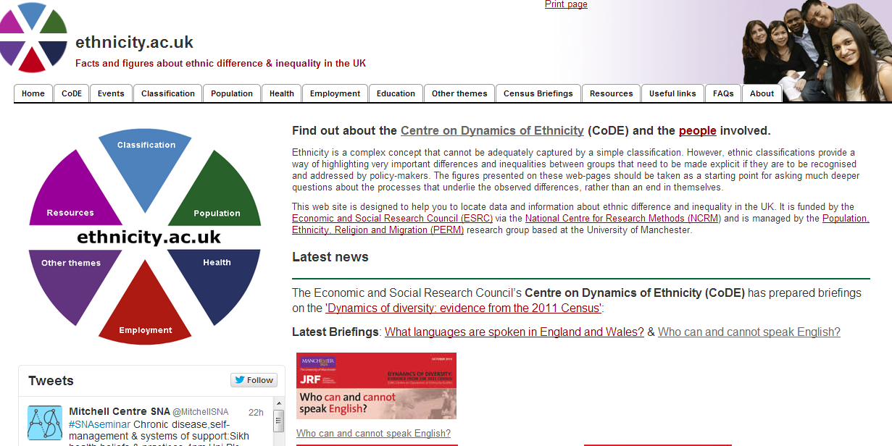
www.ethnicity.ac.uk
www.ethnicity.ac.uk

Slide 16
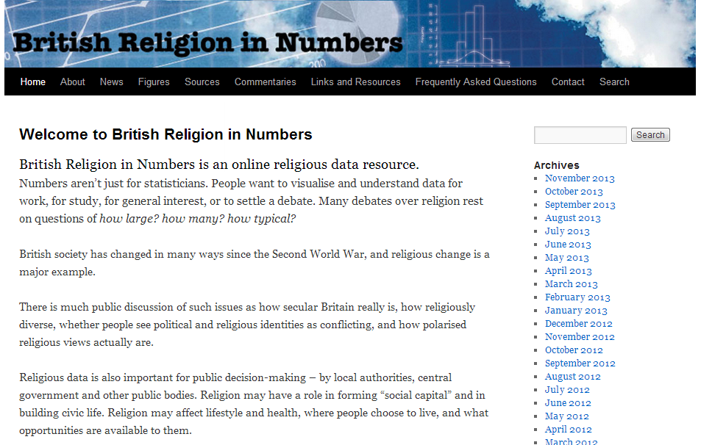
www.brin.ac.uk
www.brin.ac.uk

Slide 17
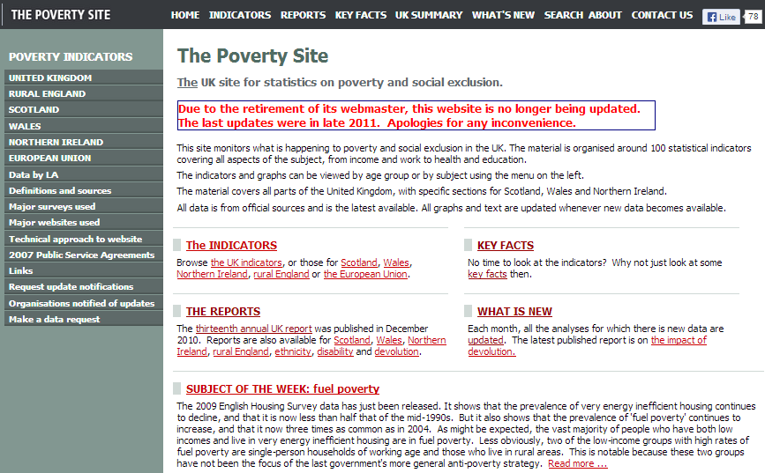
www.poverty.org.uk
www.poverty.org.uk

Slide 18
Something more bespoke?
Getting hands-on
Published tables and graphs have obvious limitations
Developments in web-technology have made underlying data more accessible to a wider range of non-expert users
A growing number of on-line interfaces allow users to create bespoke tables and graphs without requirement of downloading and analysing in SPSS or equivalent
In this way data outputs can be customised to the needs of the research – even provide scope for some exploratory data analysis
Highlight 5 examples
  None require major investment of time to learn how to use
  All are free and work through a normal web-browser

Slide 19
Getting interactive with data
1.Neighbourhood Statistics http://www.neighbourhood.statistics.gov.uk
Statistics for local areas from a number of sources on a wide range of topics from housing to crime. For dissertation projects incorporating a local case study it’s an ideal way to bring in some statistical data to help provide context.
2.British Social Attitudes http://www.britsocat.com/
Easy to generate your own crosstabulations from the full archive of BSA surveys from 1983.
3.NOMIS (2011 Uk Census) http://www.nomisweb.co.uk/census/2011
Flexible and user friendly interface to the 2011 census data – range of options from Table finder to ‘Quick Statistics’ - pull off data for specified geography
4.Centre for Comparative European Survey Data Information System:
http://www.ccesd.ac.uk/
Generate comparative statistics from an archive of 100,000s of survey questions for European countries spanning over 50 years.
5.World Bank Development Indicators http://data.worldbank.org/indicator
over 3000 indicators available for the period since 1960. Could be used to provide background statistics for a country study or as data for a cross country analysis

Slide 20
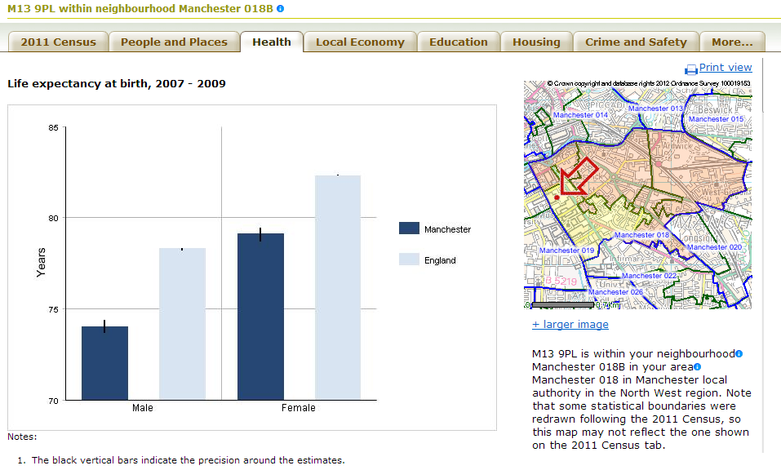
Example 1
Neighbourhood Statistics http://www.neighbourhood.statistics.gov.uk/
Select a local area in the UK for statistics on a range of topics
This e.g. Life Expectancy in M13 9PL (Manchester University postcode)

Slide 21
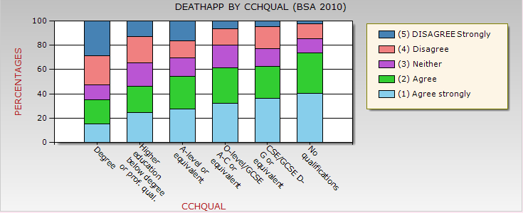
Example 2
British Social Attitudes survey: on-line www.britsocat.com/Home
On-line alternative to downloading BSA datasets and using SPSS
Quick and easy to create your own tables and graphs from the full BSA archive (1983-2012): (requires simple on-line registration)
e.g. Support for capital punishment by education

Slide 22
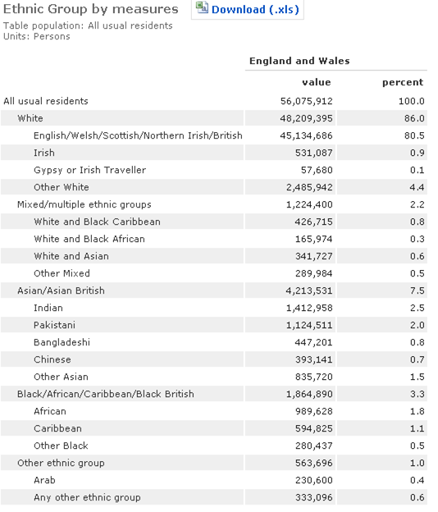
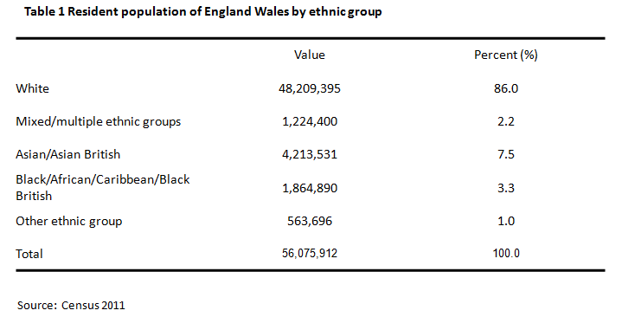
Example 3
Tables from the 2011 UK Census www.nomisweb.co.uk/census/2011
Request the table.... Download the data to create your own version
                e.g Ethnic Composition of England & Wales

Slide 23
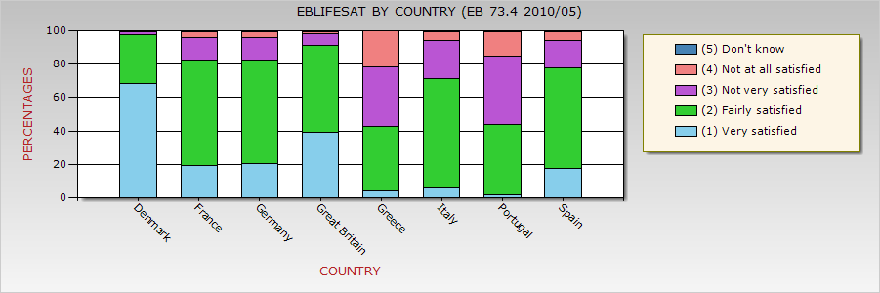
Example 4
Survey data for Europe
(includes the BSA and comparative data for rest of Europe) http://www.ccesd.ac.uk/Home
Very similar to the BSA website (uses same registration)
Can choose countries as well as years and variables
e.g. Life Satisfaction... (from Eurobarometer 2010)

Slide 24
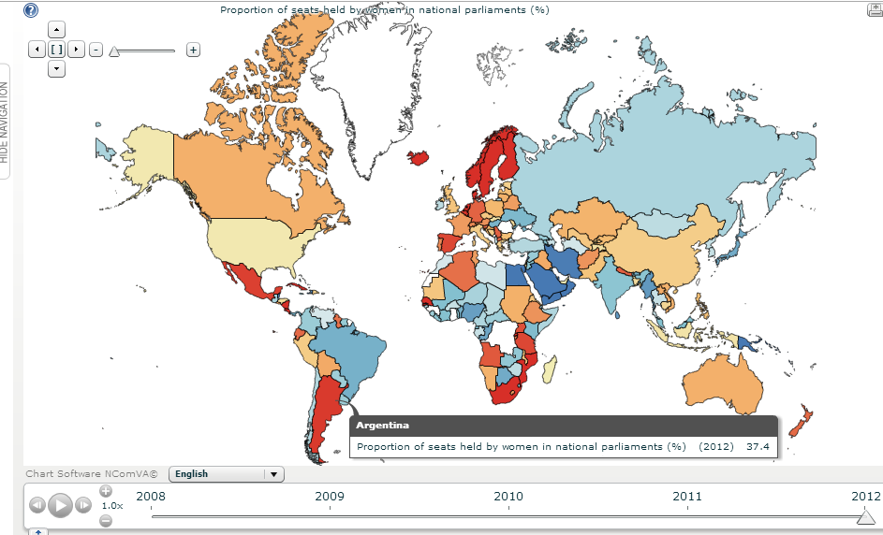
Example 5
International Data: World Bank Development Indicators http://stats.ukdataservice.ac.uk/
Hundreds of indicators available
e.g. % of parliamentary seats held by women (also available as table or graph)

Slide 25
Practical
Hands on session to try out any/all of these sites
Freestyle
Or follow one of our bespoke teaching guides
Or a bit of both

Slide 26
LUNCH

Slide 27
Bringing QM into dissertations
It isn’t all or nothing
Secondary analysis of survey data (using SPSS or equivalent)
Creating bespoke outputs on-line
Reproducing a published table or graph
Increasing QM skills
Increasing use of quants data

Slide 28
Secondary Analysis of a Survey Dataset a realistic option for final year dissertations
New opportunities
The data: UK probably unrivalled for social survey data. HE students have long had access but major advances in web-based delivery and user support have brought it within the reach of undergraduates
AND
Increasing numbers of our students now have the skills to conduct survey analysis – SPSS training integral to many programmes (especially in Sociology)
Uptake remains low – students need a lot of support...

Slide 29
A question of support
Year 2
taught methods
(SPSS)
Year 3

Slide 30
Supervising the research process
Research Questions
Research Design (unpack)
Analysis
Reporting results
Interpretation and discussion
QM methods training tends to focus on this

Slide 31
Research Questions
A successful secondary analysis is dependent on clearly specified research questions to guide the research design and subsequent analysis.
Students often struggle with this crucial stage in the research process. A common problem is where questions are expressed only in very general terms, sometimes more as topics of interest than researchable questions.
Where this is the case, even with a rich survey dataset students will quickly get bogged down in the data and lose a sense of what it is the analysis is aiming to do.

Slide 32
Supervising Research Questions
Helping students narrow down their ideas into a suitably specific question(s) for a secondary analysis is crucial
Encouraging students to take a position with regards to relevant theory can be helpful here, inspiring questions that are framed in a way that involves using the data to investigate or ‘test’ a specific theory or part of a theory, expressed as a hypothesis or series of mini hypotheses.
Major advantage of developing hypotheses is that they help give a clear focus to all subsequent stages of the research, including the search and evaluation of a suitable dataset and the design of the analysis itself

Slide 33
From topic to question to hypotheses. an e.g.
Research topic: Political participation (or apathy) among the young
Relevant theory/idea: various positions on discourse on youth disaffection - disengagement from conventional forms of political participation cf growth of new forms of political engagemnet
Research question: How does the level and nature of political participation vary by age in the UK, and how is this changing over time?
Research hypotheses 1: that the young show lower levels of prevalence on conventional measures of participation than older groups (e.g. voting)
Research hypotheses 2: that the young show greater engagement with new forms of participation than older groups (such as e-petitions and protest marches)

Slide 34
Data Analysis
In the majority of cases a secondary survey analysis at undergraduate level will involve relatively simple exploratory techniques, typically involving (depending on variable type) crosstabulation, correlation and/or comparison of means with the use of some controls (and some appropriate tests for statistical significance).
Far more important than the sophistication of techniques used is the extent to which they are used appropriately as part of a coherent analysis and interpreted with a suitable degree of critical reflection.

Slide 35
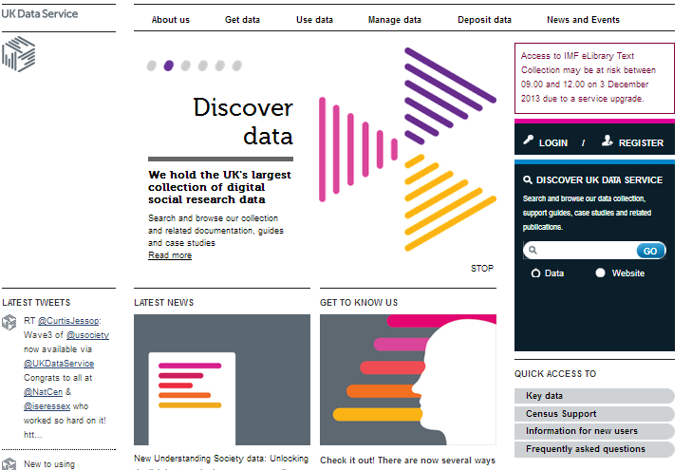
Searching for Data
The UK Data Service (http://ukdataservice.ac.uk/)
The UK Data Service is the gateway to 6,000 data collections
Includes huge range of survey data - the vast majority of which can be downloaded and used freely by students and academics in HE under a simple end user licence (registration is a quick on-line procedure)

Slide 36
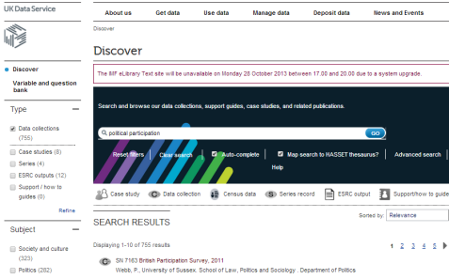
Data Discover.. http://ukdataservice.ac.uk/get-data.aspx
Highly flexible search engine
Or browse by theme

Slide 37
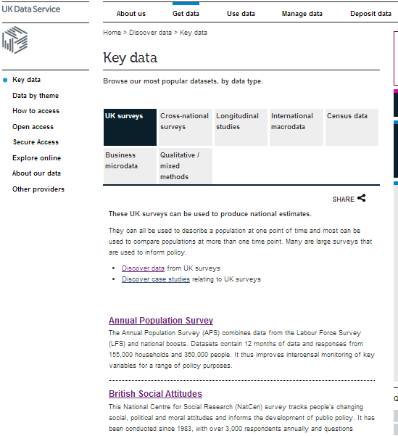
‘Key data’
Browse the most popular data sets
See ‘UK Surveys’

Slide 38
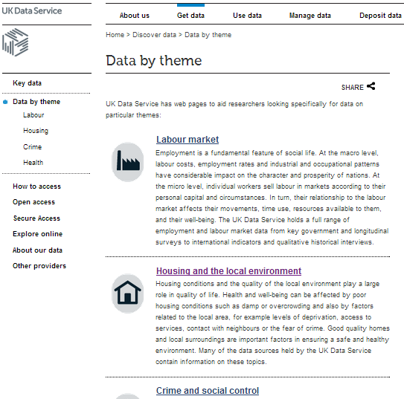
‘By Theme’

Slide 39
Data Evaluation: is it really fit for purpose?
Easily overlooked in the enthusiasm to start analysis..
But crucial
The sample.. Do the survey respondents match the population of interest? Was it a random sample? Are there sufficient cases for the groups I want to compare?
The variables... Are you able to operationalise key concepts?
This task will be made so much easier if guided by a clearly specified research question (hypotheses)
A key advantage of the UKDA is that all datasets are accompanied by detailed documentation that can be used to carry out a detailed data evaluation on-line
For many datasets this can be done using NESSTAR

Slide 40
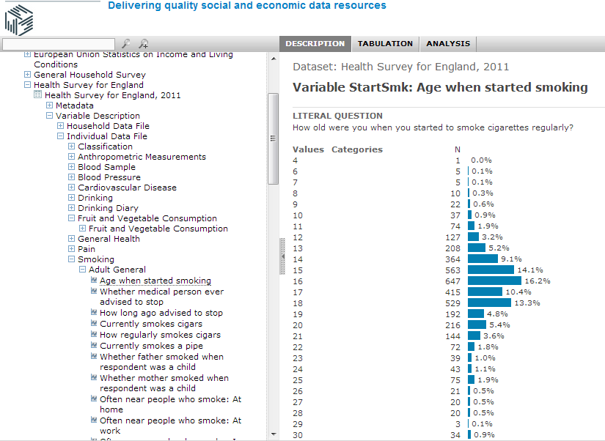
Hands on with NESSTAR http://nesstar.esds.ac.uk/webview/index.jsp

Slide 41
Practical
Searching for data
Evaluate a dataset

Slide 42
Some data issues
The use of teaching datasets in methods classes means it is easy to gloss over some of the challenges of working with ‘real survey data’.
In sourcing their own datasets from the UKDS students may encounter hierarchical data structures, complex weighting schemes and large numbers of missing values with which they are unfamiliar.
Providing support at this stage is crucial. A weekly drop-in clinic where students can get one to one support in setting up their data can make all the difference in keeping a project on track.

Slide 43
The supervision process
Research question - hypotheses
Research design – data search and evaluation
Setting up – data access and preparation
Operationalising variables - descriptives
Plan of the analysis – recoding
Analysis – formulating crosstabulations
Presenting analysis
Interpretation

Slide 44
Getting Critical
As with any methodological approach, students undertaking dissertations based on the analysis of survey data should be encouraged to discuss and reflect critically on all aspects of their research design and analysis.
This should include some engagement with the epistemological and ontological assumptions being made in survey research, and include a critical discussion of the way central concepts and definitions related to the student’s research question have been operationalized in the research design.
Statistical significance: In encouraging the use of statistical tests, students should be encouraged to reflect on the difference between a finding that is statistical significant and a finding that is of substantive interest in the context of their particular research question.

Slide 45
Association and causation:
A common pitfall in secondary data analysis is to over-interpret a statistical association between two variables as evidence of a causal relationship. When hypotheses are set up to test a relationship e.g. between political participation and age students should be encouraged to think of confounding effects of other variables and control for these wherever possible.
In most cases students conducting secondary analysis of surveys are probably best advised to avoid directly framing their research questions and hypotheses in terms of causality, especially when using cross-sectional data sets. In survey research, greater understanding of causal sequence generally requires working with longitudinal data, which is beyond the skill set taught to most undergraduate students in the Social Sciences.

Slide 46
A question of Assessment
Concerns over marking
Will a student be disadvantaged for using QM
Transparency – marking criteria needs to be made explicit

