Slide 1
Dissertation Workshop
How to design (and carry out) a quantitative analysis for a dissertation
A practical workshop
Mark Brown
(Social Statistics)

Slide 2
First things first – is a quantitative analysis the right method for your research question?
In thinking about the pros and cons of doing qualitative or quantitative research, the MAIN REQUIREMNT in any research project is that the method should be appropriate for the question
So first thing to ask is ‘have I got a research question that I can meaningfully answer with an analysis of quantitative (survey) data?
To decide this it helps if you can answer the following questions
What information does my research question actually require?
Can I get that information from survey data?
If yes, does my specific dataset (or another one) have that information?
A common problem is that research questions are left far too vague – and you discover too late that the answer to the above is no!

Slide 3
Research Questions – get specific
If your research question is looking a bit vague (more like a topic than a question) it’s worth spending some time trying to get it more specific.
A well specified research question should help
Confirm whether quantitative methods are appropriate
Confirm whether the dataset you have identified is suitable
And
Make it much easier to design and carry out your data analysis (what you actually do with the data in SPSS)

Slide 4
Developing a Hypothesis can help
A hypothesis is simply a statement of what you think is true..
It can be based on theory... or a hunch... or reasoning
A research question can often be broken down into a series of hypotheses
An advantage of this approach is that it can
help guide your analysis in a structured way – i.e. Your aim being to systematically test the specific hypotheses,
Help in the interpretation and discussion of the results, which can be related back to the hypotheses
Result in in a much more coherent dissertation than one where the specific purpose of the analysis is left vague.

Slide 5
Refining research questions for an analysis..
‘The effect of the increase in student fees?’
Is this a good research question?

Slide 6
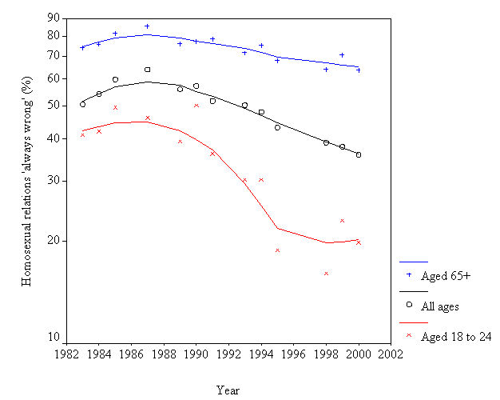
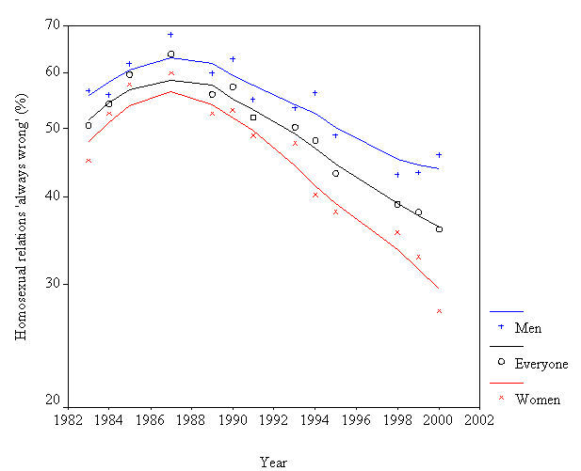
Attitudes to same same-sex relationships by age and sex (British Social Attitudes Survey)
REMEMBER THIS?
Crockett A and Voas D (2003) 'A Divergence of Views: Attitude change and the religious crisis over homosexuality‘ Sociological Research Online, vol. 8, no. 4, <http://www.socresonline.org.uk/8/4/crockett.html>

Slide 7
Workshop example
Research by Crockett and Voas (2003) used British Social Attitudes (BSA) Survey to look at how public attitudes had changed on same sex relationships (note same survey we used in Year 2 methods classes last year)
Established major differences by age, sex and religion.
Surely we can’t just repeat their analysis?
But existing research often a good place to start when developing a research idea. What are the ‘new’ questions we might develop from this work?

Slide 8
Building on previous research
Update the story – where are we at the end of the noughties?
Interesting context...
Social change. Crockett and Voas related the ‘astonishing rapidity’ of changing public views on this topic to aspects of Modernity... ‘the decline in deference to authority, the increase in tolerance of anything that seems a private matter, and the sense that sexuality is fundamental to the free expression of personal identity’
Legislative changes (civil partnerships...)
So has the trend continued? Is the nature and pace of change the same for all groups e.g. are gender and age gaps in attitudes closing or widening? Are the religious less susceptible to the influences of modernity on social and moral values? What would we expect?

Slide 9
Building on previous research
Consider new factors that you’d like to bring into the analysis...
based on established theory or some other reasoning?
What is the expected relationship - can you express this as a hypothesis?
Consider a different (but related) dependent variable e.g. BSA has a range of questions on sexuality e.g. New questions on attitudes to gay and lesbian couples fostering children
Don’t be put off by ‘someone’s already done it’ - research is driven by replication and you can always add your own developments as above (even when using the same dataset)

Slide 10
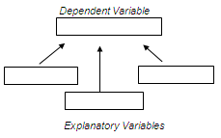
I have my data in SPSS.. Now what?
Think what information you need to answer a research question (or test a hypothesis)
Identify the dependent variable and explanatory variable(s)
Use SPSS to analyse the relationship between them
What techniques?

Slide 11
Workshop: 7 Steps
STEP 1: Getting started: Locate & open the data in SPSS
STEP 2: Apply the weighting variable
STEP 3: Identifying the key variables
STEP 4: Looking at variable distributions
STEP 5: Exploring the relationship between the dependent and explanatory variables with cross-tabulation
STEP 6: Can we generalise the findings of our crosstabs from our sample to the UK population? Adding a test of statistical significance
STEP 7: Developing the analysis with the use of control variables

Slide 12
STEP 7: developing the analysis to include control variables
The bivariate (2x2) tables show the expected relationship for all our explanatory variables when considered separately.
But what about possible interactions
e.g. Are the differences by sex and age found equally for church goers and non-church goers
To explore this we can develop the SPSS analysis by running a 3 way table (e.g. attitude by gender, controlling for religion and attitude by age, controlling for religion)

Slide 13
Association is NOT Causality the dangers of over-interpretation
What does the analysis allow us to say?
Establish patterns of difference (in attitudes)
This is where hypotheses can help guide your interpretation and discussion – i.e to what extent does your analysis confirm or reject the hypotheses?
But note our hypotheses were essentially descriptive, useful contribution to understanding the relationship but not possible to establish cause and effect – or gain real understanding of why the patterns are as they are.
But you can discuss the possible/likely factors by engaging with the theory that informed your hypotheses

Slide 14
Finally..
If you do end up doing secondary analysis of survey data in your dissertation..
We can provide some additional support to your normal supervision in the form of drop in sessions running in semester 2 (details to be confirmed)
These will be run by PhD student working in Social Statistics who can provide you with advice on using SPSS (though note they will not do your dissertation analysis for you!)
Stay in touch!

