Slide 1
Who makes Manchester? - Place & ‘the right to the city’ -
Alistair Sheldrick
Notes:
Hi! My name’s Ali and Welcome to the UoM, and the department of Geography… Today I’ll be delivering a lecture on the topic - Who makes Manchester? - Place and ‘the right to the city’ – which I’ve designed to link to the ‘Changing place; changing places’ and ‘Contemporary Urban Environments’ A-level content as well as provide a sample of a university-style geography lecture.
But First - I just need to run through some housekeeping info…
Fire/evacuation procedure…
toilets….
Short break half-way through… but feel free to take a break without asking at any point.
Pressing Qs please throw up your hand but there will also be a chance to ask any questions at the end…
Intro (me)
Before we start the lecture…. Introduce myself/role at the University…
Doctoral Researcher in Human Geog – my research focuses on the Geography Asylum-seeker dispersals and social welfare in the UK.
I also teach on the Geography undergraduate programme…
and am a Widening Participation fellow for 2017/18 academic year – which I’ll be delivering this lecture as part of today.
… joined the Uni in 2010 as a Geography Undergraduate, so can offer some perspectives on Geography here from a students’ point of view too…

Slide 2
Today’s Lecture
1. University Geography (5mins)
Teaching, facilities, skills, research.
2. The Place of Manchester (5mins)
‘Place’ as a Geographical concept, continuity and change
3. Place, relationships, & connections (10mins)
Chinatown, Curry Mile, ‘ethnic enclaves’ through time
- Break (5mins)-
4. Representing Manchester & ‘the right to the city’ (10mins)
Meaning, representation, & contestation in the City Centre
5. Researching Place - Quantitative & qualitative methods (10mins)
Notes:
So… quickly run through an outline of what to expect from todays Lecture…
First few slides… briefly tell you a bit about what University Geog is all about and how it differs to AS/A-level study…
Then begin the main talk - introduce the concept of ‘Place’ and how different aspects of place can be seen to stay the same and change through time – grounded in Manchester to illustrate these ideas.
In the 3rd part of the lecture, we’ll then move on to look at Chinatown and the Curry Mile as examples of places which are shaped and constantly re-shaped through relationships and connections on a global and local level… and also critically look at the notion and label of ‘ethnic enclaves’ in Manchester.
- Quick break –
After the break we’ll look at the role meaning and representation play in shaping places – and also consider how the use of city centre spaces are contested by different groups, ideas, and interests.
- The final part will consider the different ways in which place can be researched by Geography students – including quantitative and qualitative methods – including more creative methods such as smell-scapes and media analysis.

Slide 3
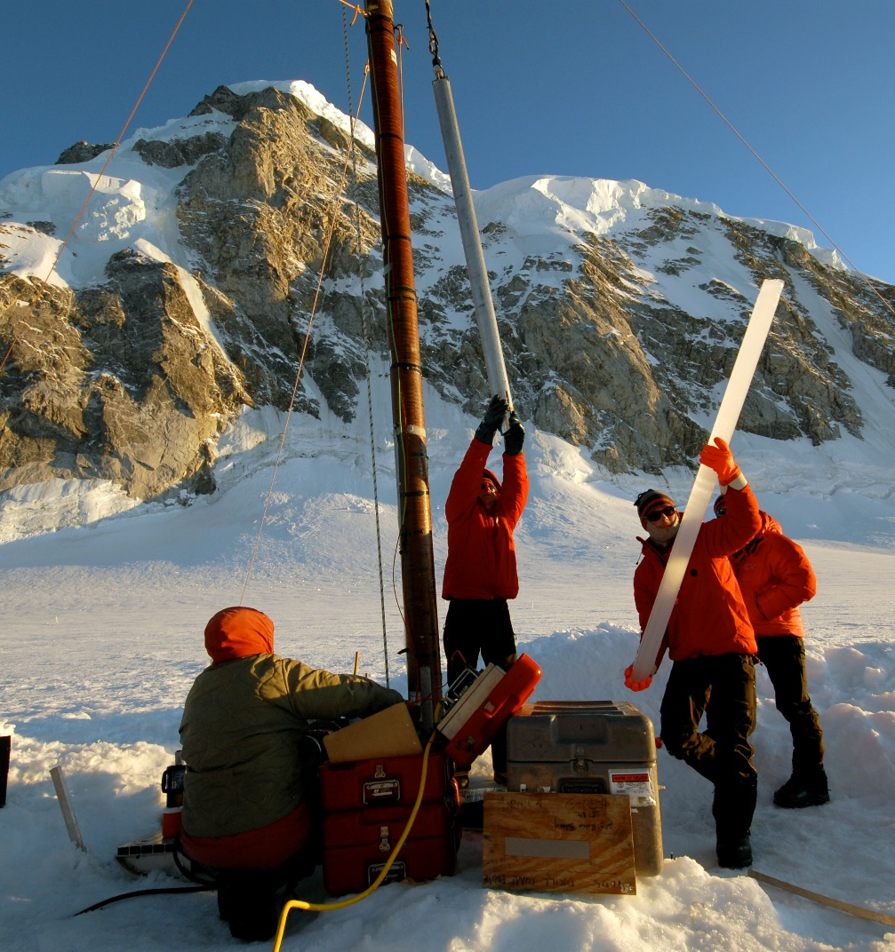
University Geography 1. Physical Geography
Notes:
The study of Geography at University can be split into 3 different areas….
Physical Geography - the study of the earth’s physical features and processes - Includes climate science, river system dynamics, Glaciology, and Coastal environments

Slide 4
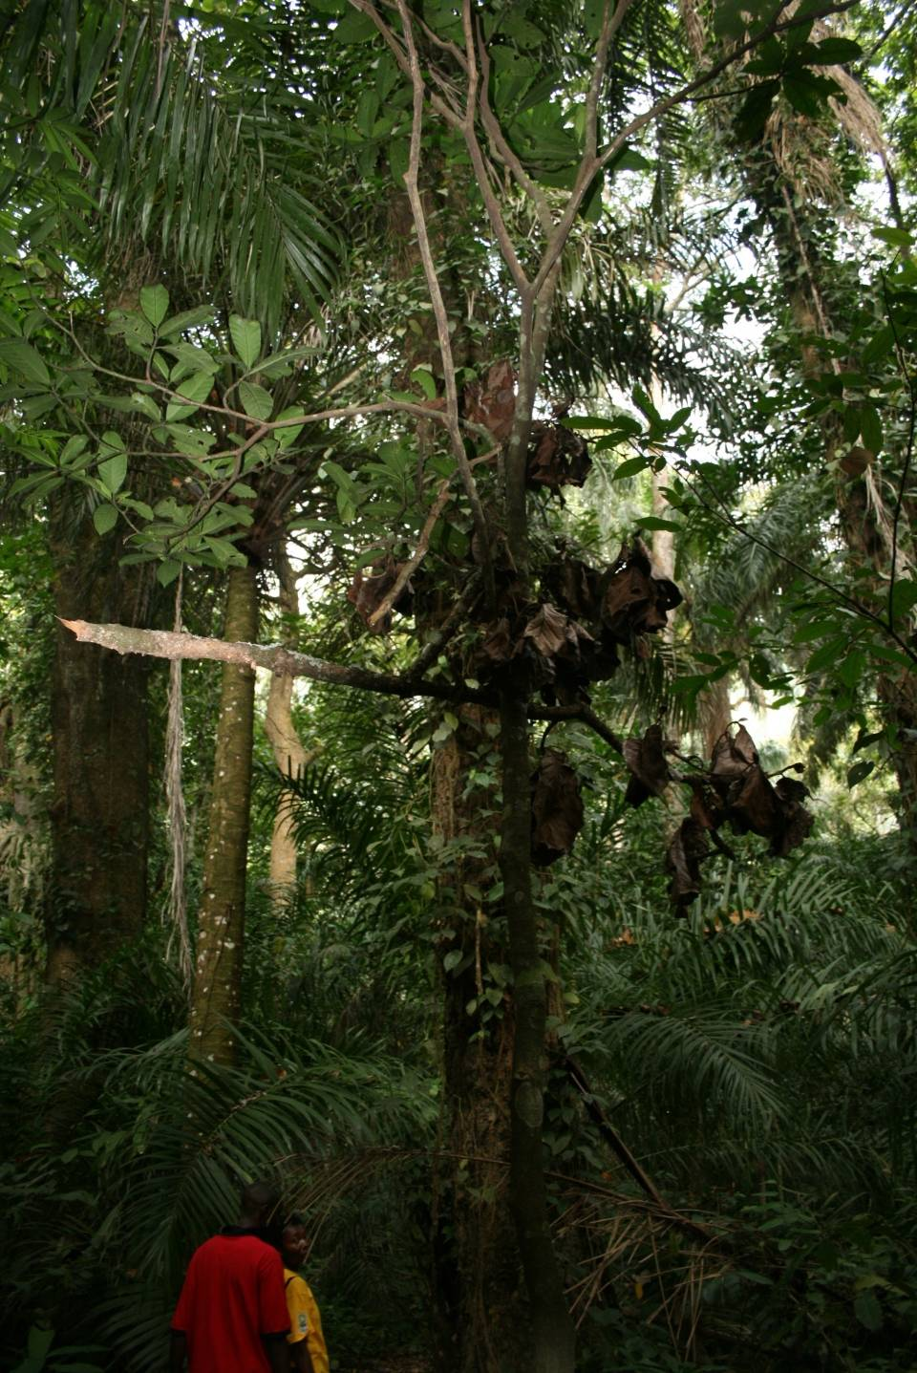
2. People and the Environment
Notes:
Secondly, is what we call People and Environment – which is the study of interactions between the physical and the human world… this includes
Environmental science, the study of natural resources and resource management, environmental pollution and conservation, flooding and wildfires

Slide 5
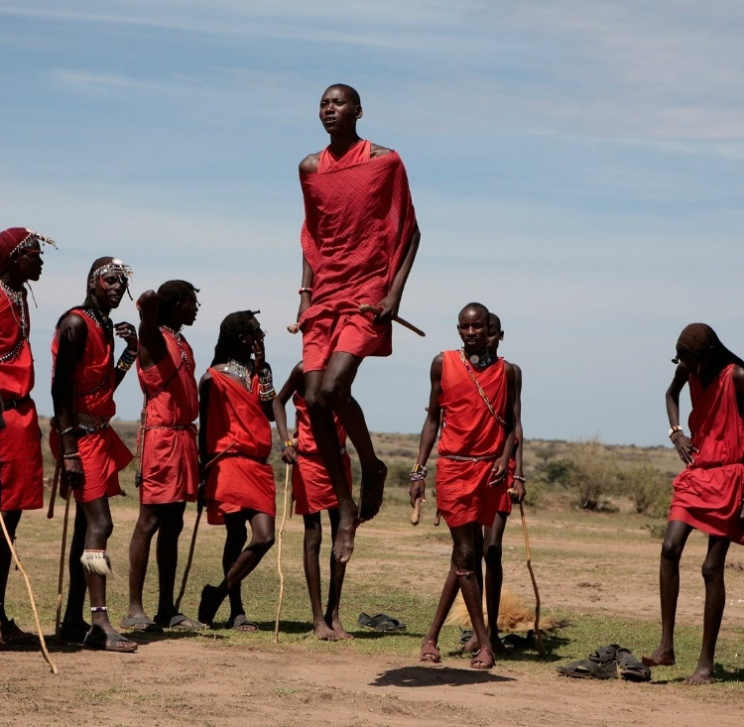
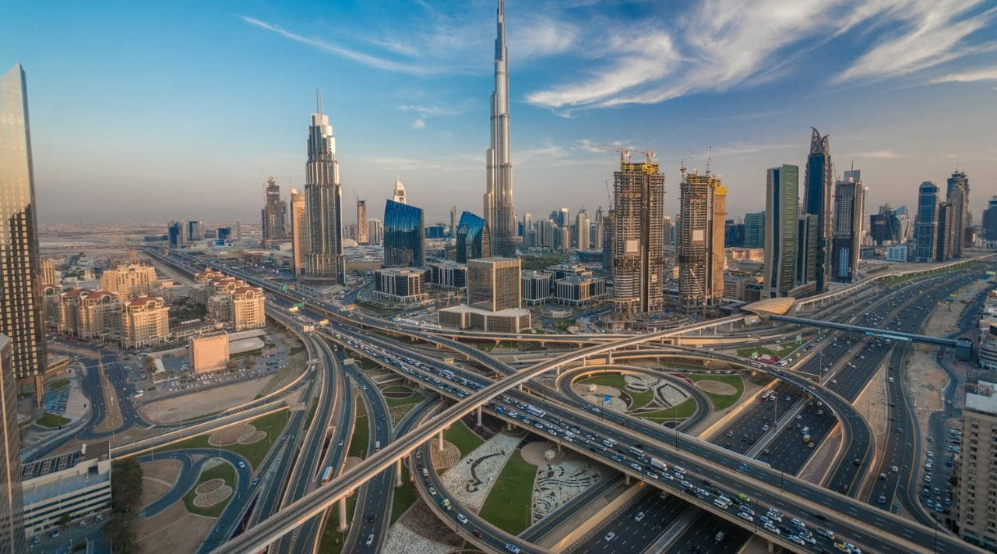
3. Human Geography
Notes:
Finally there’s Human Geography, which is the study of the planet’s human features and processes, including globalisation, migration, economic geography, political geography, cities, society and culture - with a particular emphasis on scale, space, and place as key concepts.
Important to stress here, that today’s lecture reflects only one subject area, of Human Geography, that maps on to the A-level content.
If you’re more interested in Physical Geography, People and Environment interactions, or other Human Geography topics, then you can increasingly focus your studies on whichever areas of interest that you choose as you progress through your degree
… a diverse subject which allows you to determine your own area of expertise…

Slide 6
How you learn…
Lectures  seminars  tutorials, online  film, media & Art  lab work  field work  independent reading
How you’re assessed…
Group work  presentations  research projects  exams  coursework  practicals (labs, IT, fieldwork)
Notes:
Forms of teaching and assessment will probably be different than what you’re used to at AS/ A-level – as well as more conventional classroom-based lectures, seminars, and tutorials…
… also be able to make use of Geography Labs, for Physical geography, and fieldwork for Human and Physical…
… they’ll also be plenty of opportunities to learn through media-based resources and artistic forms, mostly in Human Geography
Assesment – this variety is also reflected in the different assessment formats – which include presentations, practical work, and research projects, as well as exams and essays.

Slide 7
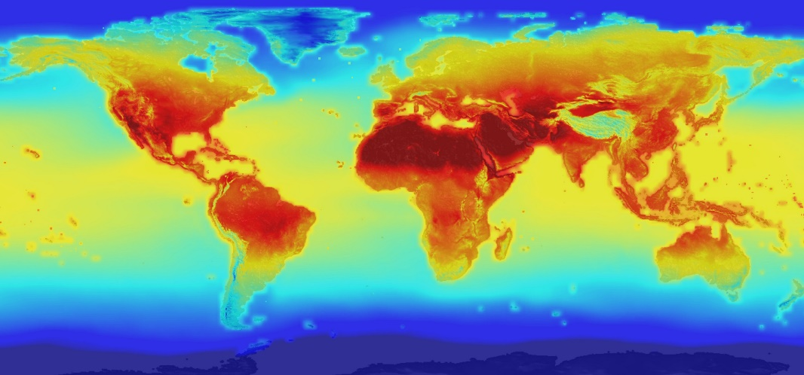
Skills, Impact, & Research
Analytical and technical skills
Real-world application and impact
‘Producing’ Geographical knowledge through research.
Expanding & challenging current understanding
Notes:
- Transferable skills – critical analysis of different types of data, communicating complex data and concepts to different audiences, IT and field-based skills,
Students encouraged to think critically and independently – going beyond learning to produce new geographical knowledge and challenge existing beliefs

Slide 8
2. The Place of Manchester

Slide 9
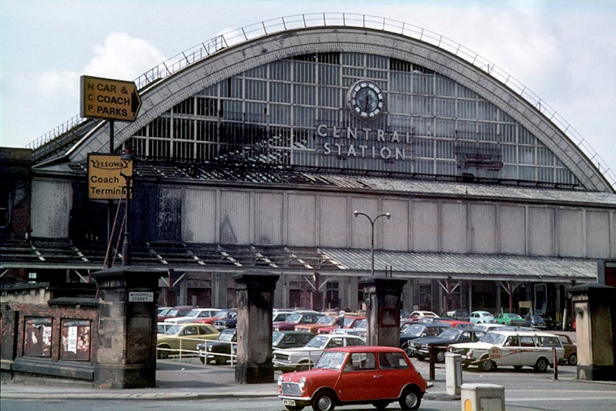
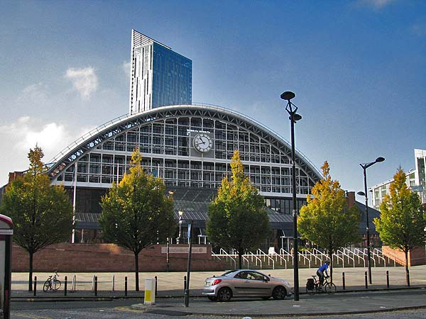
Manchester – continuity and change

Slide 10
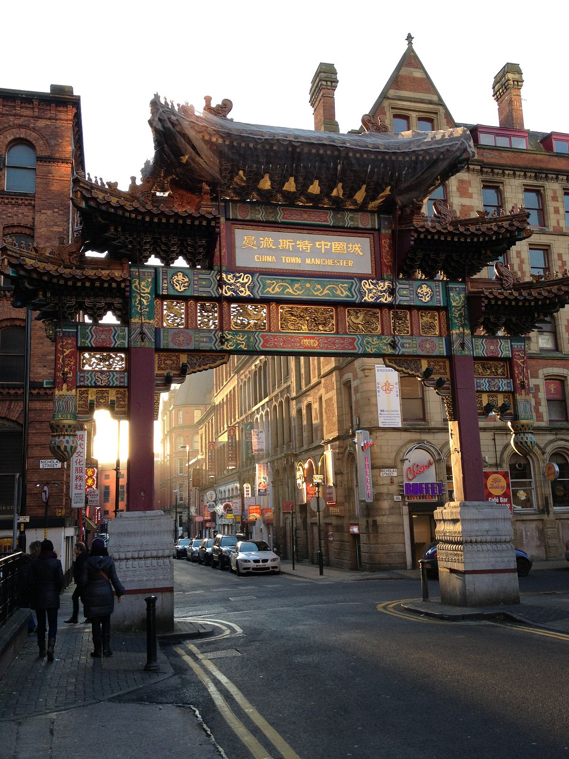
Notes:
(repeat earlier activity as plenary)
… Now you’ve heard a bit about Geography at university, I want to know what you think about Geography and what Geog is all about
Ask audience - When I say ‘Geography’, what first springs to mind? (prizes for answers) –
(* would ‘snowball’ suggestions work here?)

Slide 11
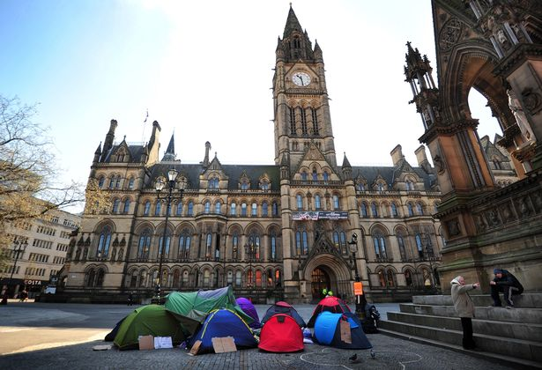

Slide 13
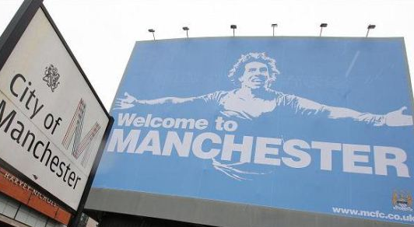

Slide 14
Questions?
Alistair Sheldrick
Notes:
Hi! My name’s Ali and I’m here to tell you a little bit about studying Geography at university, how it differs to what you study in Geography at school, and some of the fantastic opportunities and experiences that studying at university can offer.

