Slide 1
Tackling social inequalities in later life
‘The Golden Generation?’, MICRA, July 2017
Dan Jones, Director of Innovation & Change

Slide 2
About the Centre for Ageing Better
We work for a society where everyone enjoys a good later life – especially those at risk of missing out
We are an independent charitable foundation
We are a What Works Centre, promoting the better use of evidence
We work across the issues that matter for a good later life
In all our work, we start with the person – people’s different experiences of later life
The Golden Generation? Tackling Social Inequalities in Later Life
2

Slide 3
The Golden Generation?
fRaill research highlights the impact of inequality across all the dimensions of a good later life - health, wellbeing and social connections, as well as financial security
Powerful confirmation of the central importance of social and economic inequality in shaping people’s divergent experiences of later life
Seeing these inequalities play out starkly in our work with people in later life
Completing our own review of evidence on inequalities in later life
Financial security
Health
Social connections
Wellbeing
The Golden Generation? Tackling Social Inequalities in Later Life
3

Slide 4
Inequalities and health in later life – policy implications
The gap between richer and poorer is widening
Poorer people are experiencing ill health and frailty earlier
Overall growth in frailty is driven by increases among poorer older people
The priority for policy is to tackle this growing gap
Preventative / ‘upstream’ interventions
Restorative / rapid responses to stop bad situations getting worse
Holistic approaches that consider work and family as well as health
Challenge of ‘double running’
Still need to provide care for people who already have serious conditions
The Golden Generation? Tackling Social Inequalities in Later Life
4

Slide 5
Inequalities, health and work in later life
Ill health is the biggest driver of labour market exit in later life
Reasons for not working, age 50 to State Pension Age
Labour Force Survey, 2013
The Golden Generation? Tackling Social Inequalities in Later Life
5

Slide 6
Inequalities, health and work in later life – policy responses
Prevention
Workplace-based support to help people manage health conditions at work
Restoration
Rapid response for people at risk of falling out of work
Tailored health and employment support for people out of work with a health condition
NHS focus on functional rehabilitation – beyond treatment
Care
More enabling benefits regime and support for people who are not going to return to work
The Golden Generation? Tackling Social Inequalities in Later Life
6

Slide 7
Tackling inequalities in practice – Ageing Better’s response
Our priority programmes all have a focus on those at risk of missing out:
I am in fulfilling work – new approaches to support people who are out of work or in insecure / low-paid work to gain better employment
I live in a suitable home – more effective adaptations to help people with limiting health conditions to live independently at home
I am contributing to my community – enabling voluntary activity by people who are under-represented in formal volunteering (poorer, BME)
I get what I need from the internet – new approaches to support people who are not benefiting from being online (predominantly poorer / less educated)
I am prepared for later life – focus on helping poorer people save for later life and ensure that pensions and care settlements address inequality
The Golden Generation? Tackling Social Inequalities in Later Life
7

Slide 8
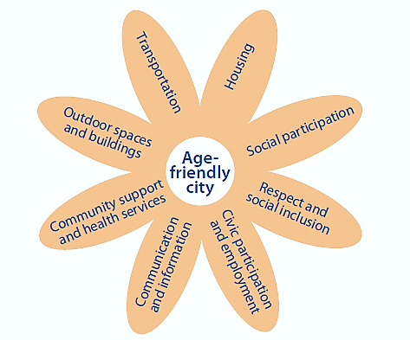
Tackling inequalities in practice – Ageing Better’s response
We’re also taking a place-based approach:
Multi-sectoral responses to address local priorities
Putting older people’s voice at centre
Huge opportunity to tackle inequalities
Working with Greater Manchester Combined Authority to support them to become first age-friendly city region
Supporting UK Network of Age-Friendly Communities
Built Environment
Social Environment
The Golden Generation? Tackling Social Inequalities in Later Life
8

Slide 9
Dan Jones
dan.jones@ageing-better.org.uk
@DanFJones72
Centre for Ageing Better
Angel Building, Level 3
407 St John Street, London, EC1V 4AD
020 3829 0113
www.ageing-better.org.uk
The Golden Generation? Tackling Social Inequalities in Later Life
Registered Company Number: 8838490 & Charity Registration Number: 1160741

