Slide 1
An Introduction
The SENSE-Cog Care Home Study
Nisha Chauhan
SENSE-Cog Research Assistant
&
Kristina Link
PhD Student, University of Manchester

Slide 2
The care home study
What?
Exploring the diagnosis and management of hearing and vision
impairments in people with dementia living in care homes.
How?
Using a knowledge, attitudes and practices (KAP) survey tool.
Who?
Staff working in care home settings, and friends/family of
people with dementia living in care home settings.
To adapt the sensory intervention to a care home setting.
Why?
UK-wide and internationally.
Where?

Slide 4
Adapting the SENSE-Cog intervention
Adaptation considerations & challenges
Intervention in the community
Intervention in care homes
?
?

Slide 5
Adapting interventions
Common challenges when adapting interventions into care homes:
Competing priorities | Access to staff training
Time pressures | Established routines
High staff turnover | Consent procedures
Level of residents’ functioning
?
(Maas et al, 2002; Mentes & Tripp-Reimer, 2002; Rahman et al, 2012)

Slide 6
Adapting the SENSE-Cog intervention
Current home-based intervention | Adapted intervention in care homes
Inclusion criteria: mild to moderate dementia | ?
The role of the companion | ?
Onward referral to other services | ?
Prescription of aids and devices and continuous training in their use | ?

Slide 7
Example: hearing aids
Trouble-shooting / maintenance
Expensive = afraid of loss / damage
Lack of staff training
Time pressures
Increased reliance on staff support
Possible reasons for under-use of hearings aids in care homes
(Cohen-Mansfield & Taylor, 2004; Hopper & Hinton, 2012; McCreedy et al, 2018; Punch & Horstmanshof, 2018; Slaughter et al, 2014)

Slide 8
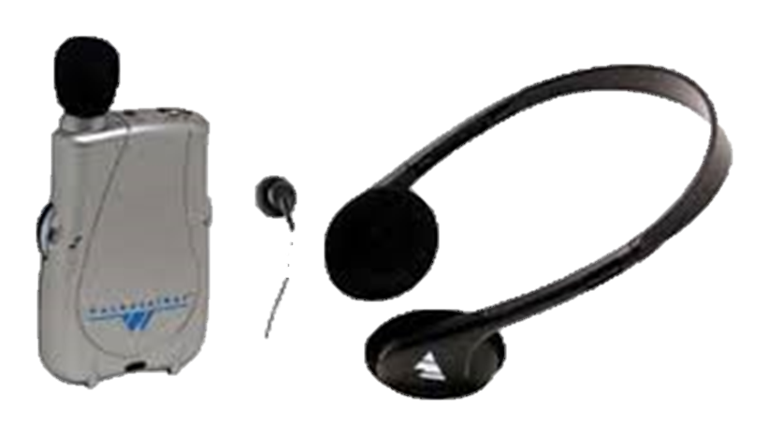
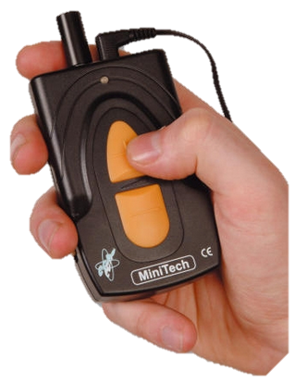
Example of possible adaptation: personal sound amplifiers
Over-the-counter devices that amplify sound to help people hear in different situations
Advantages:
Easy to use and manage
Simple volume/tone controls
Inexpensive
Headphones or ear buds
Could help enhance communication and
quality of life for people with dementia and
hearing impairment
(Hopper & Hinton, 2012; Jupiter, 2016; Mamo et al, 2016a; Mamo et al, 2016b; McInerney & Walden, 2013)

Slide 9
Group Activity
The SENSE-Cog Care Home Study

Slide 10
Group activity
Please complete the activity in groups of 2–3.
Please complete one questionnaire per group – you can find this in your registration pack.
You will have approximately 2 minutes for each question.
If you need help, please do not hesitate to ask. There are no wrong answers!
We will collate your responses, and the main themes will be shown on the screen shortly.

Slide 11
Scenario 1
Imagine you work in a care home with people with dementia – for example as a manager, nurse, allied health professional or paid caregiver.
What do you think are the important things to consider when supporting a person with a hearing and/or vision impairment?
2:00
1:59
1:58
1:57
1:56
1:55
1:54
1:53
1:52
1:51
1:50
1:49
1:48
1:47
1:46
1:45
1:44
1:43
1:42
1:41
1:40
1:39
1:38
1:37
1:36
1:35
1:34
1:33
1:32
1:31
1:30
1:29
1:28
1:27
1:26
1:25
1:24
1:23
1:22
1:21
1:20
1:19
1:18
1:17
1:16
1:15
1:14
1:13
1:12
1:11
1:10
1:09
1:08
1:07
1:06
1:05
1:04
1:03
1:02
1:01
1:00
0:59
0:58
0:57
0:56
0:55
0:54
0:53
0:52
0:51
0:50
0:49
0:48
0:47
0:46
0:45
0:44
0:43
0:42
0:41
0:40
0:39
0:38
0:37
0:36
0:35
0:34
0:33
0:32
0:31
0:30
0:29
0:28
0:27
0:26
0:25
0:24
0:23
0:22
0:21
0:20
0:19
0:18
0:17
0:16
0:15
0:14
0:13
0:12
0:11
0:10
0:09
0:08
0:07
0:06
0:05
0:04
0:03
0:02
0:01
End
2:00

Slide 12
Scenario 2
Now imagine that you are a family member or friend of someone living in a care home who has dementia and a hearing and/or vision impairment.
What do you think your role could be in supporting them?
2:00
1:59
1:58
1:57
1:56
1:55
1:54
1:53
1:52
1:51
1:50
1:49
1:48
1:47
1:46
1:45
1:44
1:43
1:42
1:41
1:40
1:39
1:38
1:37
1:36
1:35
1:34
1:33
1:32
1:31
1:30
1:29
1:28
1:27
1:26
1:25
1:24
1:23
1:22
1:21
1:20
1:19
1:18
1:17
1:16
1:15
1:14
1:13
1:12
1:11
1:10
1:09
1:08
1:07
1:06
1:05
1:04
1:03
1:02
1:01
1:00
0:59
0:58
0:57
0:56
0:55
0:54
0:53
0:52
0:51
0:50
0:49
0:48
0:47
0:46
0:45
0:44
0:43
0:42
0:41
0:40
0:39
0:38
0:37
0:36
0:35
0:34
0:33
0:32
0:31
0:30
0:29
0:28
0:27
0:26
0:25
0:24
0:23
0:22
0:21
0:20
0:19
0:18
0:17
0:16
0:15
0:14
0:13
0:12
0:11
0:10
0:09
0:08
0:07
0:06
0:05
0:04
0:03
0:02
0:01
End
2:00

Slide 13
Scenario 3
Finally, imagine that you are a person living in a care home who has dementia and a hearing and/or vision impairment.
How might other’s support you to manage your hearing impairment?
2:00
1:59
1:58
1:57
1:56
1:55
1:54
1:53
1:52
1:51
1:50
1:49
1:48
1:47
1:46
1:45
1:44
1:43
1:42
1:41
1:40
1:39
1:38
1:37
1:36
1:35
1:34
1:33
1:32
1:31
1:30
1:29
1:28
1:27
1:26
1:25
1:24
1:23
1:22
1:21
1:20
1:19
1:18
1:17
1:16
1:15
1:14
1:13
1:12
1:11
1:10
1:09
1:08
1:07
1:06
1:05
1:04
1:03
1:02
1:01
1:00
0:59
0:58
0:57
0:56
0:55
0:54
0:53
0:52
0:51
0:50
0:49
0:48
0:47
0:46
0:45
0:44
0:43
0:42
0:41
0:40
0:39
0:38
0:37
0:36
0:35
0:34
0:33
0:32
0:31
0:30
0:29
0:28
0:27
0:26
0:25
0:24
0:23
0:22
0:21
0:20
0:19
0:18
0:17
0:16
0:15
0:14
0:13
0:12
0:11
0:10
0:09
0:08
0:07
0:06
0:05
0:04
0:03
0:02
0:01
End
2:00

Slide 14
Individual Questionnaire
The SENSE-Cog Care Home Study

Slide 15
Individual questionnaire
Please complete the ‘individual questionnaire’ in your packs.
Please let us know if you need any help.
All the information you provide will help when adapting the intervention in a care home setting.
There is a space at the end to give any further comments or feedback.
We will collect your questionnaire at the door as you leave.

Slide 16
Thank you for your participation

