Slide 1


Ears, Eyes and Mind:
The SENSE-Cog project to promote well-being for elderly Europeans
Iracema Leroi, MD FRCPC MRCPsych DABPN
Professor of Psychiatry in Ageing and Dementia,
University of Manchester, UK

Slide 2

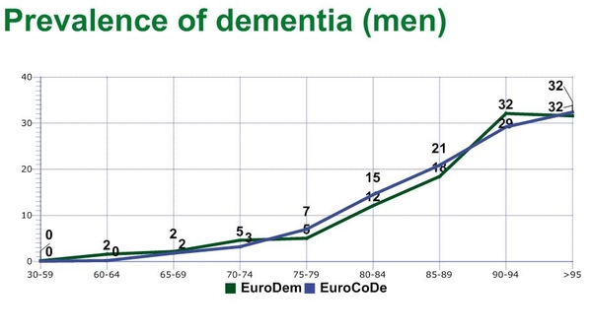
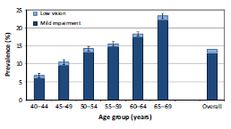
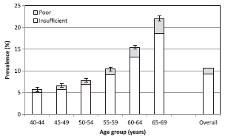
Hearing and vision impairment in dementia represents an unmet need
Dementia
Vision impairment
Hearing impairment
>33% of Europeans at age 90 have dementia
70% of Europeans >age 65 have sight or hearing loss
Cognitive & sensory problems are under-treated
Notes:
Hearing, vision and cognitive impairment are all within the top ten highest disease burdens in the European Union (EU) in terms of reduced quality of life and increased healthcare utilisation
comorbid cognitive and sensory ill health have greater difficulties in several aspects of their lives compared to individuals with dementia but without sensory impairments

Slide 3
Cognitive Impairment
Hearing Impairment
Visual Impairment
The overlap amongst sensory, cognitive and mental ill health →
“crucible of multi-morbidity"

Slide 4
Negative effect of poor sensory health on cognition and mental wellbeing
Decreased
Increased
Orientation
Self-location using visual or auditory clues
social activities and hobbies
Community interactions
Hallucinations, delusions, depression, aggression
Isolation from family
caregiver burnout
Distress leading to agitation
Overall negative impact on mental wellbeing
(Lawrence et al, 2008; McKeefry et al.; 2010; Elliott et al, 2009; Lupsakko et al., 2002; McDonnall et al., 2009)

Slide 5

Hearing Impairment
Hearing problems are under identified in dementia
(Allen et al. 2003)
Notes:
Allen, N.H., Burns, A., Newton, V., Hickson, F., Ramsden, R., Rogers, J., Butler, S., Thistlewaite, G. & Morris, J. (2003) The effects of improving hearing in dementia. Age and Ageing, 32 (2), 189-193.
83 People Mild/Moderate Dementia Memory Clinic in MCR
Differential diagnosis of hearing and cognition
HL exacerbates dementia?
Audiologists likely to be required to assess and treat people with both HL and dementia

Slide 6

PrOVIDE Study
Vision problems are under-identified in dementia
(Bowen et al. 2016)
Notes:
Clinically significant vision impairment VA<6/12
Refers to PWD resident at home (comparable to Allen hearing study)

Slide 7


Slide 8


8 EU countries; 27 investigators
Rotterdam
Manchester
Oldenburg
Frankfurt
Freiburg
Dublin
Athens
Nice
Bordeaux
Nicosia
7 EU countries 27 investigators 3 industry partners
Notes:
RCT = 36 week single blind randomised controlled superiority trial of ‘Sensory Support Intervention’ vs ‘CAU’
Primary outcome:
QoL (DemQoL) in PwD + HI/VI at 36 weeks
Secondary outcomes:
Function, cognition, behaviour, relationship satisfaction, caregiver outcomes and cost effectiveness
n=354 dyads (n=177 in the active arm)
Across 5 European sites (Manchester, Nice, Dublin, Nicosia, Athens) from April 2018
Suppliers: hearing aids (Starkey Ltd); lenses (Essilor)

Slide 9

5 years (2016-2021)
WP1: Exploration
WP2: Assessment
WP3: Intervention
WP4: Valuation
WP5: Involvement
WP6: Management
European Commission’s Horizon 2020

Slide 10
What is the link between poor hearing and vision and cognitive decline of aging?

Slide 11

Work Package 1:
Evaluation
Epidemiology to investigate hearing, vision and cognition
UK Team:
Dr Asri Maharani
Prof Neil Pendleton
Dr Gindo Tampubolon
EU wide WP 1 Lead:
Cécile Delcourt (Univ of Bordeaux)

Slide 12



WP1: Evaluation through Epidemiology
The English Longitudinal Study of Aging (ELSA)
  12 year longitudinal data;
  11,392 participants aged ≥50 years;
The Three City Study (3C)
  Bordeaux, Dijon, Montpellier
  14 year longitudinal data
  9,294 participants aged ≥65 years;
The Rotterdam Study
  20 year longitudinal data;
  15,000 participants;
The Tromso Study (Norway)
  5690 participants aged ≥ 45;
The Survey for Health and Retirement in Europe (SHARE)
  a pan-European meta-dataset

Slide 13

Age-profiles of cognitive function by hearing function
Respondents with poor hearing function have lower cognitive function.
SHARE
ELSA
HRS
Multilevel growth curve analysis

Slide 14
Age-profiles of cognitive function by visual function
Respondents with poor visual function have lower cognitive function
HRS
ELSA
HRS
SHARE
ELSA

Slide 15
Age-profiles of cognitive function by sensory impairment
Respondents with single and dual sensory impairment have lower cognitive function vs. no sensory impairment.
SHARE
ELSA
HRS

Slide 16
What is the link between hearing and vision impairment and dementia?

Slide 17
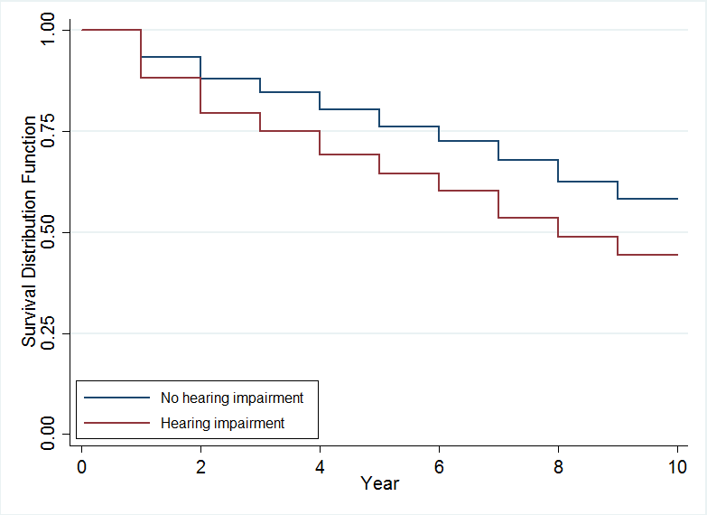
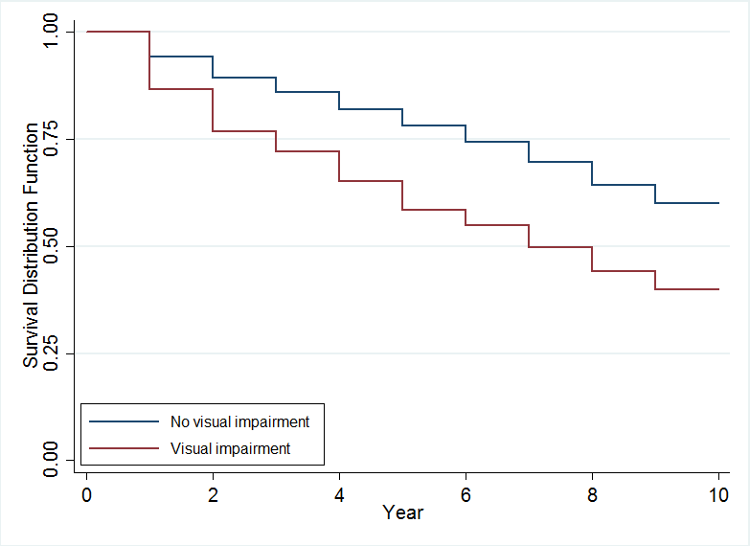
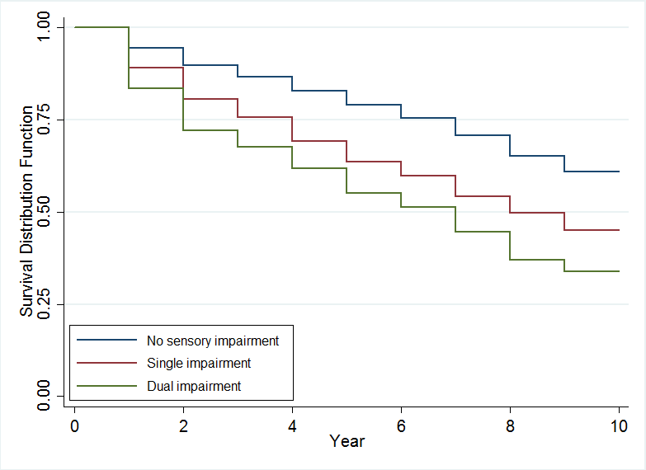
Sensory impairment and the risk of cognitive impairment no dementia (CIND)
Kaplan-Meier curves for unadjusted rates of CIND by hearing function, visual function, and both.
Hearing
Vision
Both
Hearing impairment:
HR=1.18; 95%CI=1.15-1.33;
p<0.001
Visual impairment:
HR=1.36; 95%CI=1.27-1.45;
p<0.001
Single impairment:
HR=1.31; 95%CI=1.23-1.4;p<0.001
Dual impairment:
HR=1.4; 95%CI=1.26-1.56;p<0.001
Abbreviations: HR, hazard ratio; CI, confidence interval.
Notes: Adjusted for age, gender, marital status, education, wealth, smoking and drinking behaviour, physical exercise, depression scores and number of comorbidities

Slide 18
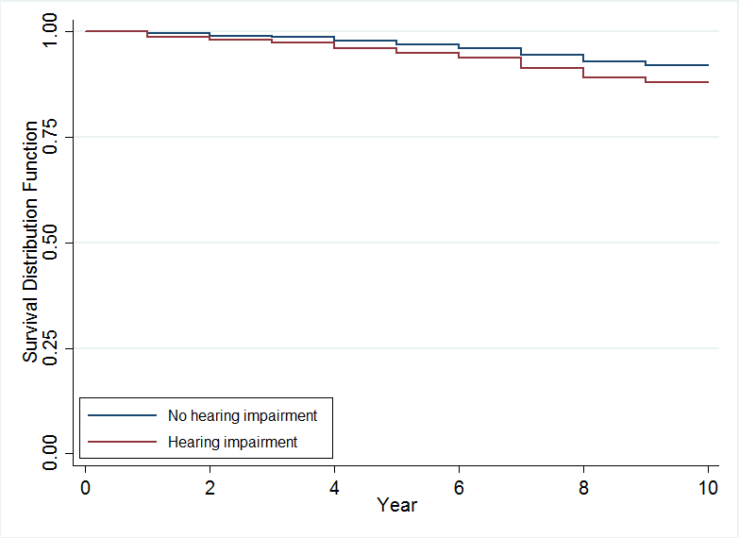
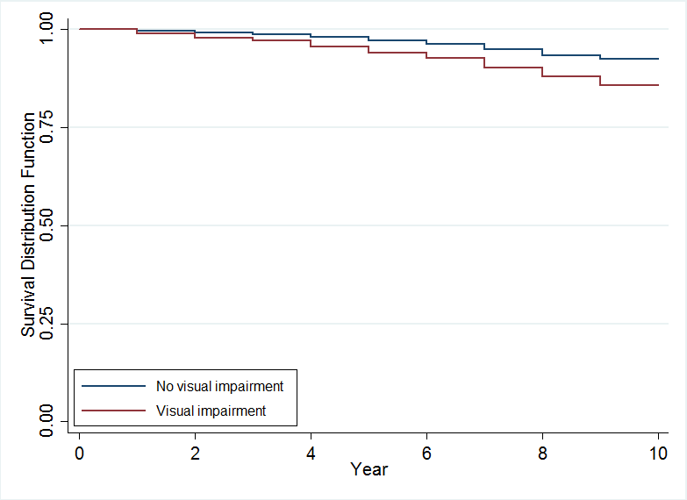
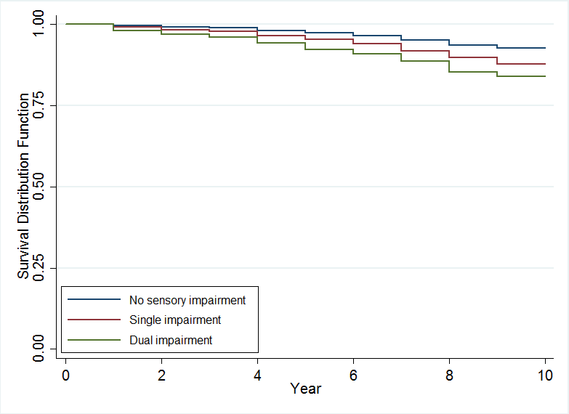
Sensory impairment and the risk of dementia
Kaplan-Meier curves for unadjusted rates of dementia by hearing function, visual function, and both.
Hearing
Vision
Single and dual
Hearing impairment:
HR=1.09; 95%CI=0.91-1.29;
p=0.313
Visual impairment:
HR=1.26; 95%CI=1.08-1.47;
p=0.003
Single impairment:
HR=1.2; 95%CI=1.03-1.4;p=0.001
Dual impairment:
HR=1.27; 95%CI=0.99-1.6;p=0.053
Abbreviations: HR, hazard ratio; CI, confidence interval.
Notes: Adjusted for age, gender, marital status, education, wealth, smoking and drinking behaviour, physical exercise, depression scores and number of comorbidities

Slide 19
Can improving hearing and vision improve cognition?

Slide 20
Is hearing aid use associated with any alteration in the rate of cognitive decline?
Sample: respondents who used hearing aids for the first time between waves 4 and 11 and who responded at least three waves of HRS. The final sample consist of 2,040 respondents.
Measures:
Cognitive function: episodic memory scores.
Hearing aid use: self-reported using hearing aids (1 for treated respondent, 0 for a non-treated respondent).
A spline model with a knot at the beginning of hearing aid use.
Statistical analysis:
Based on: Maharani A, Dawes P, Nazroo J, Tampubolon G, Pendleton N. 2018. Longitudinal relationships between hearing aid use and cognitive function in older Americans. Journal of American Geriatrics Society. DOI: 10.1111/jgs.15363

Slide 21
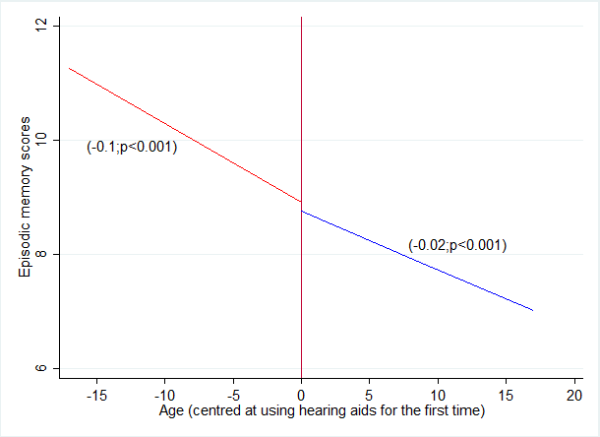
Predicted values of episodic memory before and after using hearing aids
Sample: respondents who used hearing aids for the first time between waves 4 and 11 and who responded at least three waves of HRS. The final sample consist of 2,040 respondents.
Notes: Age centered at using hearing aids for the first time. After controlled for gender, education, marital status, education, physical activities, depression scores and number of comorbidities.

Slide 22
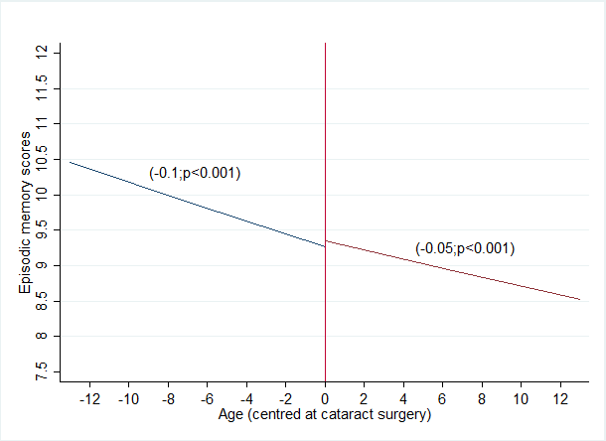
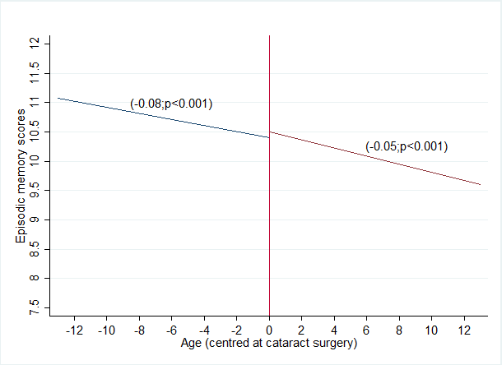
Predicted values of episodic memory before and after cataract surgery for treatment and group controls
A. Treatment group
B. Control group
Notes: Age centered at having cataract surgery.
After controlled for gender, education, marital status, employment, physical activities, depression scores and number of comorbidities.

Slide 23
Can improving hearing and vision PREVENT DEMENTIA?

Slide 24
The Lancet Commission 2018
Dementia prevention, intervention, and care
Gill Livingston et al.
Proposed a novel life-course model of risk by deriving population attributable fractions (PAF) of potentially reversible risk factors to show the possible effect on future incidence of dementia if able to eliminate these factors.
> 1/3 of dementia cases might theoretically be preventable

Slide 25

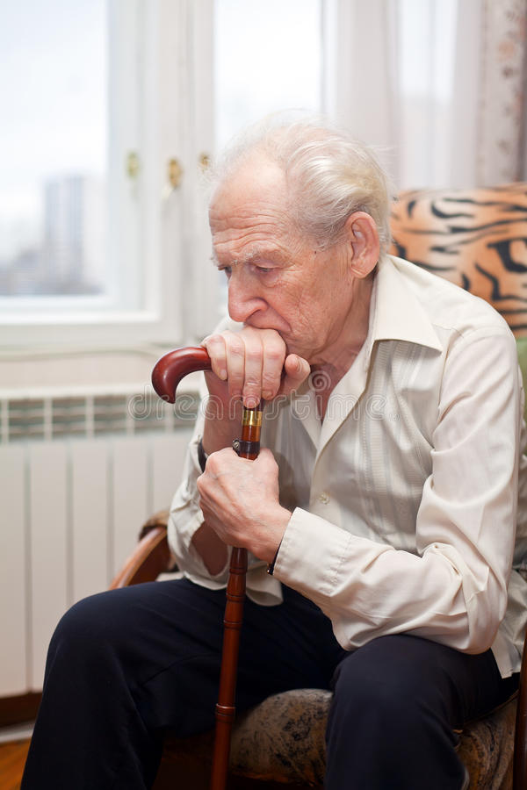

The Lancet Commission 2018
~35% of dementia due
to 9 risk factors:
education to ≤ 12 years old
midlife hypertension
midlife obesity
diabetes
late-life depression
physical inactivity
smoking
social isolation
hearing loss (6%)

Slide 26
Can improving hearing and vision improve the lives of people with dementia?

Slide 27

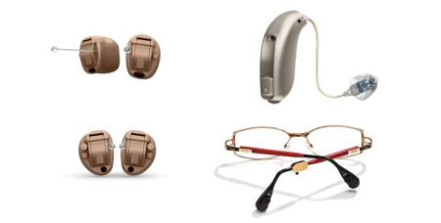
Work Package 3:
Intervention
Developing a Sensory Intervention to improve outcomes PwD and hearin or vision impairment

Slide 28




1. Expert Reference Group with 23 professionals in Athens 2016
2.Survey with 654 professionals
3. Literature Review of trials

Slide 29

Survey
ERG
Lit review
▪ Are needed and potentially feasible;
▪Should be interdisciplinary
▪Should include support in addition to devices
▪Should focus on quality of life as main outcome
Sensory interventions in PwD:

Slide 30

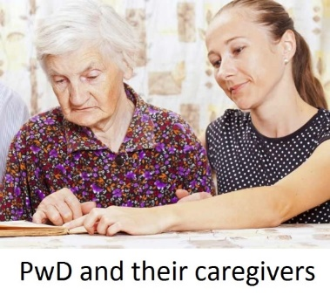



1. Identifying and developing components
Questionnaire survey
of needs
N= 100
Focus groups
n=8 PwD and n=8 caregivers per group
Key Findings:
Highly individualised pattern of need
QoL was predicted by hearing and vision impairment (controlling for age and gender)
Focus Group A:
What is life like for PwD and Hearing / Vision impairment?
Focus group B:
What are their support needs?

Slide 31

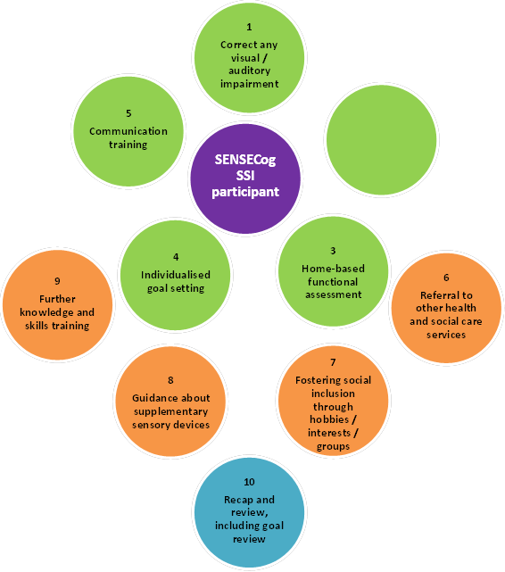


Tailored to individual needs with a focus on quality of life
Home-based,
Caregiver supported,
12 weekly sessions

Slide 32
The SENSE-Cog FIELD Study
38 individuals tried the intervention
3 countries
Intervention:
  Hearing and vision assessment
  Fitting of glasses and hearing aids
  Supporting the use of hearing aids (sensory therapist)
  Communication skills training for care partners
  Referring to community supports
  Improving the sensory environment at home

Slide 33
Interview quotes - caregivers
“My son said … oh I've noticed a difference with me dad since he's worn those hearing aids”
“That’s a huge thing that he now manages to do that [change hearing aid battery] himself…”
“Which is something very important, to feel comfortable and friendly with the person that visits you to do the research”
“It took a lot of persuasion and encouragement to wear them”

Slide 34

Step 4: Field testing the draft intervention
We have developed and refined a complex, novel ‘Sensory Intervention’ ready to be researched in a full scale, multi-site RCT.
Conclusion from the SENSE-Cog
Field Study:

Slide 35
The SENSE-Cog RCT: 5 EU Sites
Manchester
Dublin
Athens
Nice
Nicosia
Notes:
RCT = 36 week single blind randomised controlled superiority trial of ‘Sensory Support Intervention’ vs ‘CAU’
Primary outcome:
QoL (DemQoL) in PwD + HI/VI at 36 weeks
Secondary outcomes:
Function, cognition, behaviour, relationship satisfaction, caregiver outcomes and cost effectiveness
n=354 dyads (n=177 in the active arm)
Across 5 European sites (Manchester, Nice, Dublin, Nicosia, Athens) from April 2018
Suppliers: hearing aids (Starkey Ltd); lenses (Essilor)

Slide 36
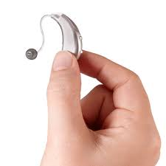


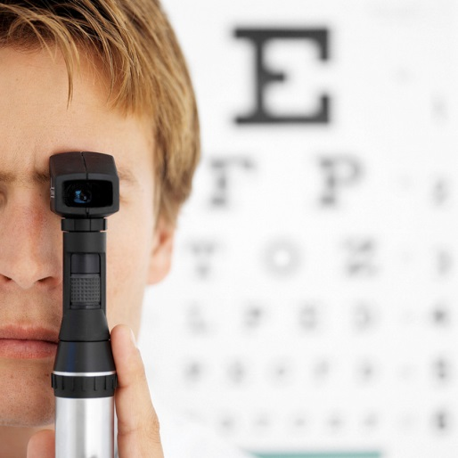
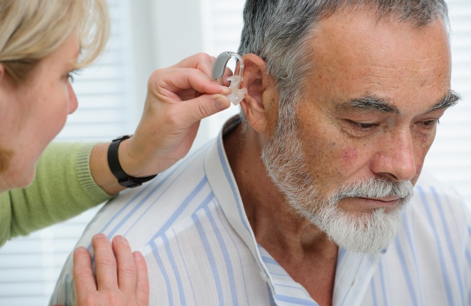

Interdisciplinary & industry involvement
Sensory Support Therapists
Audiologists
Optometrists

Slide 37

SENSE-Cog RCT: Sensory Intervention vs. CAU
n=354 participant dyads
(PwD and care partner)
From April 2018
Primary outcome:
Quality of life
Secondary outcomes: Function, cognition, behaviour, relationship satisfaction, caregiver wellbeing, cost effectiveness
Further information: www.sense-cog.eu/
or emma.hooper@manchester.ac.uk
Notes:
Primary outcome:
QoL (DemQoL) in PwD + HI/VI at 36 weeks
Secondary outcomes:
Function, cognition, behaviour, relationship satisfaction, caregiver outcomes and cost effectiveness

Slide 38
Thank you to our SENSE-Cog Family
University of Manchester
Centre des Récherches et des Ressources, Nice
University of Nice, Sophia-Antipolis
University of Bordeaux
European University of Cyprus
University of Cyprus
University of Athens
Erasmus University, Rotterdam
University of the Arctic, Tromso
Catholic University, Freiburg
Starkey Hearing Technologies Ltd
Essilor Ltd
HörTech, University of Oldenburg
http://www.sense-cog.eu/
Iracema.Leroi@manchester.ac.uk
Notes:
Any questions?
Thank you all for your time!

