Slide 1
Social prescribing: Less rhetoric and more reality
Paul Wilson
Alliance Manchester Business School, University of Manchester
NIHR CLAHRC Greater Manchester
paul.wilson@manchester.ac.uk

Slide 2
Social prescribing
Being widely promoted as a way of improving health outcomes, at low cost
Provides GPs with non-medical referral options that can operate alongside existing treatments
Usually involves referral to a link worker who works with the patient to prescribe appropriate information and advice, and or a range of community based activities

Slide 3
Context
Evaluating ways to support evidence inform decision making in NHS commissioning in the North of England
Responsive service addressing questions raised by local decision makers
Briefings based on existing synthesised evidence
Systematic reviews (DARE, Cochrane)
Economic evaluations (NHS EED)
Guidelines (NICE)

Slide 4
Emerging evidence?
“emerging evidence that social prescribing can lead to a range of positive health and well-being outcomes.”
“A study showed that for more than 8 in 10 patients referred to the scheme who were followed up three to four months later, there were reductions in NHS use.”
“Exploratory economic analysis suggested that the scheme could pay for itself over 18–24 months in terms of reduced NHS use.”
https://www.kingsfund.org.uk/topics/primary-and-community-care/social-prescribing

Slide 5
So really, what’s the evidence?
We examined the evidence for the effectiveness of social prescribing programmes relevant to the NHS
As per the Social Prescribing Network definition:
Any published evaluation of programmes where healthcare professionals refer patients from primary care to a link worker or facilitator for any form of social prescription was eligible for inclusion
Bickerdike L, et al. BMJ Open 2017;7:e013384.

Slide 6
We found a mess
Overall, we identified 15 evaluations conducted in the UK but no convincing evidence for either effectiveness or value for money
Most were small scale and limited by poor design, conduct and reporting
All were rated as a having a high risk of bias
Despite clear methodological shortcomings, most evaluations present positive conclusions, generating a momentum for social prescribing that does not appear to be warranted
Bickerdike L, et al. BMJ Open 2017;7:e013384.

Slide 7
Characteristics of evaluations
Poor reporting
Measurement issues
Completeness of data
Confounding
High risk of bias

Slide 8
Remember emerging evidence?
1607
451
108
42
1118
42

Slide 9
How do we avoid the pitfalls?
Adopt a systematic and planned approach to evaluation

Slide 10
What does that look like?
Clear objectives / theory of change
Formative evaluation
Use of validated outcome measures
Use of comparative designs
Transparent reporting

Slide 11
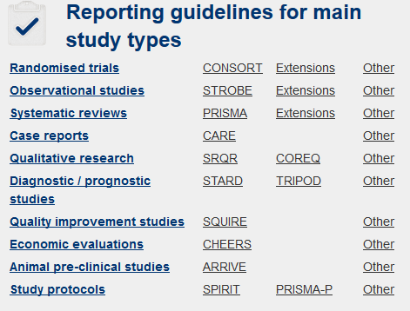
Transparency

Slide 12
Summary
Social prescribing is being widely promoted as a way of improving health outcomes, at low cost
But not yet able to reliably judge which, if any, social prescribing programmes are worth pursuing further and or what the added value may be to existing services
Evaluation is crucial if we are to determine whether new services are worth pursuing further and or what their added value may be

Slide 13
Disclaimer
Bickerdike L, Booth A, Wilson PM, Farley K, Wright K. Social prescribing: less rhetoric and more reality. A systematic review of the evidence. BMJ Open 2017;7:e013384.
This review was part of a project funded by the NIHR Health Services and Delivery Research programme (project reference: 12/5002/18). The views expressed in this presentation are those of the authors and not necessarily those of the NHS, the NIHR or the Department of Health.
For further information contact paul.wilson@manchester.ac.uk

