Slide 1
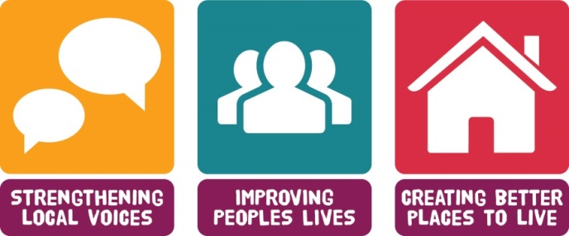
Role of Community Assets
in
supporting good health and wellbeing
Bernadette Elder – CEO
Inspiring Communities Together

Slide 2
Inspiring Communities Together
Neighbourhood based charity
Membership led – Trustees elected through membership
Delivers activity – learning and volunteering
Facilitates – bring people together through two local forums
Advocate – link between agencies and local community
Securing resources – paid work linked to aims
Integrated Care – Community Asset theme lead
http://inspiringcommunitiestogether.co.uk

Slide 3
Over view of Salford -
Total population is 236,000
Eight neighbourhoods
Although there are diverse levels of affluence, Salford is ranked as one of the most deprived local authority areas in England with life expectancy lower than the England average
Population of people aged 65 and over is 35,000
Number of older people is forecast to rise by 28% by 2030

Slide 4
Context –
Loneliness = £ to some one who smokes 15 cigarettes a day
Not eating well - 14% (nearly 5000) of people aged 65 and over may be at risk of malnutrition (using BAPEN prevalence tool)
Falls = over 4 million NHS bed days each year
Physical environment and socio-economic factors account for 50% of the determinants of health
GPs spend fifth of consultation time on non-health problems

Slide 5
What we are trying to achieve -
Improved outcomes for local people – effective use of community assets across Salford to support solutions to health and well-being for and by local people
Better informed people able to manage their own health and well-being – information is accessible in a number of formats and written in plain English
Better coordination amongst stakeholders – sharing resources and reducing duplication to improve health and well-being outcomes for people
Increase skills and knowledge – people are better able to deliver solutions and motivate others to improve health and well-being outcomes

Slide 6
Community Asset model
Using the knowledge and life experiences of people to make life better by listening to and valuing their views: making sure this influences services to be better in future by building on community strengths. This will keep people in Salford healthy, happy and independent for longer”

Slide 8
Realising the Value – Person and community centred model
Support for individuals to develop knowledge, skills and confidence to manage their own health and well-being
Formal access
Clinical and social care
Care and support planning
Informal access
Person and community- centred approaches
Including –
Peer support
Self-management education
Health coaching
Group activities
Asset-based approaches
Intended impact: People become active partners in their own care and their health and well-being improves. This leads to a reduction in the need for some formal health and care services as well as wide social benefits

Slide 9
So how do we get from…

Slide 10
…to connect to this?

Slide 11
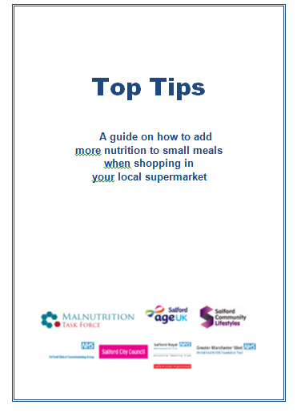
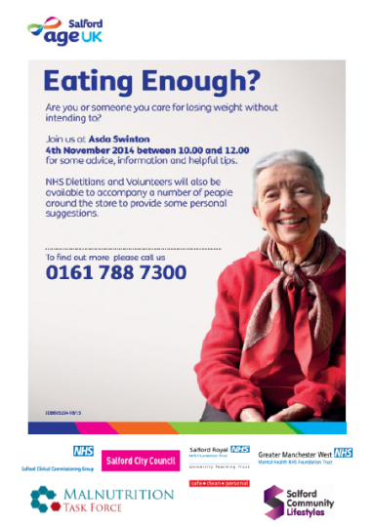
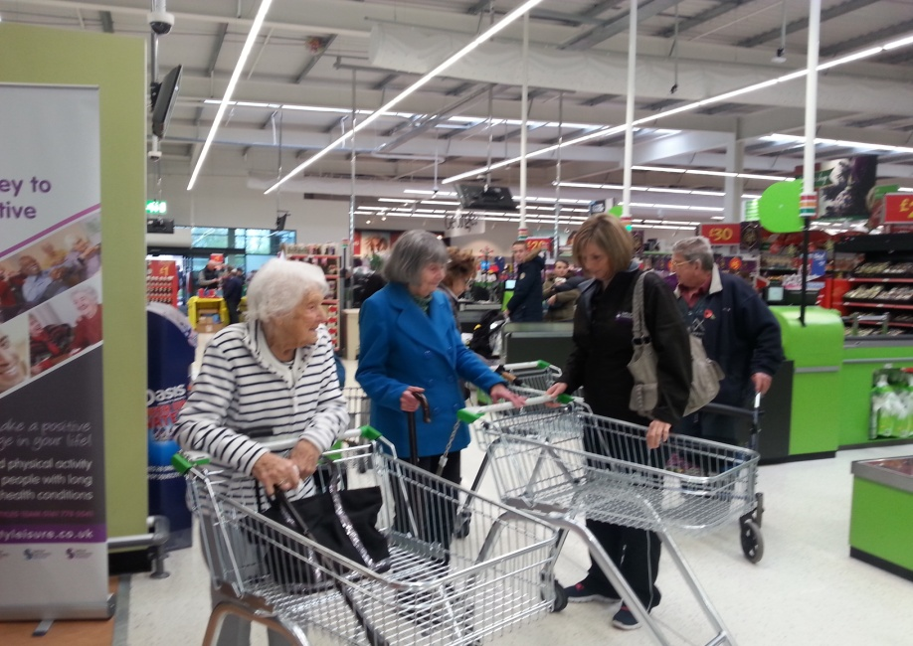
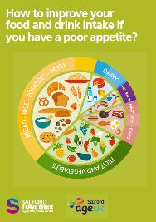
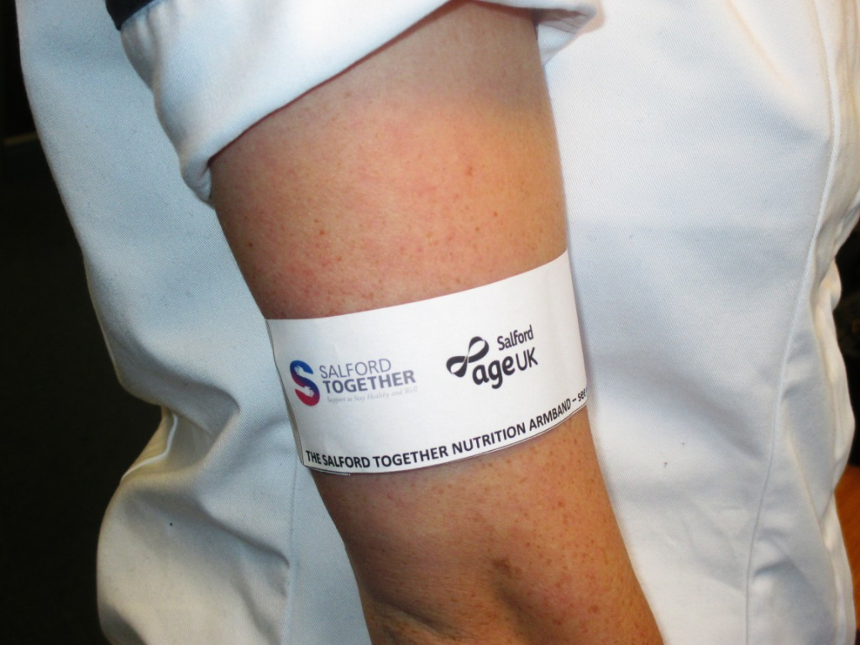
Eating well in later life
http://www.nhselect2.org.uk/malnutrition/salford.php

Slide 12
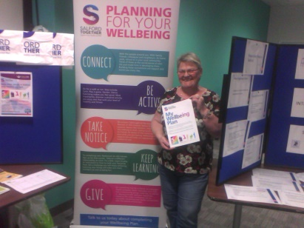
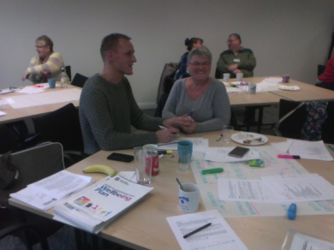
Well-being plans - Developed working with older people
Learning programme developed to enable champions to go out and have “that conversation” with people
Volunteer Well-being champions - Active in community assets across Neighbourhoods in Salford
90 Salford Together
Volunteer Well-being champions fully trained
1600 hours of volunteering time completed during 2016

Slide 13
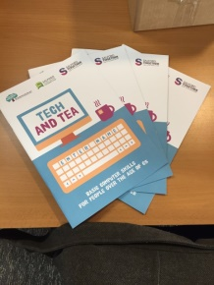
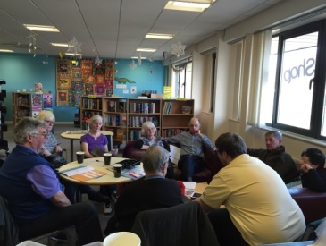
Tech and Tea
Running across community assets – care homes, libraries, community centres
Improved digital skills – on line well-being plans, access to health and well-being information, connecting with others (600 older people have attended at least one session – March 17)
Keeping in touch: Communication with family and friends was important for some of the participants
Improving health and well being: The ability to stream videos and music enabled people to set up a Spotify Account and stream music while others discovered YouTube and were browsing for old videos of Salford
Reducing social isolation and loneliness: Some participants had never met each other despite living in the same care home so new friends within the scheme have been made
Volunteering – Well-being champions support activity

Slide 14
What it means to people in Salford
Increased public awareness that losing weight, and being lonely are not a natural part of ageing
More people equipped with tools to self manage their own health and well-being
More neighbourhood assets have access to information and tools to support people to manage their own health and well- being
More neighbourhood assets are better equipped to detect early signs and know how to provide advice and guidance to people
Easier access to activity and written information for people to help them manage their own health and well-being

Slide 15
Opportunities and challenges
Opportunities:
Community Asset approach recognised as part of the solution
Budget allocation – Lowest % at present
Starting to demonstrate impact = £££
VCS and local people as partners in coproduction of model
Challenges:
Moving funding outside the system
VCS working in partnership – Salford approach 3SC (86 members)
Large contracts V small scale neighbourhood interventions

Slide 16
Thank you for listening – For further information
Participation in community assets with health-related quality of life and healthcare usage – Manchester University http://bmj.com
Realising the value - http://www.nesta.org.uk/project/realising-value
http://www.salfordtogether.com
http://inspiringcommunitiestogether.co.uk
bernadette@inspiringcommunitiestogether.co.uk

