Slide 1
Methodology for Studying the Well-Being of Poor People in Bangladesh
Monday 12th September 2016
DSA 2016: P50: Labour as method for the study of development in South Asia, Sub-Saharan Africa & Latin America
Dr. Samantha Watson, Lecturer in Global Health & Development, LSHTM

Slide 2
Acknowledgements
Gender Norms Project
(ESRC DFID Grant, Gender Norms, see:
http://www.cmist.manchester.ac.uk/research/projects/gender-norms/)
Principal Investigator: Wendy Olsen (University of Manchester)
Bangladesh PIs: Simeen Mahmud, Sohela Nazneen, and Maheen Sultan
Analysts: Bidisha (Dhaka Univ Dept of Econ) and Sadiya (BRAC BIGD)
Additional co-PI’s: Kunal Sen (University of Manchester), Amaresh Dubey (JNU), Daniel Neff (Giga)
Data Collection by the Bangladesh Team at BRAC University, Dhaka

Slide 3
Overview
Explore the evidence for adaptation in our survey data on wellbeing. Women generally report being satisfied with their lives as a whole, but this belies a complex lifeworld
Showcase ‘keyness’ - a method to analyse resonance through relative prevalence
Triangulate survey findings with interpretation of case studies based on interview data

Slide 4
Overview
RQ1:
(How) is women's well-being related to their attitudes, social position, wealth, and work?
RQ2:
(How) does a mixed-methods design incorporating ‘keyness’ aid the study of the socially embedded and changing reality of multidimensional well-being

Slide 5
The Research Sites
Sample drawn from nine probabilistically selected villages in four purposively selected districts
Three types of ‘terrain’ covered:
Char (n = 99)
Forest (n = 150)
Neither (n = 196)
Notes:
Four districts were purposively selected – three in the North of the country and one in the south. (Satkhira in the South and Gaibandha Rangpur Lalmonirhat in the North). One Upazila in each district was then selected, and one Union within each Upazilla. Two – three villages were selected from each Union, giving a total of nine villages. In total 415 households took part in the survey. One couple was randomly selected in each household to complete the individual modules. 445 women and 370 men completed the individual surveys. 41 of our survey respondents took part in semi-structured interviews.

Slide 6
Primary Data
Survey data (n = 450 probabilistically selected households)
450 probabilistically selected households
Wellbeing (one couple per household)
Attitudes (one couple per household)
Time use (one couple per household)
  Diary recall method (40 condensed codes)
  One day recall for the previous day in 15 minute intervals
Household demographics, labour, assets, debts, benefits
Semi-structured interview data (n = 45, selected by max var.)
Each interview around one hour long
Transcribed in local language, translated to English
Analysis conducted in NVIVO

Slide 7
Context
Figure one: Labour situation (paid work availability and invisibilised labour)
98% of women state “housewife” as their principle labour activity (mean time on household reproduction is 335 minutes, max is 787)
77.2% undertake market labour overall (2/3 as “own account”)
Almost a quarter (23.8%) of women have no income-earning work
Among those who work for pay the mean time was 170.8 minutes (median was 125), the max is 985

Slide 8
Context
Figure two: Household class
Wage labour and subsistence farming households dominate (57% of households, rising to 83% in chars)
  - these households have under one acre of land
Petite bourgeois households (31.7%) depend on own account or paid work, own 1-10 acres, and do not hire in
Capitalist households (11.2%) hire in labour and own more than 10 acres

Slide 9
Context
Figure three: Household non-land assets
Mean value of consumer goods is 115,649 taka
In Chars this falls to 14,990 taka
Graphed against age – we see little chance for accumulation over the life course
Notes:
The median value is 40,000 – meaning 50% of our sample have assets totalling £380 or less.

Slide 10
Context
Figure four: Household landholdings
Landlessness is widespread - 42% overall (rising to 81% in chars)
32% of landed households have only marginal acres (less than one acre)
High levels of inequality in landholdings. 19% of landed households have holdings exceeding ten acres
Notes:
The median value is 40,000 – meaning 50% of our sample have assets totalling £380 or less.

Slide 11
Subjective wellbeing
“Over the past 6 months, how satisfied have you been with your life overall”
Satisfaction with life as a whole (% of sample) | Freq. | Percent
Very dissatisfied | 12 | 2.70
Dissatisfied | 65 | 14.61
Neither satisfied nor dissatisfied | 60 | 13.48
Satisfied | 255 | 57.30
Very satisfied | 53 | 11.91
Total | 445 | 100
Very few women – 2.7% - report being very dissatisfied
  (17.3% are very dissatisfied or dissatisfied)
Overall 69.2% of women report being very satisfied or satisfied
  (very satisfied >4 x very dissatisfied)

Slide 12
Subjective wellbeing
“Over the past 6 months, how satisfied have you been with your life overall”
Value of households non-land assets | Overall satisfaction with life
 | n | Mean | Std. Dev. | Very dissatisfied | Dissatisfied | Neither satisfied nor dissatisfied | Satisfied | Very satisfied | Total
Quintile 1 (mean asset value: 5,127) | 89 | 2.62 | 0.91 | 1.12% | 15.73% | 13.48% | 59.55% | 10.11% | 100%
Quintile 2 (mean asset value: 17,299) | 91 | 2.53 | 0.98 | 2.20% | 19.78% | 9.89% | 59.34% | 8.79% | 100%
Quintile 3 (mean asset value: 42,969) | 87 | 2.59 | 1.03 | 4.60% | 12.64% | 16.09% | 52.87% | 13.79% | 100%
Quintile 4 (mean asset value: 107,041) | 89 | 2.62 | 0.90 | 1.12% | 13.48% | 19.10% | 55.06% | 11.24% | 100%
Quintile 5 (mean asset value: 406,382) | 89 | 2.71 | 1.01 | 4.49% | 11.24% | 8.99% | 59.55% | 15.73% | 100%
Overall | 445 | 2.61 | 0.97 | 2.70% | 14.61% | 13.48% | 57.30% | 11.91% | 100%
Kruskal-Wallis test: P = 0.7568 (statistically non-significant difference in life satisfaction by wealth)

Slide 13
Subjective wellbeing
“Over the past 6 months, how satisfied have you been with your life overall”

Slide 14
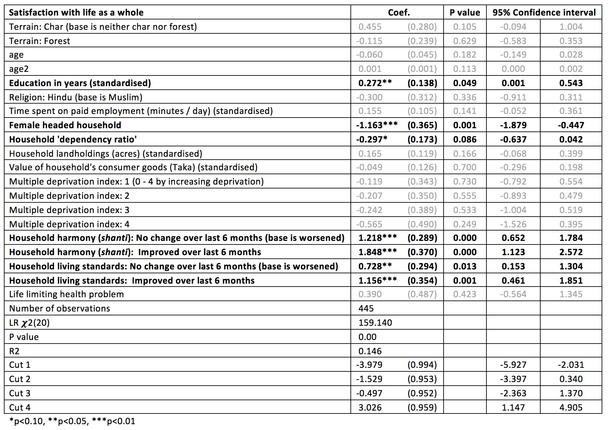
Ordinal Logistic Model: Subjective wellbeing
+
Education
Household harmony
Household living standards
-
Female headed household
Household dependency ratio
~
Household assets / deprivations
Life-limiting ill-health / disability
Paid employment
Terrain
Notes:
Preliminary analysis.

Slide 15
How to explain the high rates of life satisfaction reported?
  Adaptive capacities / satisfaction paradox
  Desirability bias (socially acceptable answers)
  ‘fit’ with aspirations / expectations
  Optimism
  Incompatibility of expressing dissatisfaction and religiosity
  However:
  Evidence of tensions and heterogeneity in a context of complex lifeworlds

Slide 16
Introducing “Keyness” as discourse analysis
Corpus linguistics offers a dispassionate way to use all the Semi Structured Interview data
’Keyness’ denotes the centrality of each word in our pooled texts
Our comparative text (corpus) is the Baby British National Corpus (BNC)
We must still use our professional judgment when coding - the analysis is not ‘automated’

Slide 17
Introducing “Keyness” as discourse analysis
Six stage analysis process, using NVIVO, EXCEL, STATA
Pool the transcripts in a single file, perform a word frequency query
Measure the ‘keyness of terms’ (using a modified version of corpus linguistics)
Code the concordances
Group the words into discourses (Interpreting select discourses only)
Discern the dominant discourse – next consider marginalised / deviant / innovative ones
Trace the key arguments through competing discourses

Slide 18
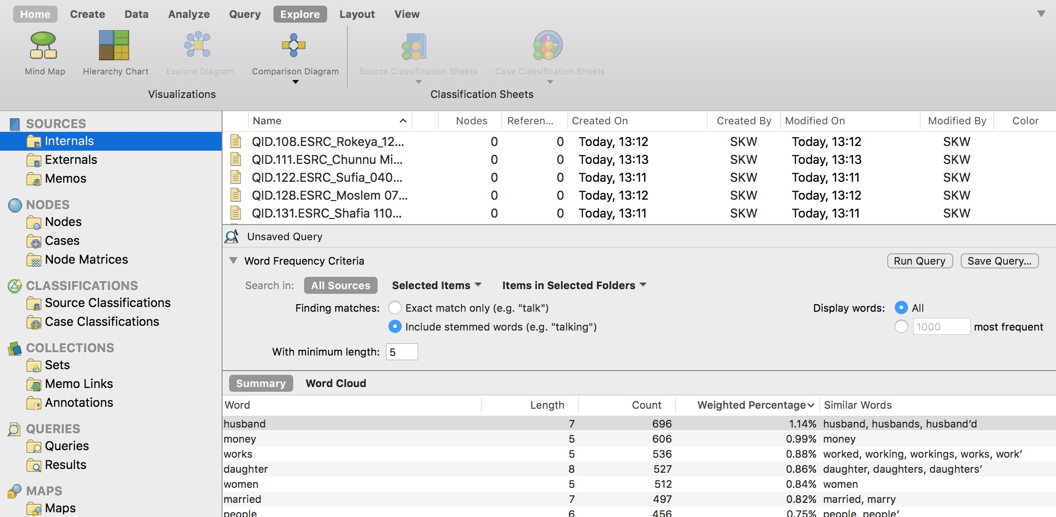
1. Pool the transcripts in a single file

Slide 19
1. Pool the transcripts in a single file

Slide 20
1. Pool the transcripts in a single file

Slide 21
1. Pool the transcripts in a single file

Slide 22
2. Measure the keyness of terms
We have a count of the number of times each word occurs in our pooled SSIs
We divide the count for each word by the total number of words (in this case 2,333)
This gives us a measure of the odds of each word’s occurrence in our pooled SSIs
ii. We repeat the process for the words in our corpus
We then calculate odds ratio’s - the relative odds of each word occurring in our SSIs relative to their occurrence in the corpus (dividing the odds of the former by the odds of the latter)
The higher the Odds Ratio, the more central the word is to our interview themes. We set a cut-off level for keyness (the odds ratio). In this study we use a cut-off of 1.5

Slide 23
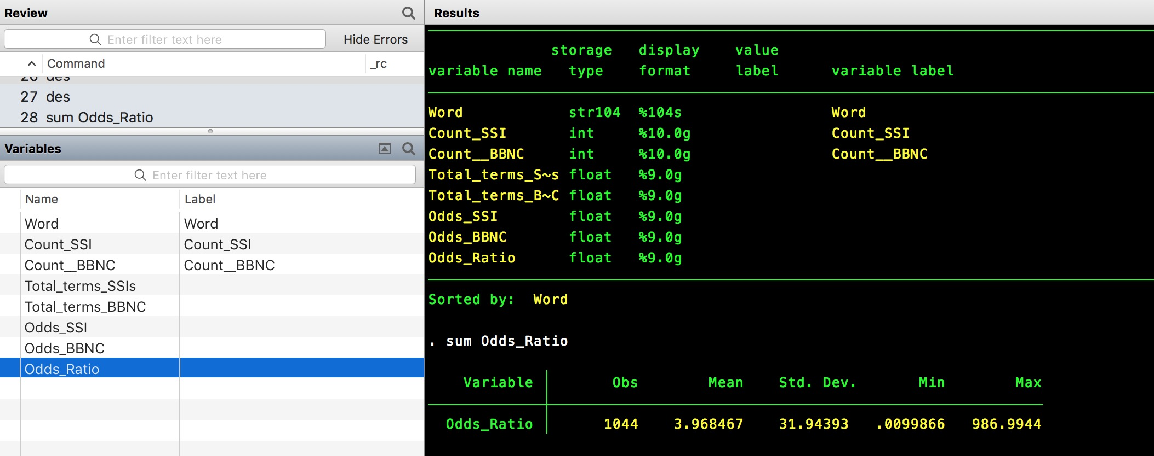
2. Measure the “keyness” of each term
Notes:
Here the maximum OR is 987 – this is for the term Allah, which occurs 58 times in our SSIs compared with once in our corpus

Slide 24
2. Measure the “keyness” of each term
Word (delematised) | Count SSIs | Odds SSIs | Count BBNC | Odds BBNC | Keyness (Odds Ratio)
Allah | 58 | 0.025 | 1 | 0.000 | 986.994
Kendra | 6 | 0.003 | 1 | 0.000 | 102.103
poultry | 29 | 0.012 | 5 | 0.000 | 98.699
gotten | 28 | 0.012 | 5 | 0.000 | 95.296
anymore | 51 | 0.022 | 10 | 0.000 | 86.787
homestead | 9 | 0.004 | 2 | 0.000 | 76.577
bazaar | 40 | 0.017 | 9 | 0.000 | 75.632
betel | 18 | 0.008 | 5 | 0.000 | 61.262
neighbors | 7 | 0.003 | 2 | 0.000 | 59.560
goats | 66 | 0.028 | 21 | 0.001 | 53.482
rokeya | 3 | 0.001 | 1 | 0.000 | 51.051
carpenter | 36 | 0.015 | 14 | 0.000 | 43.758
Labor | 23 | 0.010 | 9 | 0.000 | 43.488
behavior | 5 | 0.002 | 2 | 0.000 | 42.543
rainy | 13 | 0.006 | 6 | 0.000 | 36.870
bangles | 2 | 0.001 | 1 | 0.000 | 34.034
floodwater | 4 | 0.002 | 2 | 0.000 | 34.034
handover | 2 | 0.001 | 1 | 0.000 | 34.034
hometown | 2 | 0.001 | 1 | 0.000 | 34.034
passbook | 2 | 0.001 | 1 | 0.000 | 34.034
ramadan | 2 | 0.001 | 1 | 0.000 | 34.034
saltwater | 2 | 0.001 | 1 | 0.000 | 34.034
savvy | 2 | 0.001 | 1 | 0.000 | 34.034
paddy | 76 | 0.033 | 42 | 0.001 | 30.793
harvest | 70 | 0.030 | 41 | 0.001 | 29.054
Notes:
Here the maximum OR is 987 – this is for the term Allah, which occurs 58 times in our SSIs compared with once in our corpus

Slide 25
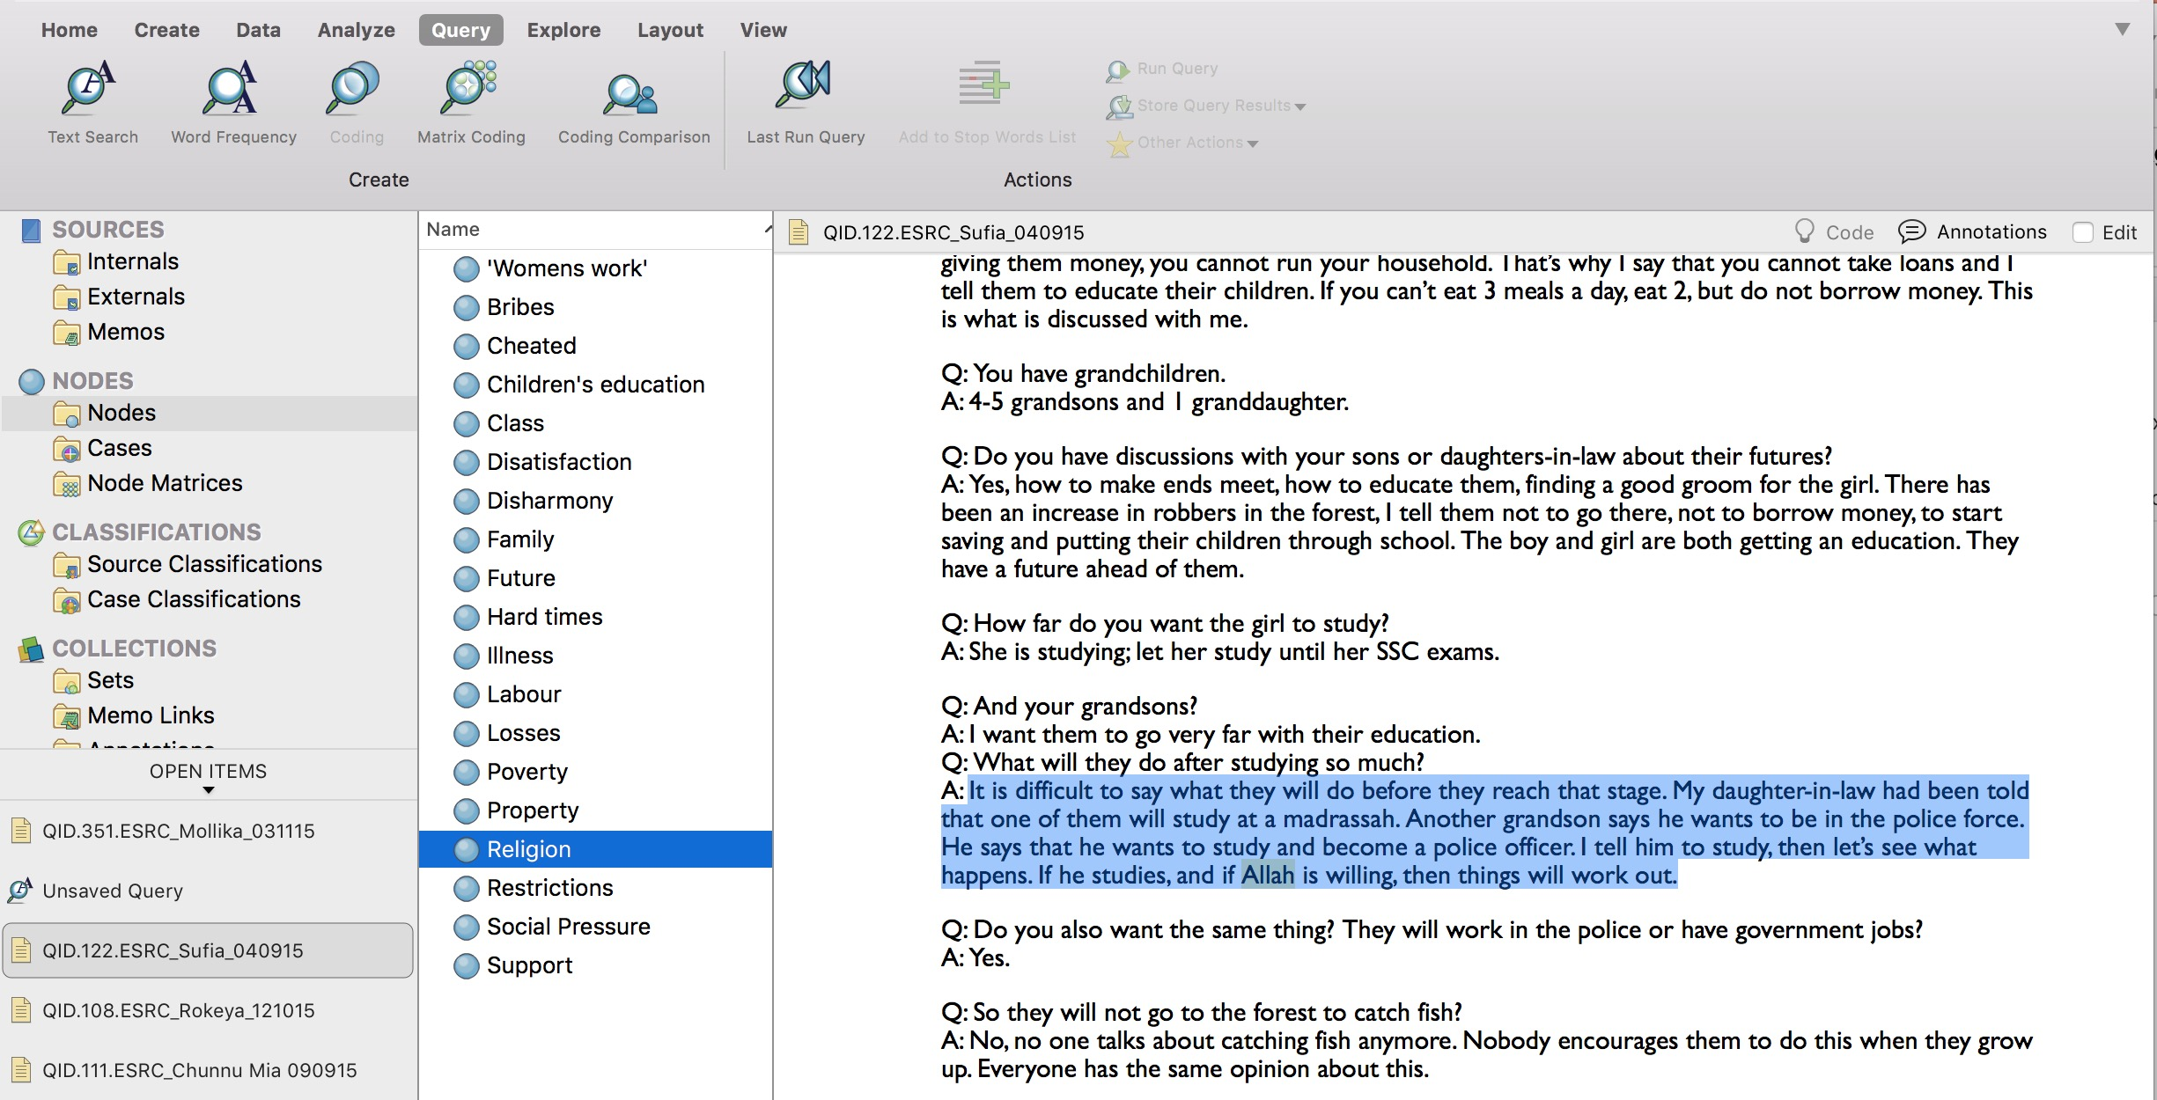
3. Code the concordances
We set the concordance to include 30 words in which the term is embedded.
We re-read the passages prior to beginning to interpret them

Slide 26
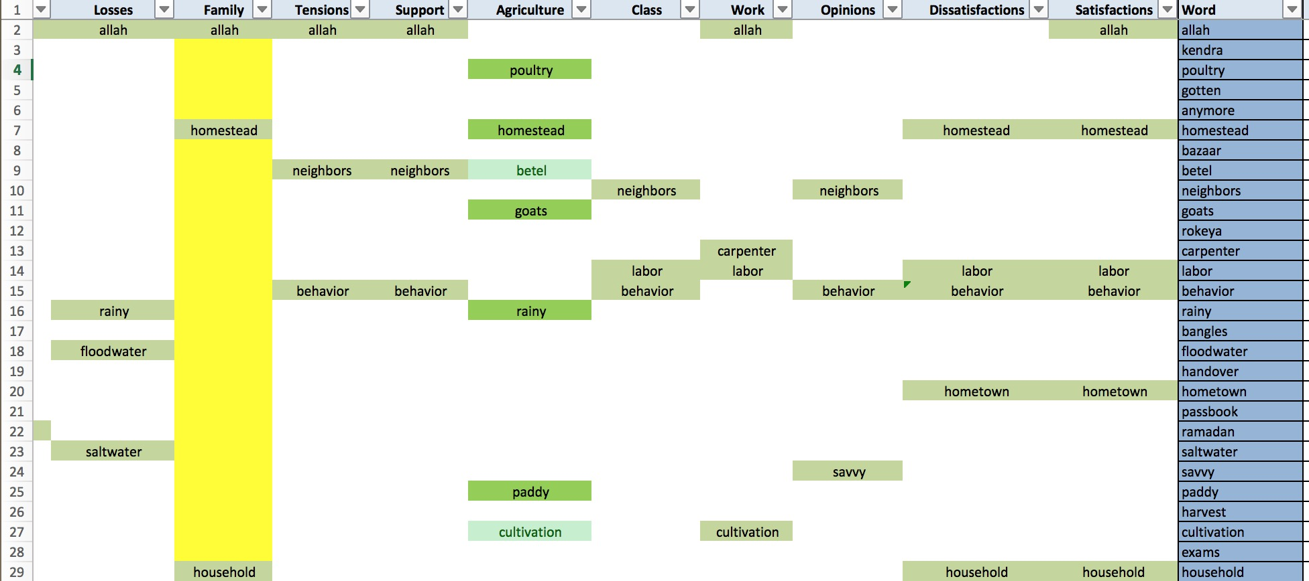
4. Group the words into discourses

Slide 27
5. Discern the dominant / marginalised / innovative discourses
Keyword | Discourse
Marriage (Keyness = 4.5) | In the dominant discourse around family inter-dependencies, a woman without family protections is described as a 'lady’. Resistance, desertion, and exception are discussed at length. Women's whose husbands have 'abandoned' them are low in the social order. But there is heterogeneity in experiences. Here strong relations with parents / in-laws / children, and / or sufficient and acceptable income-earning work make a difference.
Daughter (Keyness = 21.2) Children (Keyness = 3.1) | In the discourse around family obligations, there is evidence of shifting expectations and tensions. A dominant discourse prevails in which familial obligations extend through the generations, but competing discourses focus on the break-down of inter-generational reciprocity. Among women who have been abandoned or widowed, tensions and strains in relation to their children are evident. For women with school age children, the desire to educate both girls and boys is strong, but uncertainty about the future. For women with adult children, there are competing discourses of independence, reliability, support, and disappointment.
Labour (Keyness = 43.5) | In the discourse on public visibility, there is evidence of ongoing change. There is a consensus that it is now more acceptable for women to work for pay, where before it was not. Women undertaking daily paid labour alongside their husbands, running small shops, and working on ghers face fewer social sanctions. A renegotiation of the boundaries of modesty is apparent. While many respondees articulate these changes, not all approve of them. For women with traditional attitudes to gender norms (and / or family members who uphold them) a tension arises when they feel compelled to work outside in opposition to their beliefs about women's roles.

Slide 28
5. Trace the key arguments through competing discourses
Keyword | Competing discourse examples
Labour (Keyness = 43.5) | Saleha is 60 years old. She is a widow with chronic health problems. She reports being very dissatisfied. She lives alone in the Northern region. Her INDI score is in the highest quartile. She has suffered losses from river erosion in the past. She has tried to acquire a pension but to no avail (she can’t afford the bribes). Her egalitarian score is close to the central tendency (.2) and it pains her that she must work ‘outside’. She does so because she doesn't want to / can’t “burden” her sons. Both she and her sons are criticised for their “failure to support” her.
 | Aleha also reports that she is “very dissatisfied”. She is 32 years old, and lives with mother and two children in a single-room house in the Northern region. The house is owned by her brother. Her mother and brother wish she would not “work outside” but her situation demands it. Her husband abandoned her in Dhaka 2 years previously, leaving her with large debts. She took a job in a garment factory in Dhaka for 18 months to repay the debts (she had not worked outside the home before). She returned to the village because her daughters’ education was suffering. Her egalitarian score is -10.5. She holds very conservative views about the roles and responsibilities of women and men. The dissonance between her views and her experience is at the root of her dissatisfaction. She says “I do not worry about my own happiness. As long as my children are happy”
 | Shoshunda reports that she is “satisfied”. She is a widow and has a close relationship with her adult children. She feels respected and appreciated by her family and takes pride / pleasure in being able to support herself. She has a widow’s allowance which provides some extra income. The work she does – running a small shop but also working as daily wage labour when she needs to – has not invited social censure (“No one thinks ill of me ”). She has an egalitarianism score of 8.97, placing her in the top 1.5% of female respondees.

Slide 29
Preliminary findings
  High levels of overall satisfaction disguise heterogeneity and complexity in women’s lives. Supportive family relationships are highly implicated in high levels of overall satisfaction. Their absence is deeply felt
  Women in villages suffer considerable threats to their self-respect. Dissonance between expectations, aspirations, and experiences implicated in dissatisfaction among women, particularly when it infringes on conservative notions of honour and modesty
  The benefits of market / paid work depend profoundly on both the nature of the work and the degree to which it resonates with women’s own values and aspirations
  Concern with the future occupies women who are wholly dependent on adult children for their old age
  Comparisons between present and past and past, present, and anticipated future inform women’s assessments of their overall satisfaction. Physical and financial hardship are endured and sacrifices made to support children / avoid being burdensome

Slide 30
Implications / next steps
  By combining the ‘Keyness’ stage with a regression stage and a selective interpretation stage, the best use can be made of different kinds of expertise – translation, noticing patterns and prevalences, and interpreting. We leave some further interpretation to do later, or for others to do.
  The same thing is done in statistics where models are debated in an ongoing, open-ended way
  The goal of the interpretation stage is to match, complement or contradict the original Research Question(s) and commonly accepted factual statements.
  More details here: IMMN link: https://www.facebook.com/groups/438437119631157/

Slide 31
Thanks!
samantha.watson@lshtm.ac.uk

