Slide 2
Innovation for sustainability: telecentres and mobile phones for development
Harsha Liyanage, Phd, MBA
ICT4D Practitioner (Sarvodaya-Fusion, Sri Lanka),
Principal consultant (eNovation4D, UK)
www.fusion.lk
email: harsha@enovation4d.co.uk
Cambridge International Development Course
University of Cambridge, Cambridge, UK
03 December 2011

Slide 3
Content
Sustainable development – definition and hypothesis
Sri Lanka, ICT and Poverty profile
Problem – we are trying to answer
Fusion – an introduction
Innovation & sustainability
Programme innovation landscape
Product innovation – in telecentre landscape
Product innovation– in mobile phone 4D landscape
Summary

Slide 4
Definition
"Sustainable development is development that meets the needs of the present without compromising the ability of future generations to meet their own needs”.
(Needs: in particular the essential needs of the world's poor)
Brundtland Report, 1987
Working Hypothesis
Innovation 4SD = product + social impact + community acceptance
(or programme)
(community = target market)
(Innovation 4SD: Innovation for sustainable development)
(Note: environmental impact was not taken into the account, in our current effort)

Slide 5
Sri Lanka Poverty profile
Poverty profile, Sri Lanka
Poverty head count ratio at $1.25 / day | 7%
Poverty head count ratio at $2/ day | 29.1%
Poverty incidence at urban sector | 6.7%
Poverty incidence at rural sector | 15.7%
Source: World Bank & Censes and Statistics by Gvt SL, 2011.

Slide 6
Sri Lanka ICT profile
 | 2000 | 2009
Telephone lines (per 100 people) | 4.1 | 16.9
Mobile cellular subscriptions (per 100 people) | 2.3 | 69.4
Population covered by mobile cellular network (%) | 58 | 95
Fixed Internet subscribers (per 100 people) | 0.2 | 1.2
Source: World Bank statistics, 2010.

Slide 7
Problem
Despite the presence of technologies (telecentres, internet, mobile phones) rural poor are not educated or skilful to apply them for their development.
600+ telecentres are underutilized
95% mobile penetration is not systematically tapped for development advantage
Middle income sector of 21mil population in 36,000 villages in 25 districts seek appropriate ICT services to meet their aspirations

Slide 8
Mission : e-Empowerment of communities
Capacity building>>
ICT education and skills
Accessibility >>
Telecentres, mobile, Smart-Phones
Applications>> Fusion Education, FarmerNet
Economic sustenance of
Community + partners +
Fusion
Social bottom line
Economic bottom line

Slide 9
Programme Innovation (1997~2007)
Time period | Programme | Sector
1997 - 2000 | Design, develop, introduce telecentres as a development model | Telecentres as an ICT4D model
2004 | Design and develop Subsidy vouchers for telecentres | Community participation at telecentres
2005 - 2007 | Virtual – villages: WiFi applications for rural villages | WiFi technology application
2005 - 2008 | Telecentre networking and sustainability | Telecentre networking (scale up)
2007 | Design and development of ICT Education programme | Telecentre based education service

Slide 10
Was it sustainable?
Innovation 4SD = programme + social impact + community acceptance
Programme innovation - √
Social impact - ? (limited to anecdotal evidence)
Community (market) acceptance – ?
Serious point of frustration....!!!!

Slide 11
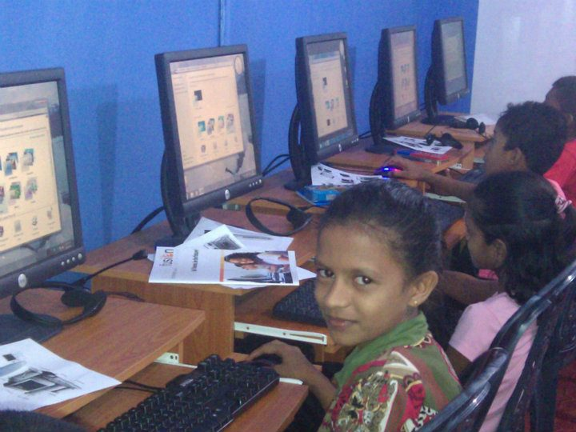
Product innovation 1 (2007 ~ 2011)
Product brand – ‘Fusion Education’
ICT Education package
ICT hand book
National ICT examination offered through telecentres
Product development – from 2004 ~ 2007
Product launched - 2008

Slide 12
How was the community response?
Continues increasing demand for the paid service

Slide 13
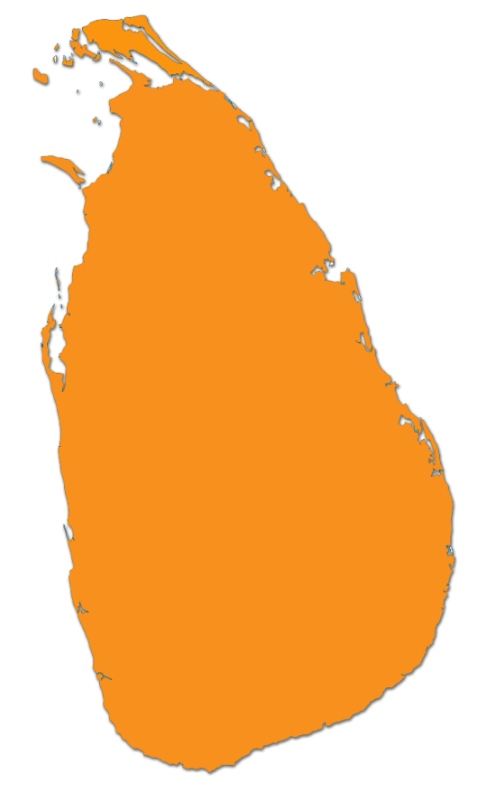
Economic impact?
Jaffna
2 Centres [128]
Mannar
1 Centre [75]
Vauniya
1 Centre [18]
Trincomalee
3 Centres [163]
Price advantage to rural youth – 47% cheaper
than the available options in the market
Anuradhapura
6 Centres [162]
Puttlam
2 Centres [53]
Batticaloa
1 Centre [17]
Revenue to telecentre network – Rs. 6.2mil
Kurunegala
8 Centres [210]
Matale
1 Centres [37]
Kandy
3 Centres [8]
Ampara
3 Centres [140]
Revenue to Fusion – Rs. 2.4mil
Gampaha
1 Centre [4]
Bibile
2 Centres
Colombo
2 Centres [40]
Nuwara Eliya
3 Centres [139]
Badulla
4 Centres [58]
Kaluthara
1 Centre [2]
Rathnapura
1 Centre [42]
Hambanthota
1 Centre [10]
Galle
2 Centres [15]
Matara
5 Centres [220]
Dots represent telecentres offering the product

Slide 14
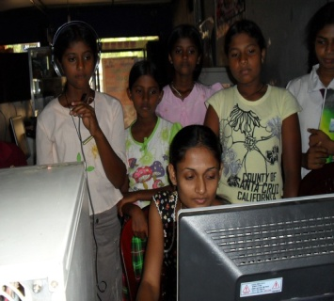
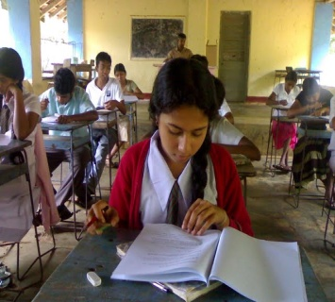
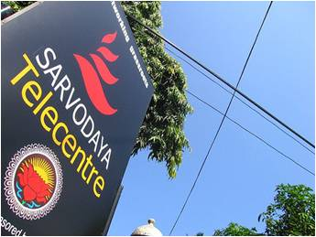
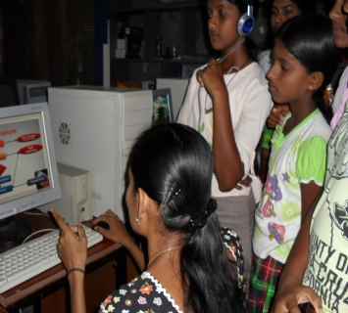
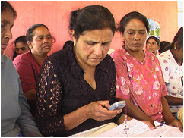
A,B
Students will have correct attitude and self-discipline to continue programme
Increased access to appropriate information
Students have developed their marketable ICT skills
C
D,E
F
Accessibility of ICT facilities available with minimum restrictions
Students engaged in self learning
Skilled facilitators would provide training
Students sit and pass DICA exam
⁴
⁵
⁶
⁷
Children & youth attend the classes regular basis
Impact mapping – ‘Theory of change’
²

Slide 15
Impact measurement
Measuring Indicators
Exposure
Motivation
Skill development
Self learning
Exploration
Application
Qualification
Time 0
3 months

Slide 16
Is it sustainable?
Innovation 4SD = product + social impact + community acceptance
Product innovation - √
Social impact - √
Community (market) acceptance – √
source of inspiration....!!!!

Slide 17
Innovation in progress
From telecentres to mobile for development
Product (live prototype) –
Mobile SMS based trading platform for rural farmers
Product development – from 2007 onwards
Prototype launched – 2009 Aug.

Slide 18
Innovation process
Impetus to innovation
Innovation process (from idea to prototype)
Social sustainability

Slide 19
Impetus to innovation
The unexpected | Recurring telecentre sustainability issues that had challenged the sustenance of the sector State and private sector sponsored telecentre networks becoming competitors
The incongruity | Village communities were not ready to invest to build telecentres Micro-loans (SEEDS) did not recognize the telecentre as an economically viable micro-enterprise model
The inadequacy in underlying processes | Could not generate sufficient number of telecentre based services in order to satisfy the broader development objectives
The changes in industry or market structure | Unexpected and rapid development of mobile technology and ubiquity in and around the rural sector
Demographic changes | Over 90% of the rural population uses mobile phones In contrast less than 5% of adults participated in telecentres
Changes in perception | Donors and partners started recognizing the mobile phone as a better ICT application for development
New knowledge | Growing body of case studies and research evidence on the effectiveness of M4D applications
Framework adapted from ‘Innovation & entrepreneurship’ - P. Drucker (1985)

Slide 20
Innovation process of FarmerNet
Idea
development
Concept
development
Prototype
development
testing
Gate 1
Gate 1
Stage gating

Slide 21
Idea generation
Idea | Technology | Purpose
Mobile phone application to improve pest & disease information dissemination | Mobile phones and telecentres | Dissemination of pest and disease information, combining with telecentre infrastructure for rural farmers
Application of mobile, PDA & GIS technologies for snake bite prevention | Combining mobile phone, PDA and GIS technology | Dissemination of health information for snake bite prevention to the rural sector
Application of ‘community PDA’ for livelihood development | Combining mobile phones, PDA and GIS technology | Provision of support tools (decision support, educational & income generation) to rural community
Convergence of Facebook and mobile phone for community empowerment | Mobile phone and social networking (internet, Facebook) | Peer networks and village networks using Facebook as a back end support system
Mobile phone application to facilitate rural famer trading, using rural telecentres as information centres | Mobile phones and telecentres | Support rural farmer trading

Slide 22
Stage gating criteria
Criteria
Strategic fit | Does the idea or concept fits into Fusion’s mission, strategic objectives and capabilities of staff?
Technical feasibility | Is it technically feasible to develop within the developing country context in terms of acquiring services from the available in-country software vendors?
Resource intensiveness | How feasible is it to manage the project within the limitations of Fusion’s fund raising and fund management capacity?
Risks | What is the chance of failure due to competitive forces from corporate telecoms and other potential competitors?
Returns | How feasible is it to develop into a marketable product in a social enterprise context?

Slide 23
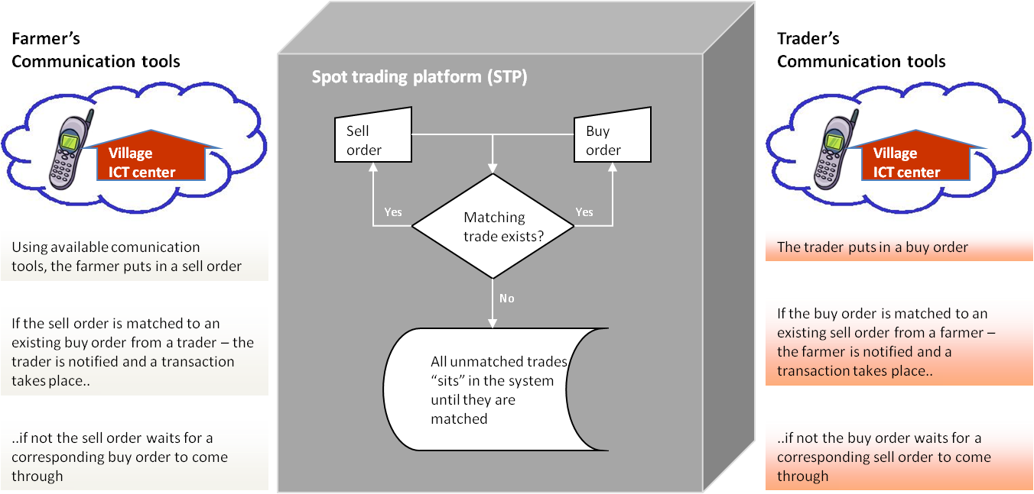
Concept development

Slide 24
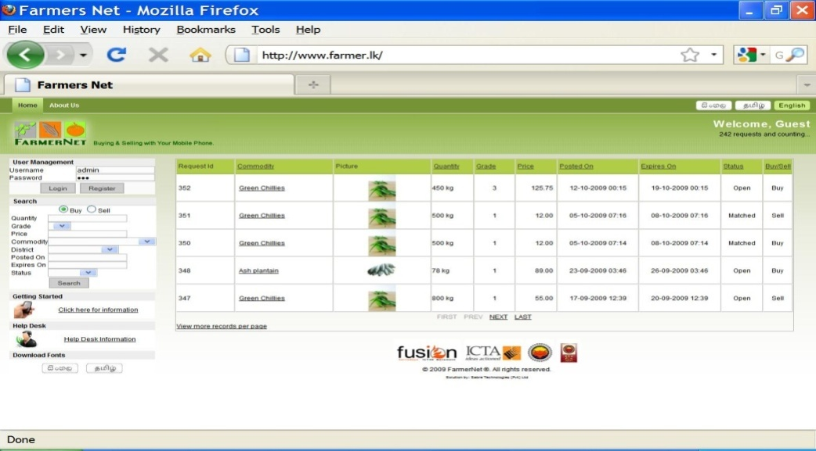
Prototype development
Live prototype: www.farmer.lk
Nationally accessible via all the mobile networks
Being tested with selected communities

Slide 25
Is it an appropriate technology?
meets the needs of both women and men
enables people to generate income for themselves and their family
affordable
has a limited impact on the environment
can be designed, improved, managed and controlled by local people
uses local skills and materials as much as possible.
Framework adapted from E.F. Schumacher (1973) & Practical Action (2010)

Slide 26
Sustainability check
Innovation 4SD = product + social impact + community acceptance
Product innovation – partially done √
Social impact - ?
Community (market) acceptance – ?
Very frustrating...but hopeful....!!!!

Slide 27
Summary
Problem we try to answer
Innovation and social enterprise approach
Fusion Education - telecentre product - as a success story
FarmerNet – mobile 4D product – work in progress
Thank you!
Contact:
harsha@enovation4d.co.uk

