Slide 1
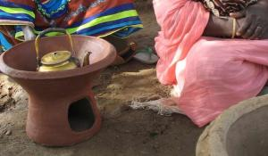
Technologies of Othering:
The Case of Fuel-Efficient Stoves for Darfur
Actor-Network Theory for Development Workshop
June 30, 2010
Samer Abdelnour, PhD candidate, London School of Economics
Dr. Akbar Saeed, Assistant Professor, Wilfrid Laurier University
Photo: Women potters show their goods in El Fasher, North Darfur, August 2008 (Samer Abdelnour)

Slide 2
Stove discourses
“By reducing the need for wood and emission of smoke, a switch to simple, more fuel-efficient stoves could reduce the time women spend collecting wood, a task that exposes them to the risk of rape and other forms of gender-based violence.”
--Rapidly Expand the Use of Fuel-Efficient Stoves in Darfur, Refugees International; October 2005, p.1
“While there is little evidence that producing fuel-efficient stoves reduces violence against women, the best fuel-efficient stoves did produce other benefits for women”
--Ending Sexual Violence in Darfur: An Advocacy Agenda, Refugees International; November 2007, p.18
“Reliance on biomass (e.g. wood, dung, coal) for cooking fuel and heating forces women and children to spend many hours each week collecting these items. Women and girls face severe personal security risks as they collect fuel, especially those living in communities of instability, including refugee camps and conflict zones.”
--The United States and the Global Alliance for Clean Cookstoves Factsheet, US Department of State; September 21, 2010

Slide 3
Our thesis
Discourse is not the only means of Othering
Technology also helps to perform the Other by anchoring dichotomous framings, or modes of understanding
How? US-centric discourses in the case of fuel-efficient stoves (FES) for Darfur
Who? Advocacy groups, development networks
What? Awareness, accountability, consequences

Slide 4
Methods, data
We use ANT to investigate the emergence of networks promoting the stove as a solution to sexual violence
Family of material-semiotic tools, sensibilities and methods of analysis that treat everything in the social and natural worlds as a continuously generated effect of the webs of relations within which they are located (Law, 2007)
Our focus is problematization (Callon, 1986)
To do so, we
Draw primarily on advocacy/NGO material, stove discourse
Build on prior research examining US discourse on Darfur
Allow inferences from fieldwork in Darfur and interviews with stove protagonists to guide our investigation

Slide 5
Repackaging the stove
Over the past 40 years in Sudan/Darfur, fuel-efficient stoves have been promoted as a panacea for three major crises:
Deforestation (post-oil crisis);
Smoke and health;
Sexual and other violence relating to the Darfur crisis
In each case, stoves failed to adequately address the problem it was to solve (Abdelnour, 2010)
But this is much than a ‘repackaging’ story…

Slide 6
Problematization
How is the problem of rape defined such that the stove becomes (remains) the ‘logical’ solution?
“Women and girls who have fled the genocide in Darfur, Sudan, are particularly vulnerable to rape while performing the critical task of collecting firewood for cooking. […] Black Africans have been terrorized, driven out of their villages, and decimated by Arab militias, the Janjaweed and the Sudan government since 2003” (JWW, 2011)
How does this understanding emerge?

Slide 7
i. US Darfur advocacy network
“foreign news is a geopolitical space in which news organizations represent foreign events differently for distinct intended audiences” (Kapila: 2010: x)
The crisis is drawn along a series of dichotomous framings*
Racial (African/Arab)
Perpetrator (Victim/Victimizer)
Gender (Women, girls/Men)
Spatial (Safe/Unsafe)
Interventionist (Moral/Beneficiary)
Together, the network frames the problem as ‘Arab genocidal rape’, with specific solutions advocated (military intervention, ICC, genocide) – widespread domestic support by powerful lobbies
*We build on work by Jodi Eichler-Levine and Rosemary Hicks (2007), Mahmoud Mamdani (2009), Rosemary Hicks (2010), and Bella Mody and colleagues (2010)

Slide 8
ii. Darfur development network
A Darfur stoves network emerges from within the the development network around the stove as a solution for sexual violence
Meaning and activity of the network is strongly driven by the advocacy problematization through the dichotomous framings
NGOs, advocacy groups, donors, research institutes, beneficiaries and the stoves themselves adopt the message of the ‘call’, aligning their functions to serve it
Hundreds of millions in aid funding; NGO competition over efficiency/programming (Abdelnour, 2011; Abdelnour and Branzei, 2010)
The promotion of the stove as solution anchors the network; this meaning persists even after stoves are shown to be no panacea for sexual violence in Darfur

Slide 9
iii. Global stoves network
Stoves come to be promoted to protect (African) women in other contexts (the Congo and Uganda)
September 2010 launch of Global cookstoves network by US Secretary of State Clinton
“Reliance on biomass (e.g. wood, dung, coal) for cooking fuel and heating forces women and children to spend many hours each week collecting these items. Women and girls face severe personal security risks as they collect fuel, especially those living in communities of instability, including refugee camps and conflict zones.”
--The United States and the Global Alliance for Clean Cookstoves Factsheet, US Department of State; September 21, 2010

Slide 10
Individuals, organizations
Key actants play a role in the stoves story by connecting multiple networks (translating interests)
i.e. Dan Wolf: wrote original call on behalf of Refugees International, at the time had his own NGO in Darfur promoting stoves
i.e. Erin Patrick: sexual violence and stoves advocate, works with NGOs, advocacy organizations, and donors to enroll actants into both the advocacy and development networks
Refugees International part of multiple networks; Darfur advocacy and development network actors in the global stoves network

Slide 11
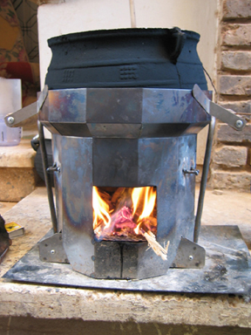
A technology of Othering
The stove anchors framings, these are the resources from which meanings are drawn
Technology privileges particular meanings and in so doing marginalizes others
Photo: the Berkeley-Darfur Stove

Slide 12
Thoughts, directions
Stoves as a non-human actor (what technology does)
Infused discourses, ability to hold framings in place, in so doing influences the kinds of meanings which can be drawn
‘Orientalism’, what an Arab is and does
‘Africanism’, recreating the image of Africa/African women; contested visions (Callon), (i.e. African women as hero/victim); racism and discourse (Brookes, 1995)
Rape, technology and aid – which contexts permit action?
Materialize legitimacy across contexts, space, place
Where are the local voices?
Relevance for a number of fields
Development/humanitarian response (NGOS/advocacy groups), gender/energy, international law (genocide/ICC), comparative studies (Darfur/Iraq/US), media/discourse

Slide 13
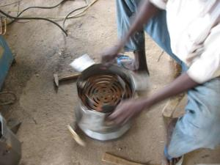
Thank you
Thoughts, comments welcome: s.r.abdelnour@lse.ac.uk
Photo: Producing metal stoves in Nyala, South Darfur, July 2008 (Samer Abdelnour)

