Slide 1

PGR Welcome Event 2018
dalinder.sall@gmail.com
The Faculty of Humanities

Slide 2
Professor Stuart Jones
dalinder.sall@gmail.com
Professor of Intellectual History and Associate Dean of PGR

Slide 3
Researcher Development
dalinder.sall@gmail.com
Dr Ian Fairweather
Researcher Development Manager

Slide 4

Why do a Doctorate?
Most people embark upon a doctoral
programme because they are interested in
their topic and want to find the answers.
Many, but by no means all, aspire to a career as a university academic or professional researcher in another context.
The statistics show that unemployment among doctoral graduates, including those in Humanities is very low.
The ‘knowledge economy’ values doctoral graduates, not necessarily for their subject expertise but for their broader knowledge and networks.

Slide 6

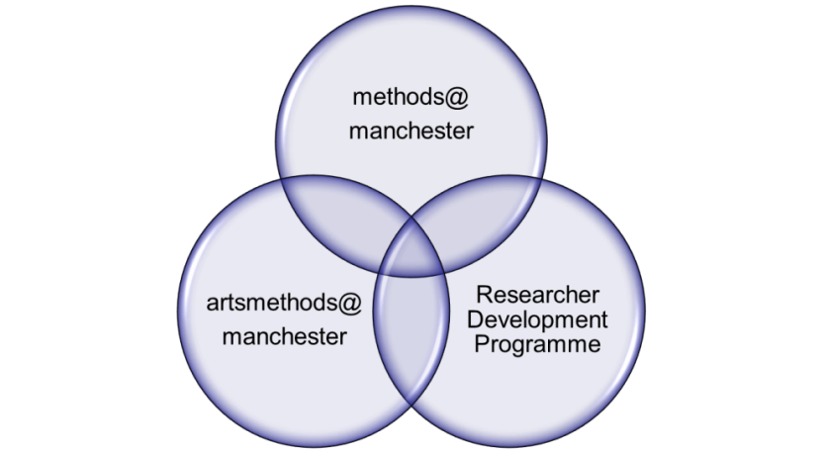
Professional Development for Researchers
A Doctoral degree is awarded for ‘research and training.’
Rather than prescribing a minimum training requirement the Faculty aims to support researchers in managing their own professional development.
Each researcher is expected, in consultation with their supervisors, to identify their professional development needs and develop a training plan.
A good place to start is the
ProGRess@humanities training hub.

Slide 7
Professional Development Areas
Subject & Discipline Knowledge
Research Communities
Interdisciplinary working
Teaching
Researcher Development and reflective practice
Research Integrity
Researcher-led activities
General research methods training
Specialist research training
Publications
Research Seminars
Supervision & Dialogue
Methodology & Approaches
Academic Practice
Fieldwork & Data Collection
Reflective Practice
Academic Conferences

Slide 8
Researcher’s responsibility
Develop a training plan with your supervisor.
Identify and reflect on your training needs (the ‘Researcher Development Form’ on EPROG).
Booking and cancelling attendance on training courses.
Recording and reflecting on your development (PDP)
The Supervisor’s Responsibility
To encourage and support the training process
Assist and advise the researcher in identifying their training needs
Enquire as to the progress of training on a regular basis
Bring to the attention of the supervisory board and/or Review Panel any problems or lack of progress in a timely manner

Slide 9
Professional Development Planning for Researchers
Researcher Evaluation and Reflection
A Research Diary – research reflections, records and evidence of training
Formal reviews – interim and annual
Records of meetings with supervisors
The recording of professional development activities can be done through EProg by completing the researcher development milestone and regularly uploading an up-to-date report to the EProg personal document store. Attendance at most faculty training events will automatically be recorded in EProg.

Slide 10
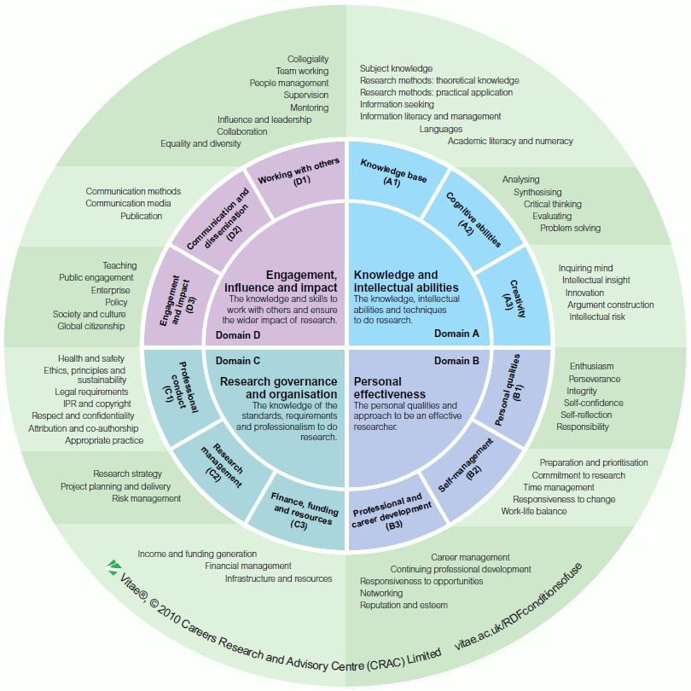
Researcher Development Framework
The Researcher Development Framework provides a comprehensive overview of all the areas in which PDP for researchers can take place

Slide 11
eProg
dalinder.sall@gmail.com
Claire Smith
PGR Officer (eProg Faculty of Humanities Lead)

Slide 12
eProg Induction
eProg Faculty of Humanities Lead: Claire Smith
(claire.smith@manchester.ac.uk)

Slide 13
What is eProg?
SUBMISSION TO EXAMINATION
PROGRESSION
eProg is a University wide system that is specifically designed to help to structure and breakdown the PGR programme and monitor progress, both for supervisors and Postgraduate Research Students (PGRs)
TRAINING

Slide 14
Benefits of eProg to you
Stay on track & plan targets
View history from anywhere
Training
Track examination
Record supervisory meetings

Slide 15
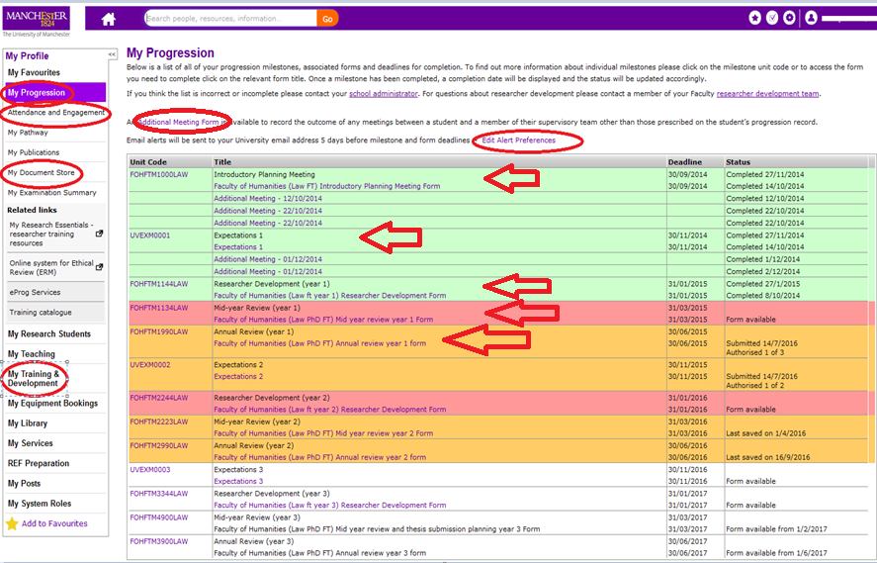
Your eProg progression record

Slide 16
Accessing eProg & Support
You will need to use eProg regularly throughout your studies
Access eProg via My Manchester: http://app.manchester.ac.uk
Type in your a central account username and password
Help and support page in eProg – School contacts and Faculty Lead contact
Online handbook
Faculty of Humanities intranet - http://www.humanities.manchester.ac.uk/humnet/our-services/postgraduate-research/eprog/
YouTube guides -
https://www.youtube.com/channel/UCKxBlPG7eQSm7blaVAPN72w

Slide 17
PGR Placements
Dr Louise Davies
PGR Placements and Partnerships Officer

Slide 18
PGR Placement Scheme
Dr Louise Davies
Faculty of Humanities & NWCDTP
PGR Placements & Partnerships Officer

Slide 19
Key Facts
A flexible scheme:
  Placement duration 2 weeks – 3 months;
  Full-time or part-time;
Supervisor agreement is essential;
Bursary for placement may be available;
Placement options:
  Apply for an advertised placement;
  Be creative - propose your own project!

Slide 20
Partners & Placements
Current partners include: MoSI, Greater Manchester Combined Authority, National Football Museum, Opera North, FACT, HOME, Futureeverything, the BBC, John Rylands Library, The National Trust.
Placement projects include:
  Developing a toolkit to promote public engagement with historical sites & for exhibitions;
  Carrying out thematic reviews of digital collections;
  Analysing statistics for [local/central] Government reports;
  Researching backgrounds of students who are ‘first generation PhDs’.

Slide 21
Placement Preparation
Plan as part of your programme:
Optimum time:
  after year 1 Annual Review
  before end of year 3
  post-submission;
Identify placement/host and discuss with your Supervisor;
Placement preparation will be provided and support preparing proposals & whilst on placement.

Slide 22
Benefits of taking a Placement
The evolving research environment:
  recognising the impact of your research;
  fewer doctoral graduates going into academic roles.
Employability skills
  team working, knowledge exchange, project design;
  public engagement & professional networking.
Student Experience
  adds value and gives context to your PhD programme.

Slide 23
Further Information & Advice
Application forms & other documentation are available on ProGRess:
http://progresstraininghub.humanities.manchester.ac.uk/training/future/category/placements-and-internships/
Any questions or advice contact:
Dr Louise Davies –
  louise.davies-2@manchester.ac.uk
  Tel: 0161 306 2657

Slide 24
IT Services
Tom Clegg (IT Marketing and Communications Officer)
Gillian Sinclair (Research IT Relationship Manager)

Slide 25




Slide 26


^{www.manchester.ac.uk/iam}

Slide 27



PC clusters

Slide 28


eduroam

Slide 29



Hornet

Slide 30




Laptops, phones and tablets

Slide 31




video.manchester.ac.uk

Slide 32



Web or mobile

Slide 33




All over campus

Slide 34



Back up your work,
back up your work,
and back up your work

Slide 35


www.its.manchester.ac.uk/students
@UoM_ITS

Slide 36


Online: www.its.manchester.ac.uk/help
Telephone 24/7: 0161 306 5544
In person: Alan Gilbert Learning Commons
Main Library
Joule Library
      Kilburn Building

Slide 37


Research IT
Gillian Sinclair
Research IT Relationship Manager
@UoM_eResearch http://www.itservices.manchester.ac.uk/research/

Slide 38

Research IT
Supports postgraduate, post-doctoral and academic staff carrying out research at UoM
There to support research not day to day IT
Provide specialised research services
Highly skilled staff ready to work with you to realise your research goals
@UoM_eResearch

Slide 39
eResearch
Platforms
Access to a wide range of eResearch platforms including high performance (HPC) and high throughput computing (HTC) platforms to support computationally intensive research
Access to local, regional, national and international resources as your research progresses
@UoM_eResearch

Slide 40
Software &
Data Engineering
Professional software developers with particular expertise in creating software for academic research
Produce high quality scientific software by working with researchers to create reliable, sustainable and efficient code.
Available to work with you on the software engineering aspects of your research projects.
@UoM_eResearch

Slide 41

Research Data
Management
Demands on researchers to manage their research output are growing and we are ideally placed to assist
Can help with the technical input on Research Data Management (RDM) plans and deliver highly scalable, agile, research-data aligned secure storage
Can also advise on and provide database hosting and bespoke network infrastructure solutions to researchers
@UoM_eResearch

Slide 42
Training,
Support & Advice
Diverse range of training
  Introductions to applications and techniques (i.e. Matlab, Visualisation)
  Introduction to programming (i.e. Python)
  Introduction to advanced eResearch (i.e. CSF, HPC)
Responsive support via the helpdesk
Regular drop-in sessions close to you as well as grant support clinics & Research IT Club
@UoM_eResearch

Slide 43
Keep in touch
www.itservices.manchester.ac.uk/research/
Twitter -@UoM_eResearch
Blog – www.researchitnews.org
Monthly newsletter sign up – www.eepurl.com/b0uwDv
@UoM_eResearch

Slide 44
Get Started
Hannah Pope (Research Data Services Assistant)

Slide 45

Get started
with the Library
Books are just
the beginning…

Slide 46
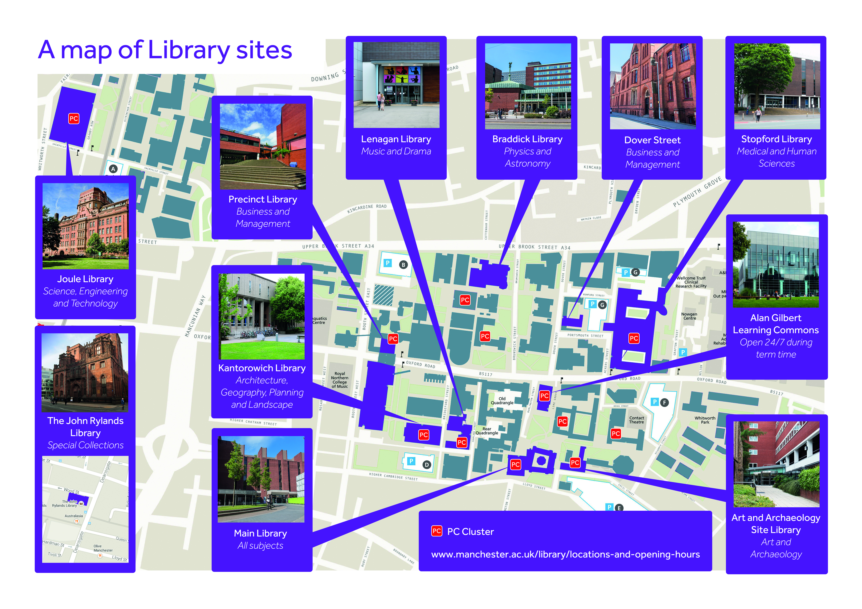

Slide 47
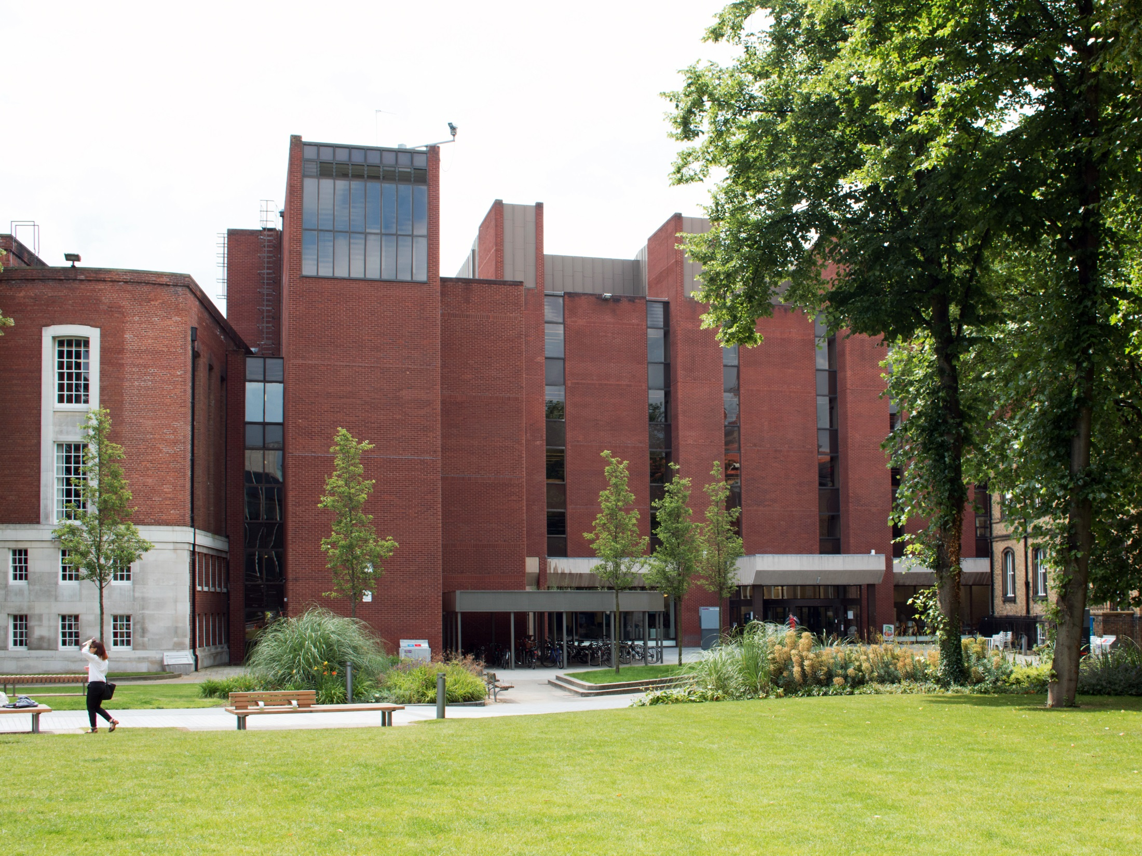
Main Library

Slide 48
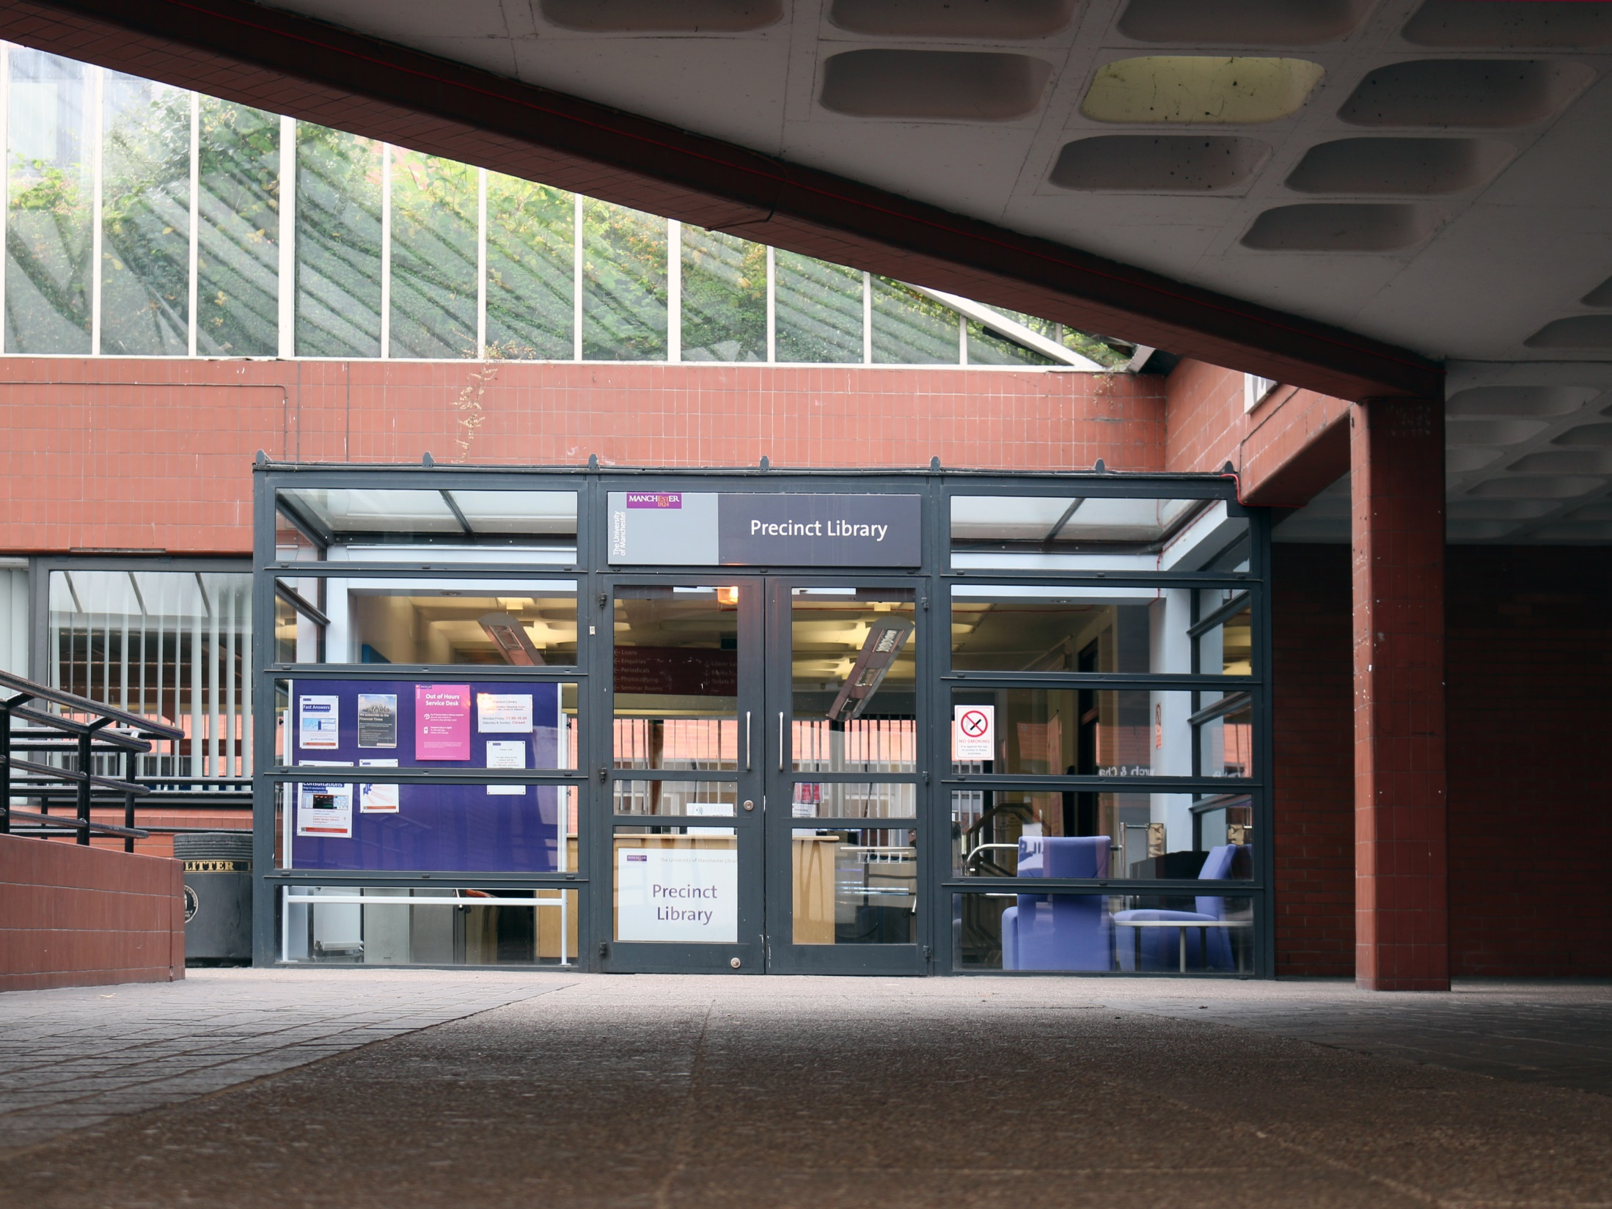
Precinct Library

Slide 49
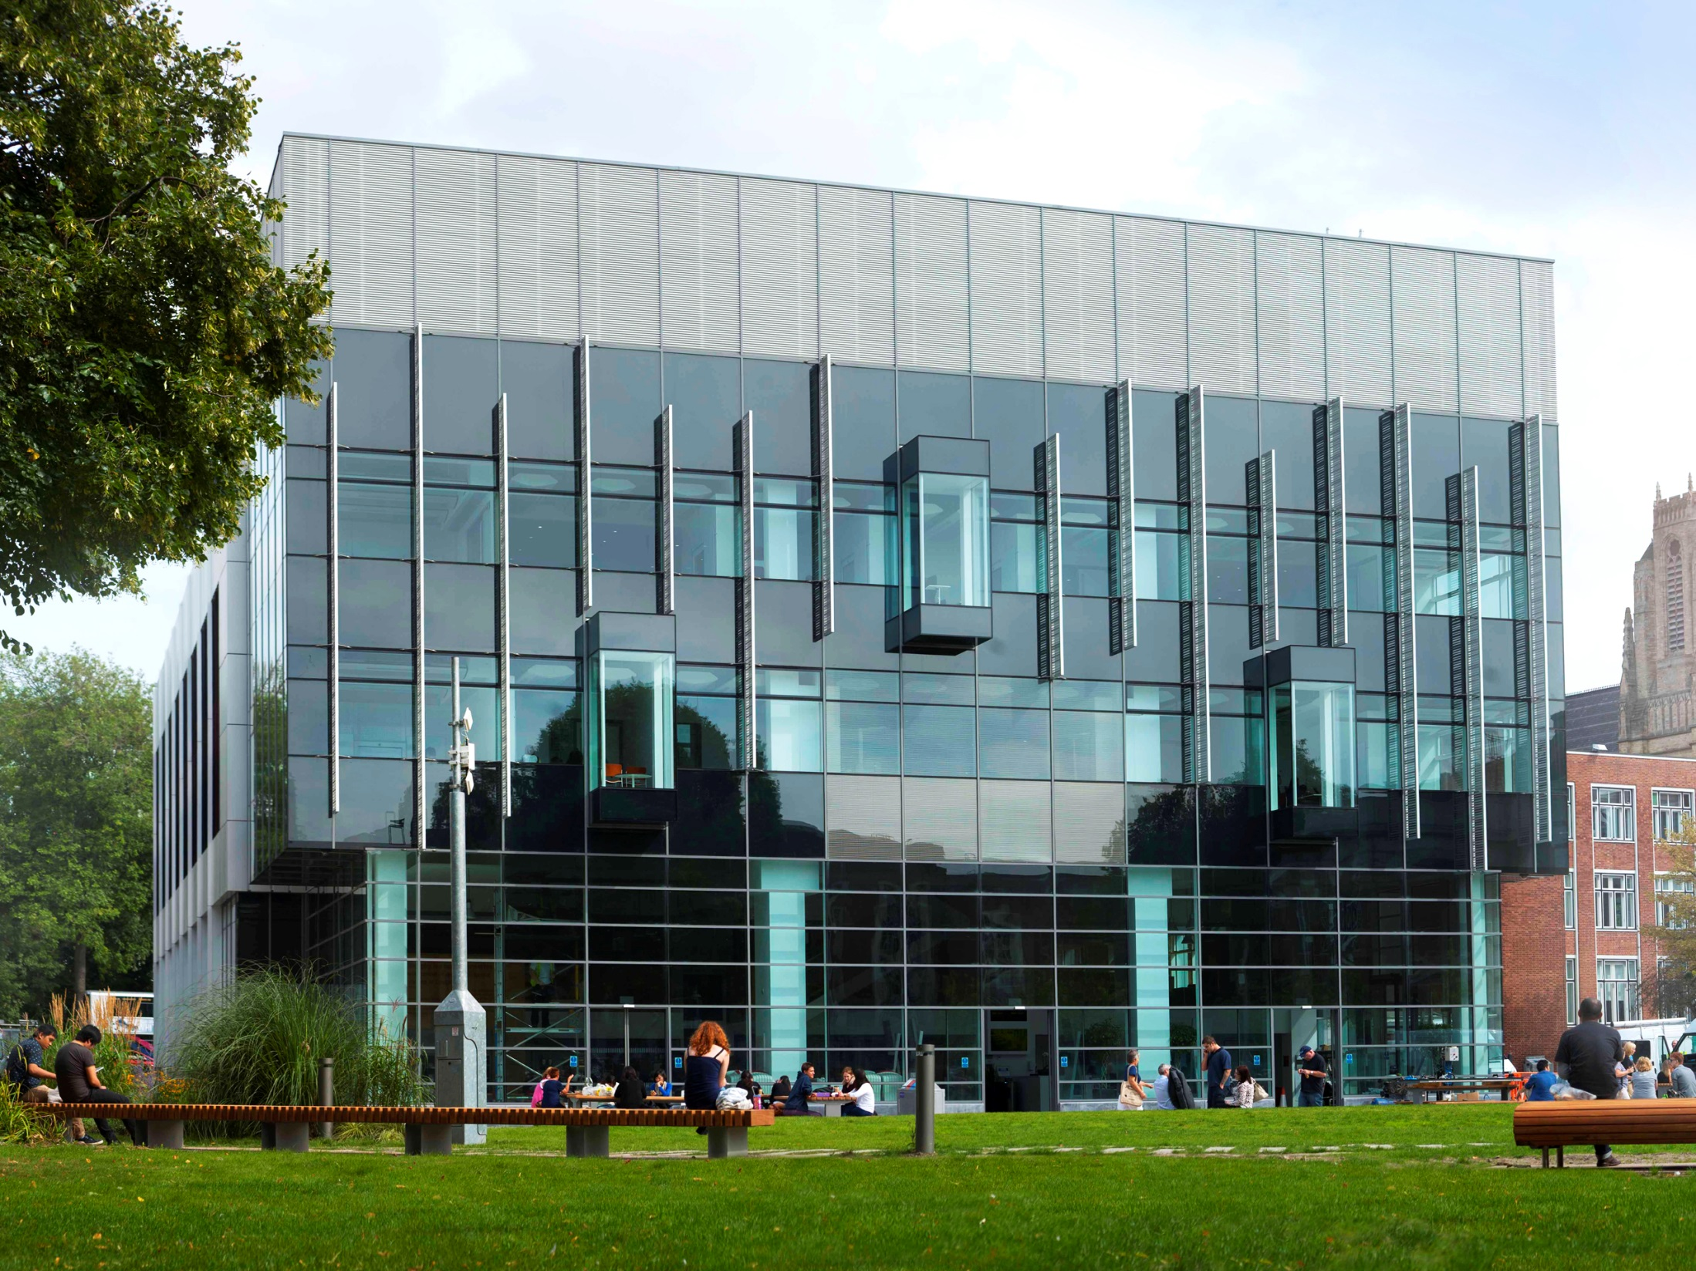
Alan Gilbert Learning Commons

Slide 50
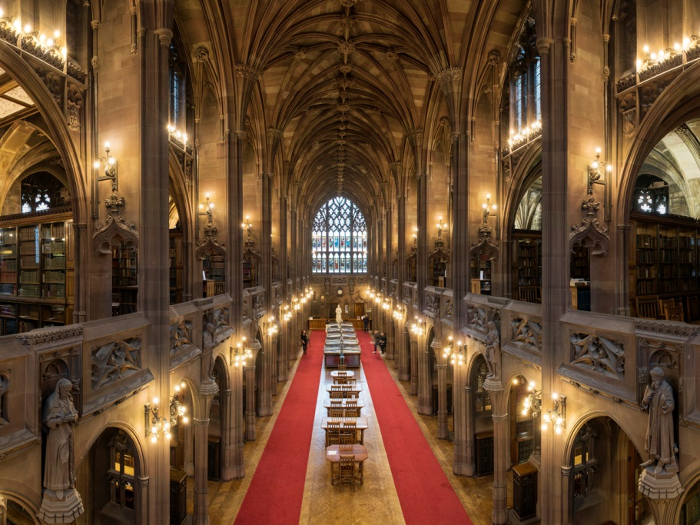
The John Rylands Library

Slide 51
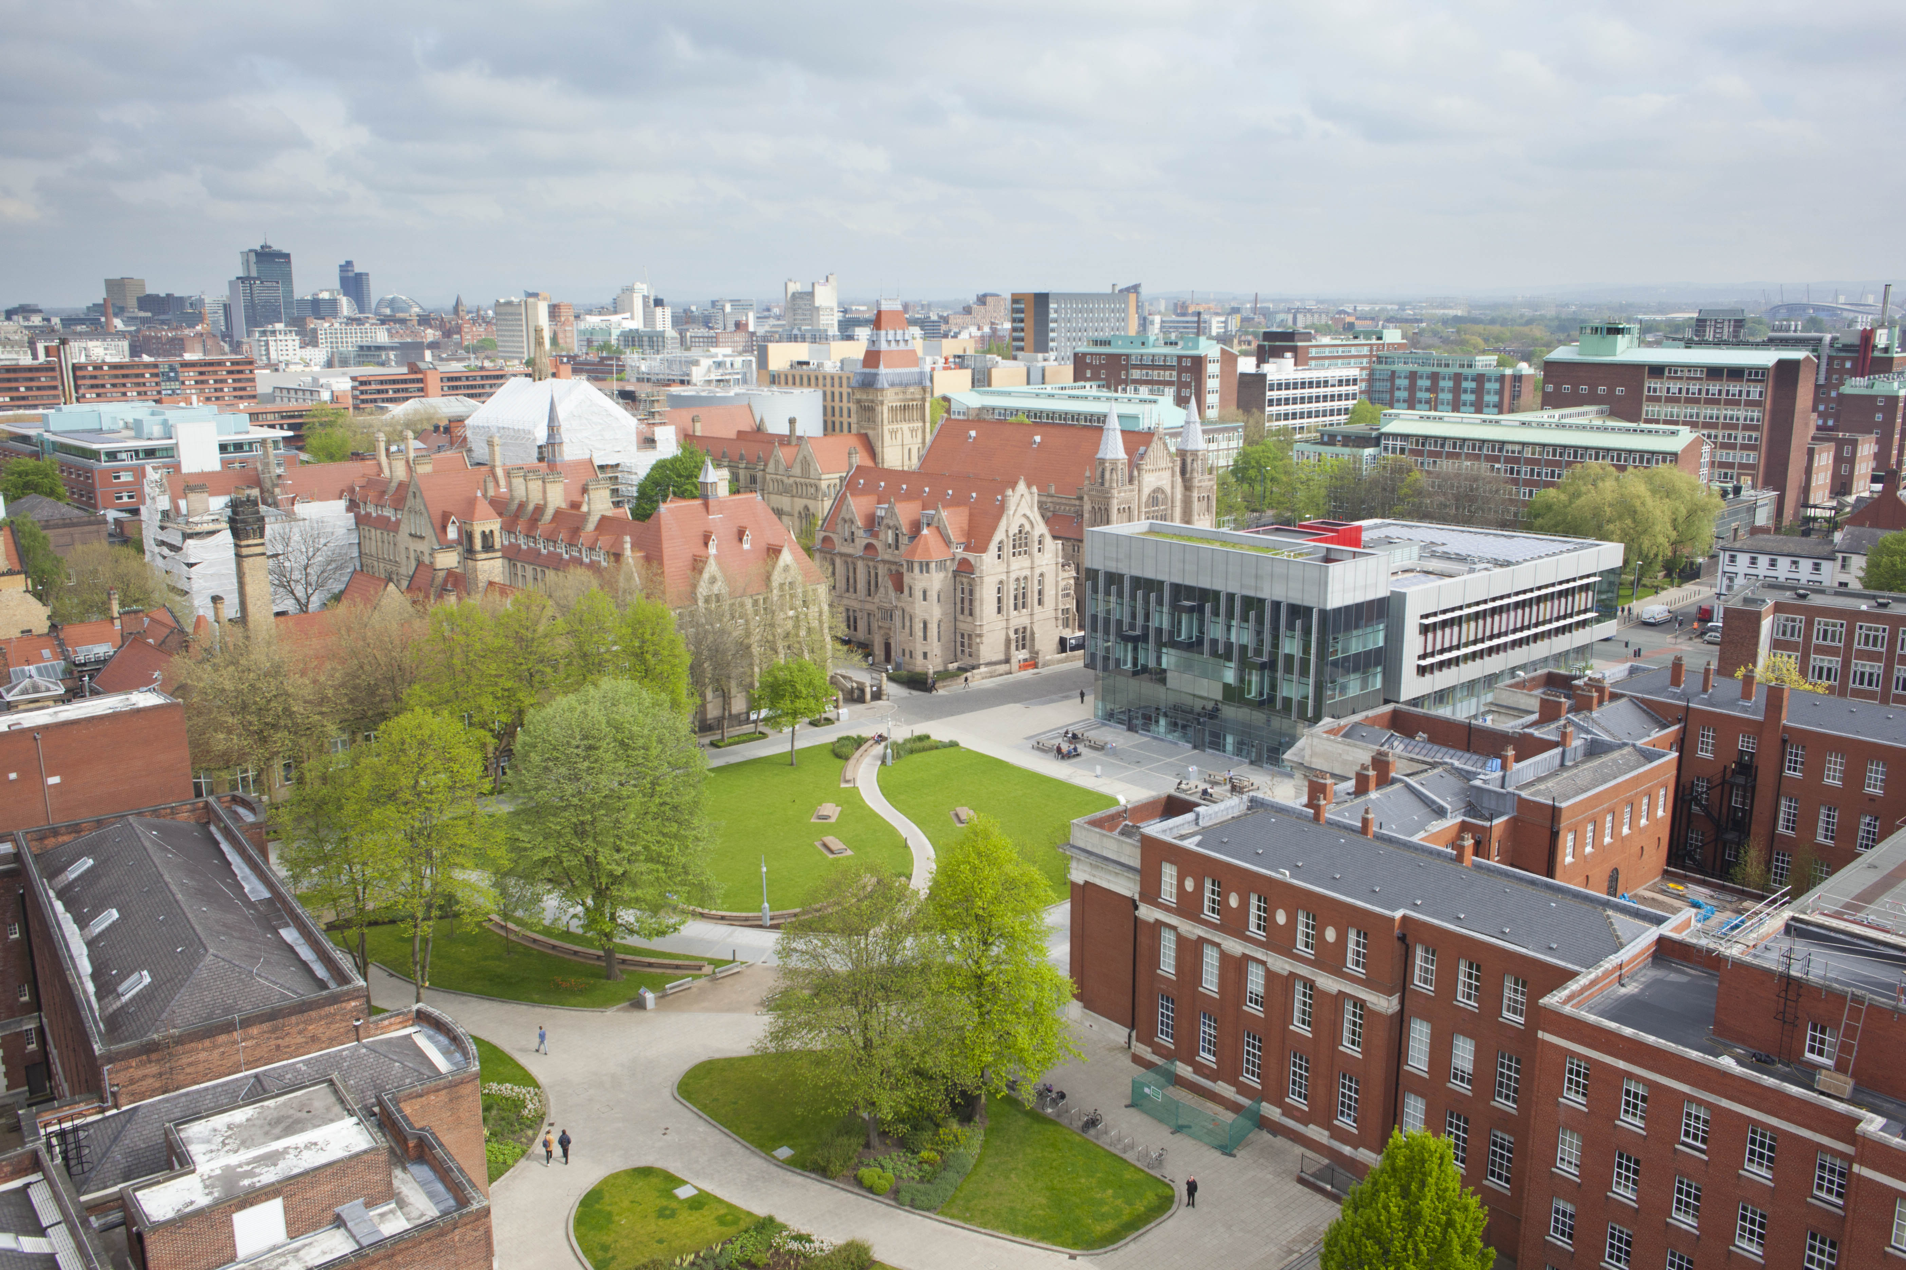
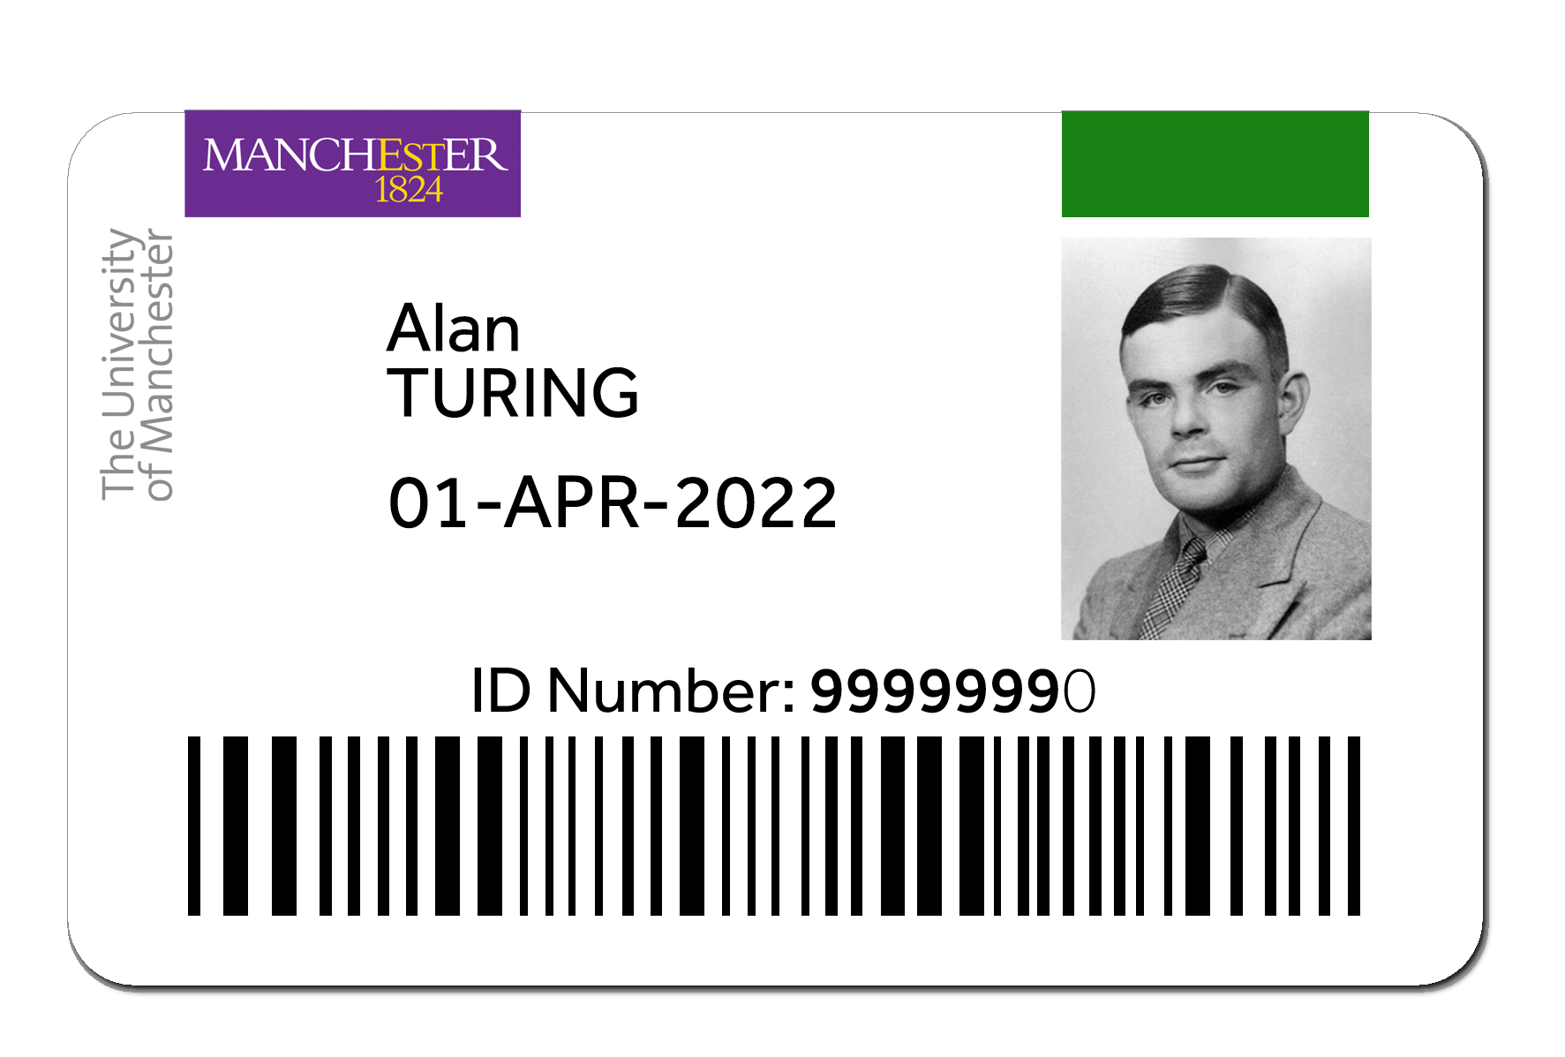
How to gain access
Your University I.D card

Slide 52

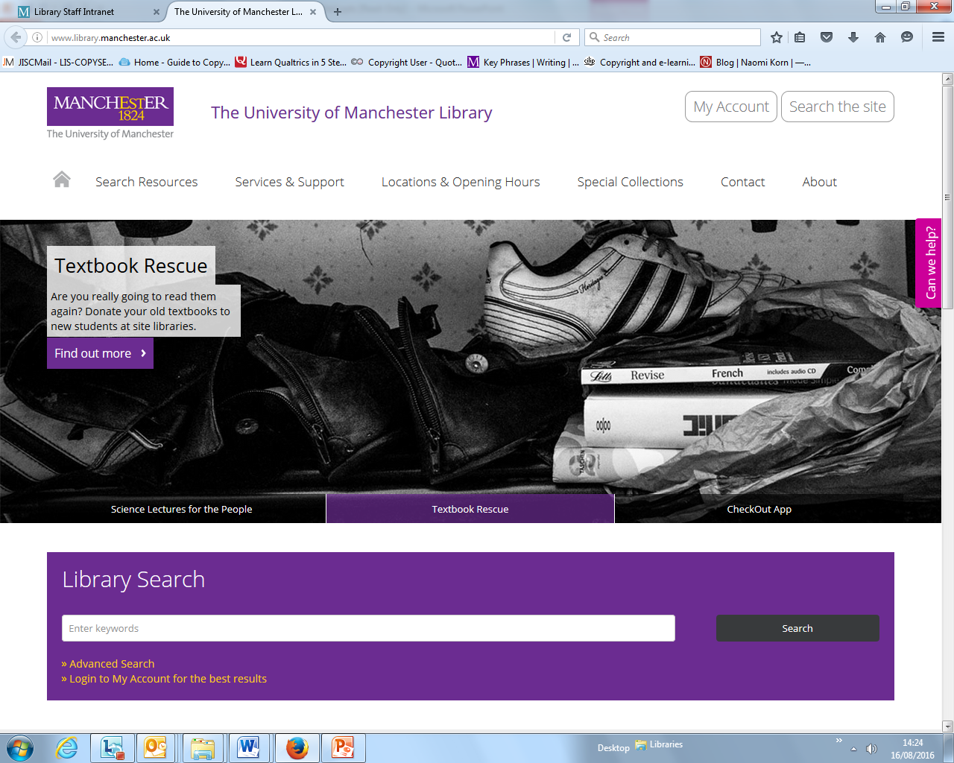
www.manchester.ac.uk/library

Slide 53
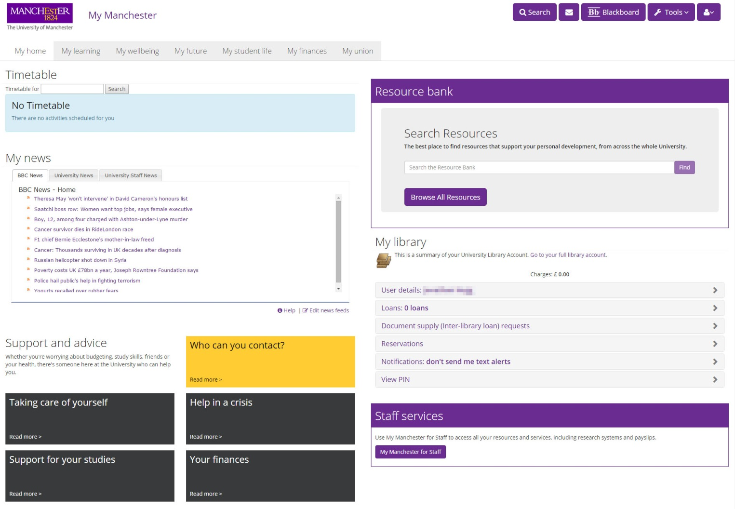
My Manchester

Slide 54

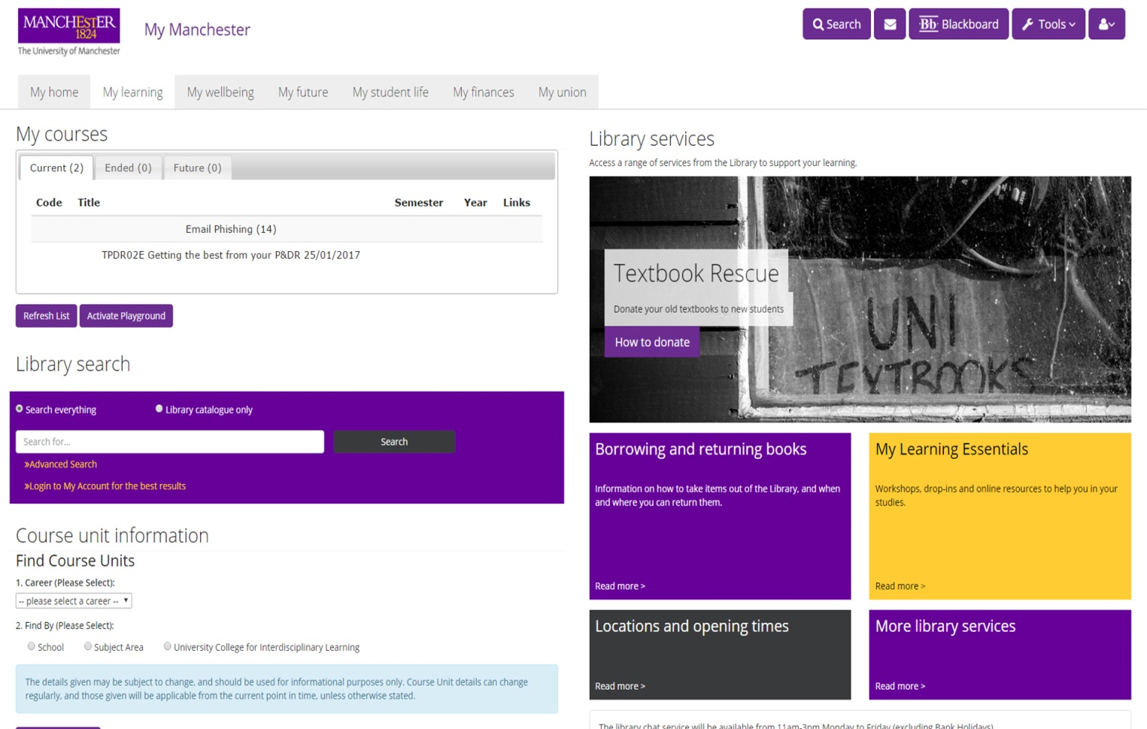
My Manchester

Slide 55
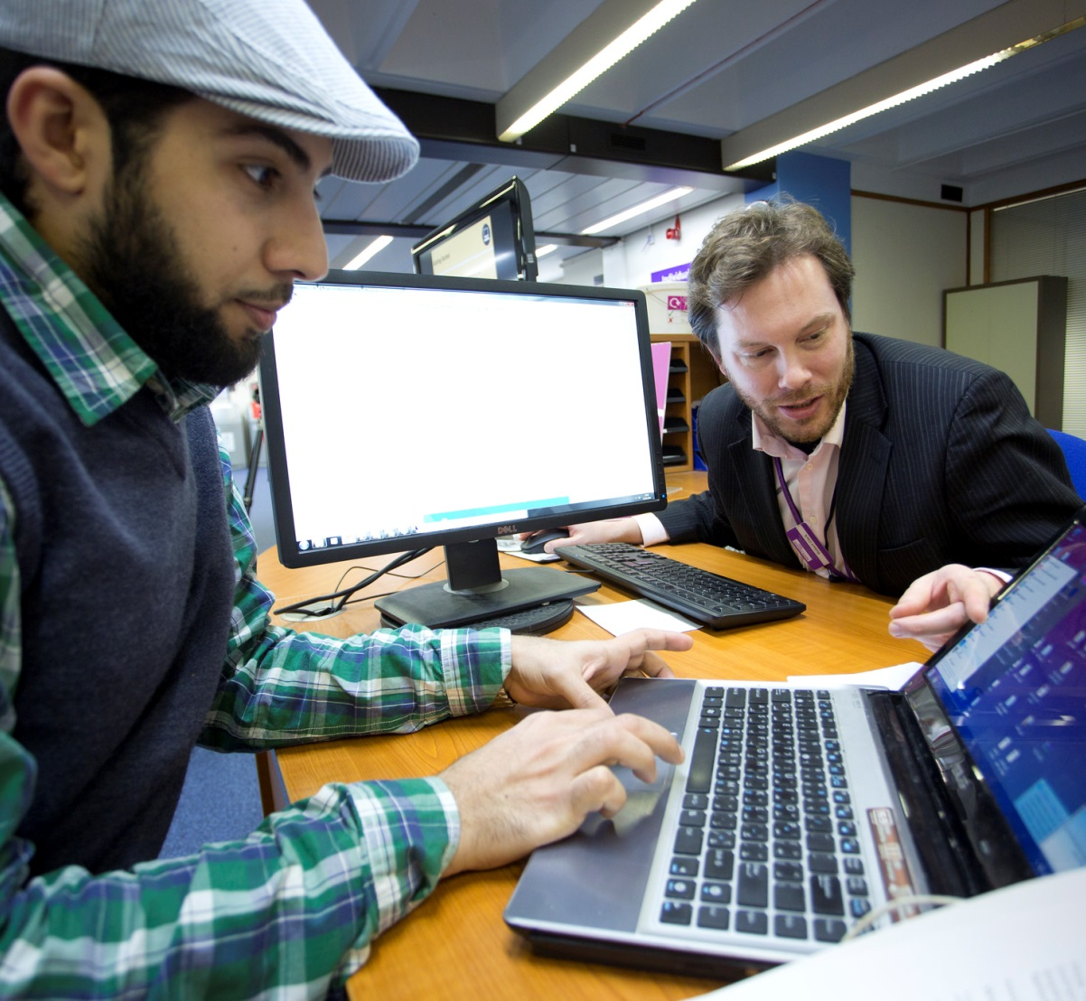
Library IT Support
Alan Gilbert Learning Commons
Main Library
Joule Library

Slide 56
Research Services
Research Data
Management
Open Access
Altmetrics
SERVICES
Design
Investigate
Disseminate
Manage
Evaluate
My Research
Essentials
Citation services
My Research
Essentials
Research
Lifecycle
Raising your
research profile
ORCIDs
eThesis Support
My Research
Essentials
Open
Access
Pure
Research
Data
Management

Slide 57

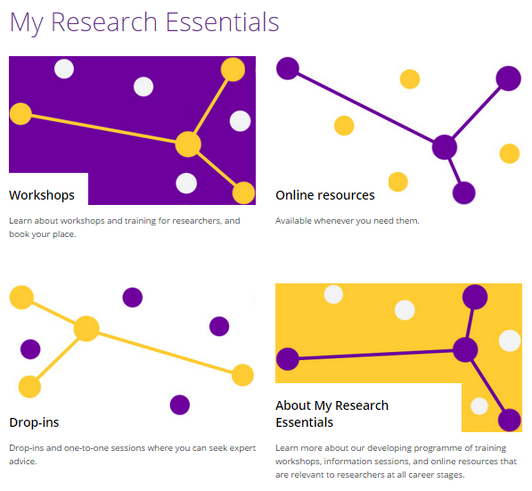
Research Services
My Research Essentials
(MRE)
Check in with us over the coming weeks

Slide 58

Get Started
Check in with us over the coming weeks at
www.manchester.ac.uk/library/get-started

Slide 59
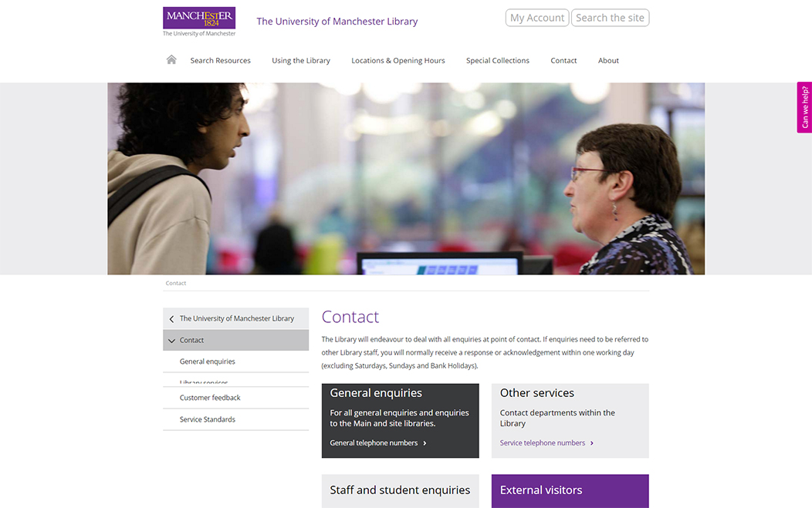
Ask us for help

Slide 60
Get started
with the Library
Thanks for listening!
www.manchester.ac.uk/library

Slide 61
Welcome to Manchester

